Slide 1
Section 1- Lift Truck Fundamentals Section 2- Stability, Balance, And Capacity Section 3- Preoperational Inspection Section 4- Safety Guidelines for Operating Lift Trucks Section 5- Safe Load Handling Techniques Section 6- Refueling Gasoline, Diesel, And LP Lift Trucks Section 7- Battery Charging And Changing

Slide 2
Why is Operator Safety Training Important ?
Reduce the risk of personal injury
Reduce the risk of product and property damage
It’s the law

Slide 3
Accident Statistics
85 Fatalities 34,900 Serious Injuries

Slide 4
Section 1 Lift Truck Fundamentals

Slide 5
Powered Industrial Truck Standards 29 CFR 1910.178
Requirements
Formal Training Must Include:
Truck Related Topics Employer Certification: Name of operator
Work Related Topics Date of training
Practical Experience: Date of evaluation
Demonstrated by Trainer Identity of person(s) performing training and evaluation
Exercise by Trainee
Evaluation of Driving Skills:
On the Type of Truck You Operate
Recertify Every 3 Years
Refresher Training
Operates in Unsafe Manner
Near Miss
Changes in the Workplace
New Equipment
Involved in an Accident

Slide 6
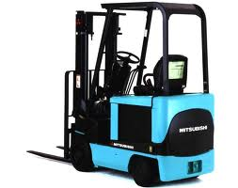
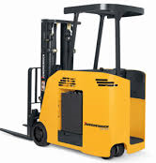
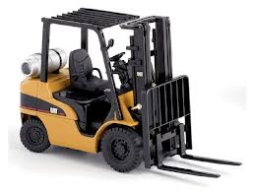
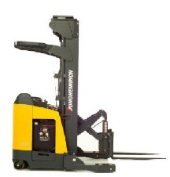
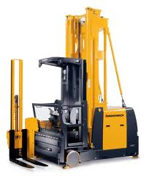
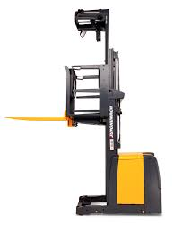
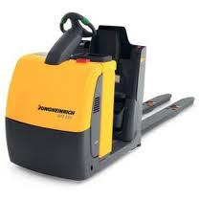
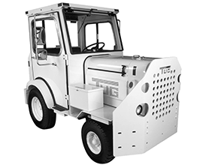
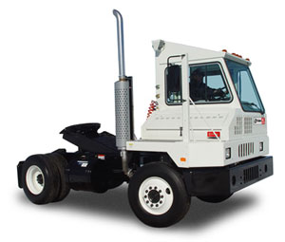
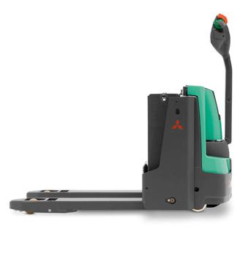
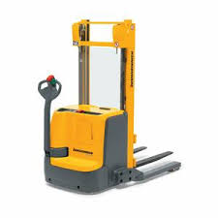
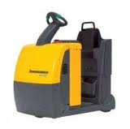
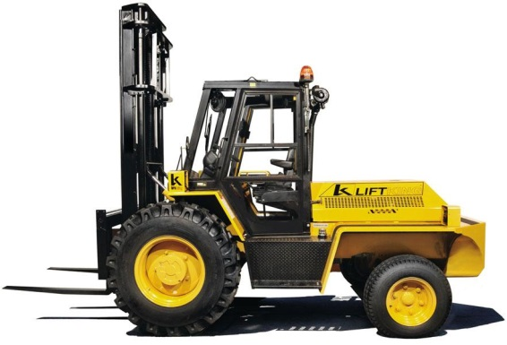
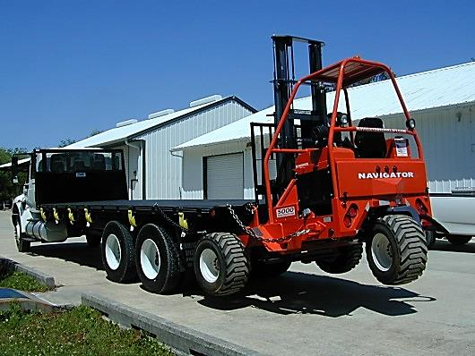
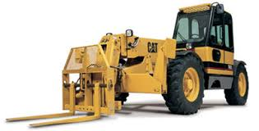
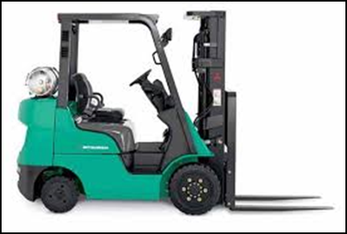
Truck Classification
Class 1 Class 5
Class 2 Class 6
Class 3 Class 7
Class 4

Slide 7
Qualities of a Professional Lift Truck Operator
Is responsible
Arrives on time
Is rested, alert, and physically prepared
(If you are under prescribed medication that causes drowsiness, contact your supervisor)
Is knowledgeable about company rules
Wears required protective clothing and equipment
Uses safety equipment including the operator restraint system
Has a desire to learn
Is skilled and works to improve those skills
Keeps vehicle under control
Removes jewelry if required

Slide 8
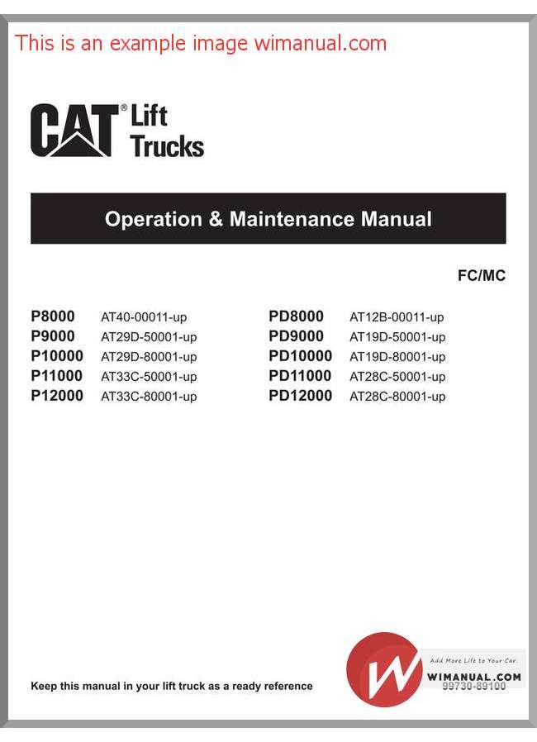
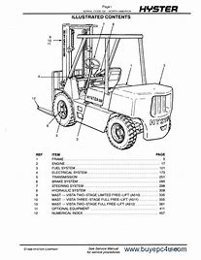
Operation and Maintenance Manual

Slide 9
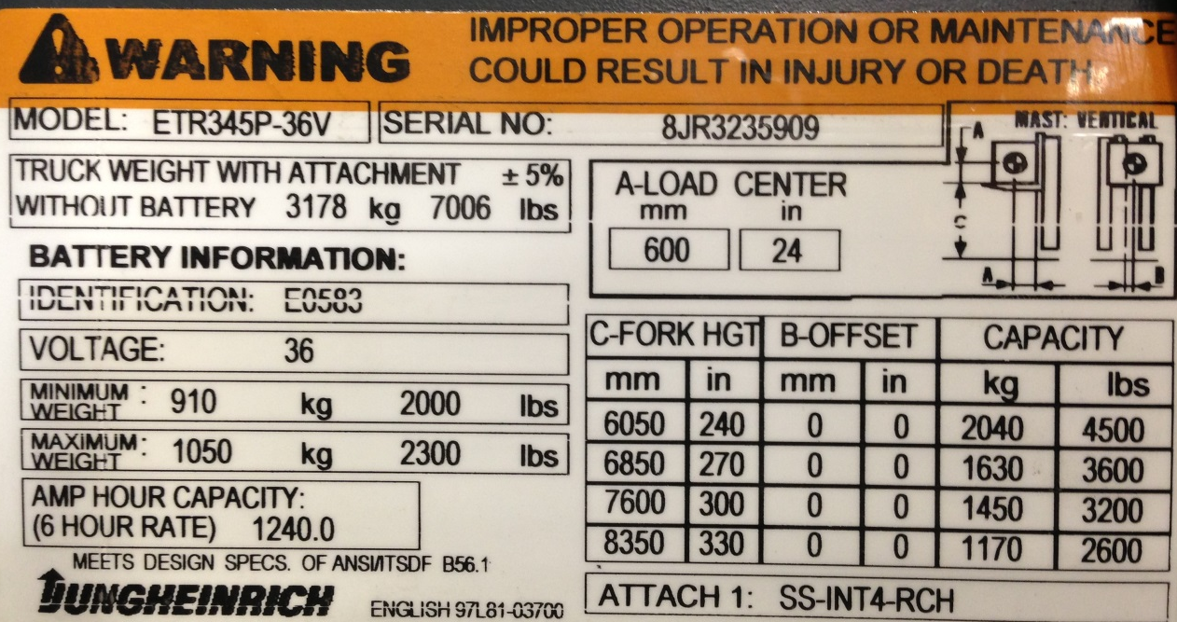
Legal Plates

Slide 10
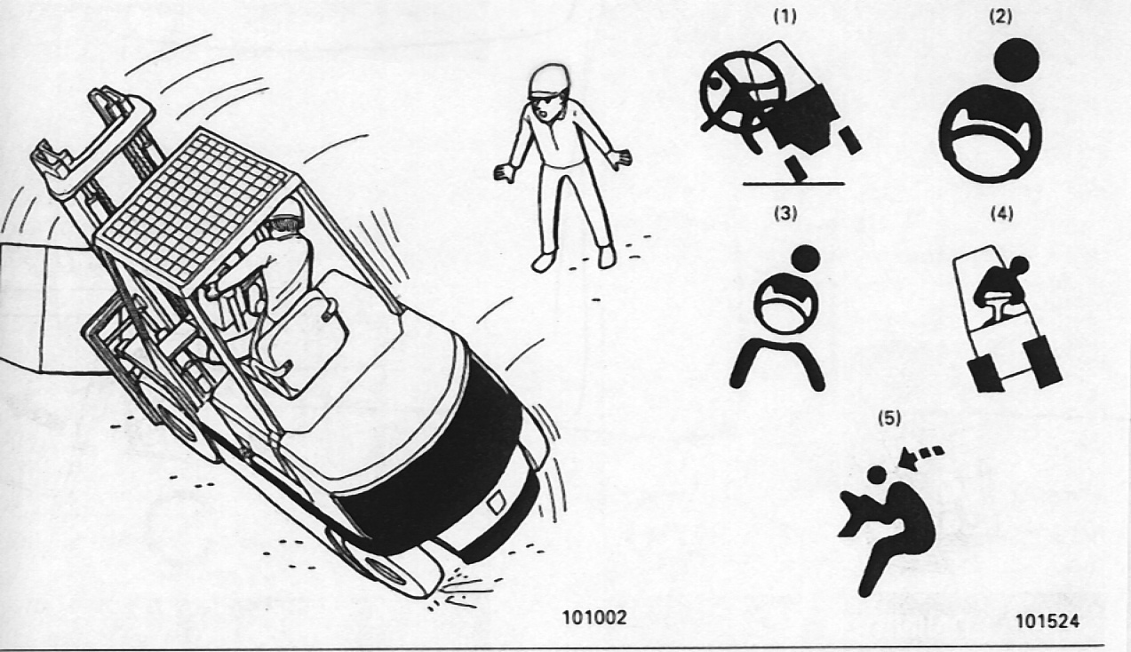
Danger, Warning, And Caution Labels

Slide 11
Differences Between Lift Trucks And Automobiles
STEERING
BRAKES
Forklifts steer differently than automobiles.
Forklifts brake differently than automobiles.
Visibility drive in the direction that gives you the best site
A forklift with a load may weigh 5 times more than an automobile.
VISIBILITY
WEIGHT

Slide 12
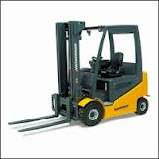
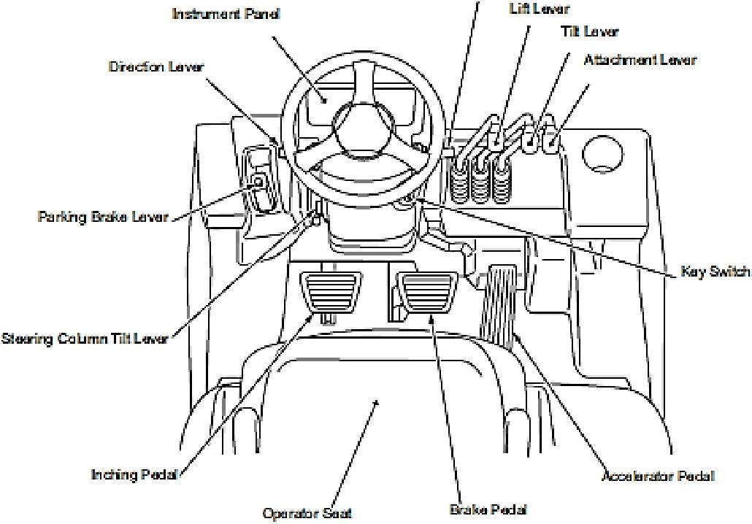
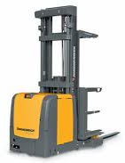
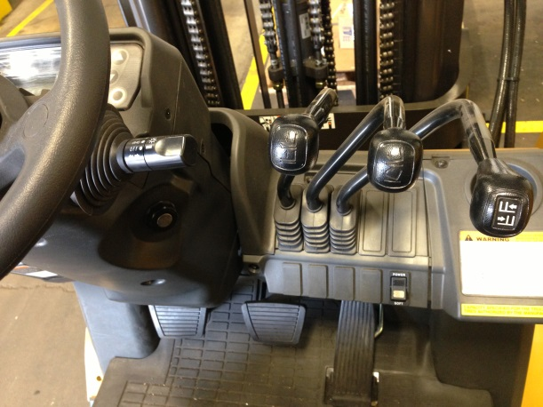
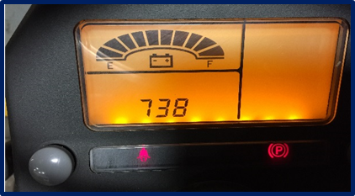
Lift Truck Terminology

Slide 13
Lift Truck Fundamentals: Course Review
1) All lift trucks are required to carry a warning that improper operation or maintenance could cause injury or death.
True____ False____
2) What are the differences between lift trucks and automobiles?
A. Steering B. Vehicle weight C. Braking D. All the above
3) Federal OSHA regulations require all lift truck operators to be trained.
True____ False____
4) Driving evaluations must be done every year?
True____ False____
5) A lift truck could weight as much as 5 times more than and automobile?
True____ False____

Slide 14
Section 2 Stability, Balance, And Capacity

Slide 15
The Principle Of Balance
Fulcrum

Slide 16
Center Of Gravity
The imaginary point in an object around which all weight is evenly distributed

Slide 17
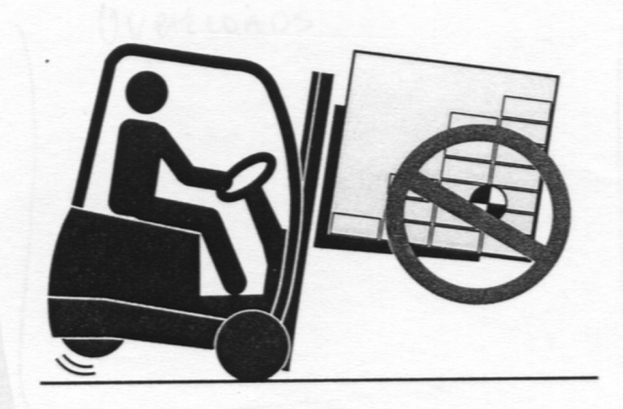
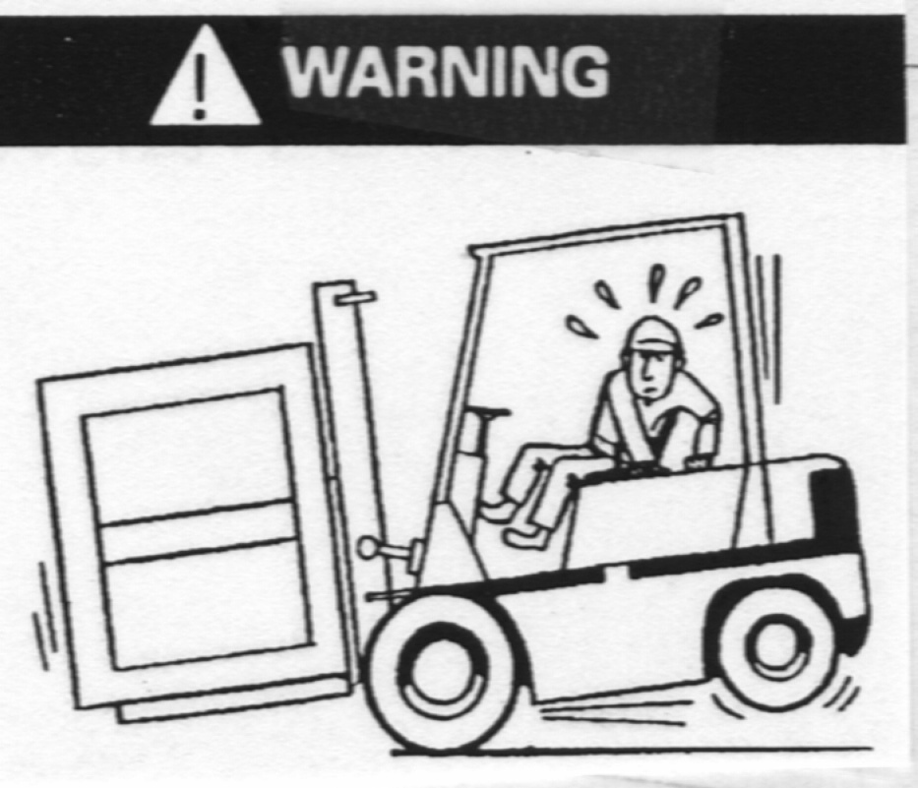
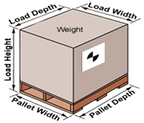
Load Center
Load center is defined as the distance from the face of the forks to the load’s center of gravity

Slide 18
Static Conditions And Dynamic Forces
Static Conditions Dynamic Forces
Load Size
Load Weight
Height of the load
Amount of tilt
Tire Conditions
Traveling
Truck Speed
Applying the brakes
Surface conditions

Slide 19
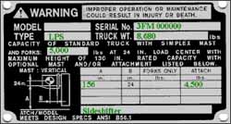
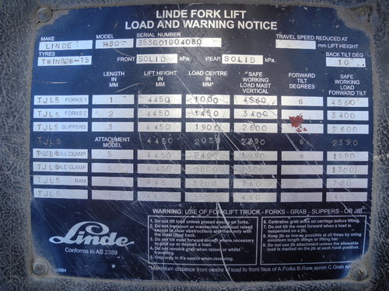
Capacity Plates

Slide 20
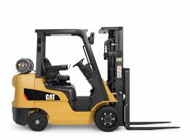
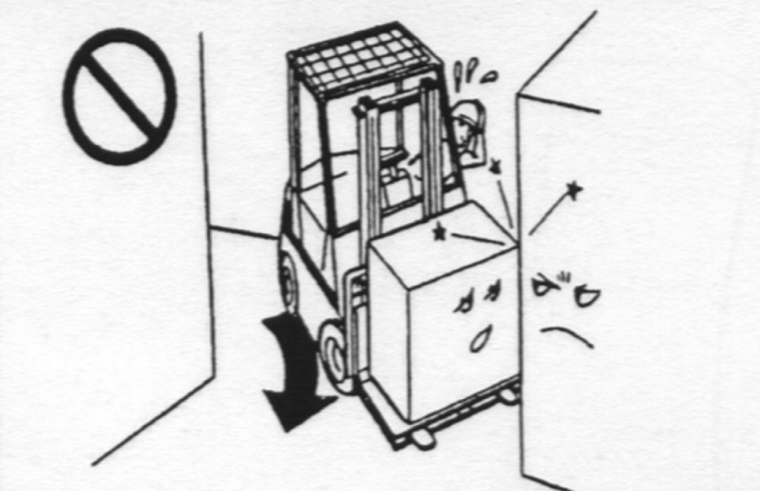
Pivot Points
Where is the PIVOT POINT ?
Keep the pivot point close to the INSIDE corner.

Slide 21
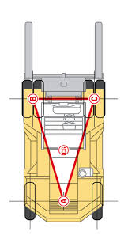
The Principle Of Stability
The stability triangle is formed by drawing a line between the 3 Point suspension of a lift truck.
Combined center of gravity
Longitudinal Stability
Lateral Stability

Slide 22
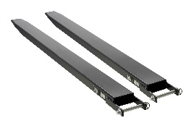
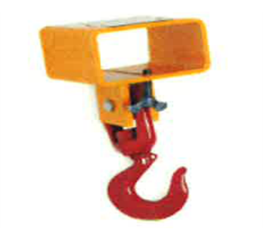
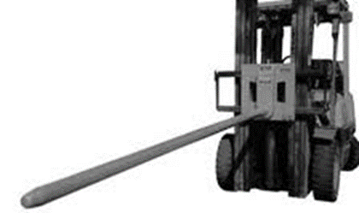
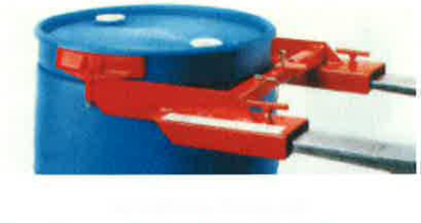
Attachments And Effect On Capacity And Stability
Do attachments effect the trucks stability ?

Slide 23
Stability, Balance, And Capacity: Course Review
1) The basic principle used by all lift trucks is the principle of balance and stability?
True____ False____
2) The center of gravity does not move?
True____ False____
3) Raising a load changes the truck’s center of gravity?
True____ False____
4) A load with an extra-long load center changes the balance of your truck?
True____ False____
5) Fork Extensions decrease the safe capacity of the lift truck?
True____ False____

Slide 24
Section 3 Preoperational Inspection

Slide 25
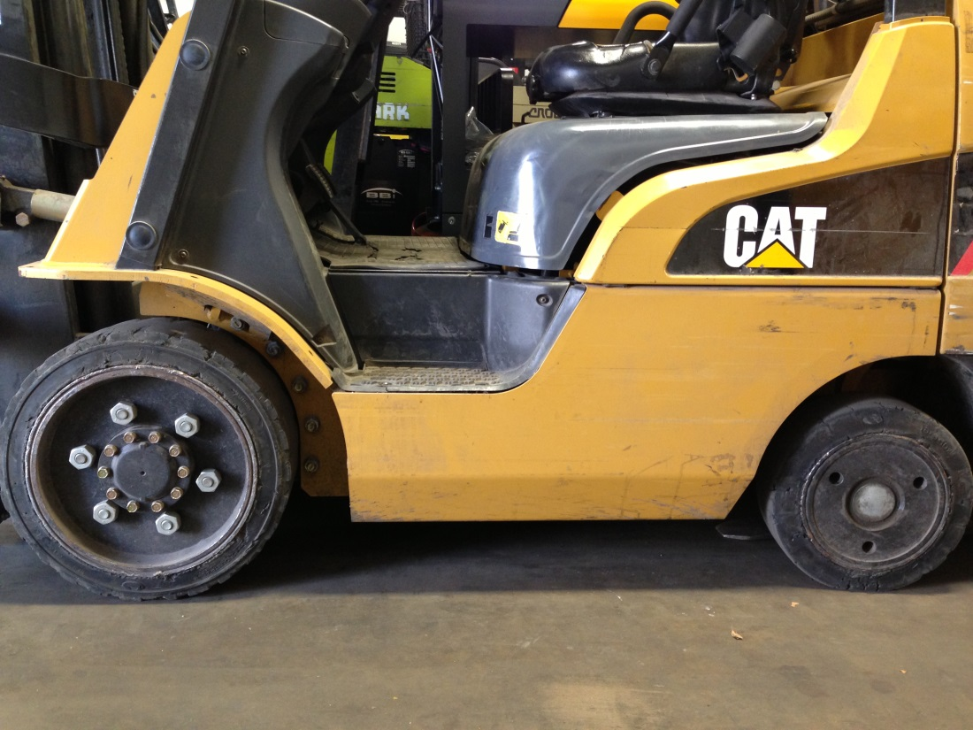
The Visual and Operational Inspection
OSHA requires a daily inspection of the truck at the start of each shift by the operator.
Forks
Fork Locks
Cylinders
Chains
Hoses
Rollers
Channels
LOOK for Damage
Chunks
Separation
Flat spots
Low pressure
Horn
Unusual noise
Safety Belt
Warning devices

Slide 26
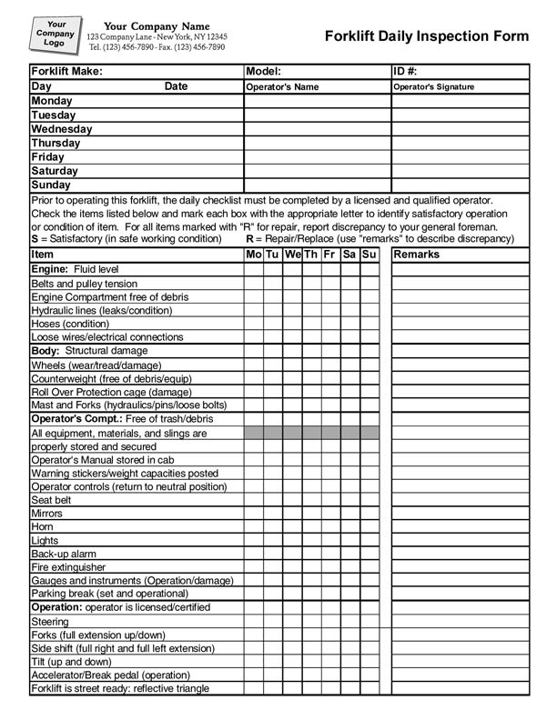
Internal Combustion / LP Trucks – Engine Compartment
Engine Oil
Hydraulic Oil
Trans. Fluid
Brake Fluid
Radiator if cool
Battery Levels
Follow Company Policies
Properly mounted tank
Pressure relief valve pointing up
Hose and connections
Tank restraint brackets
Leaks (Soapy water)
Check Tank for cracks dents
Check data stamp

Slide 27
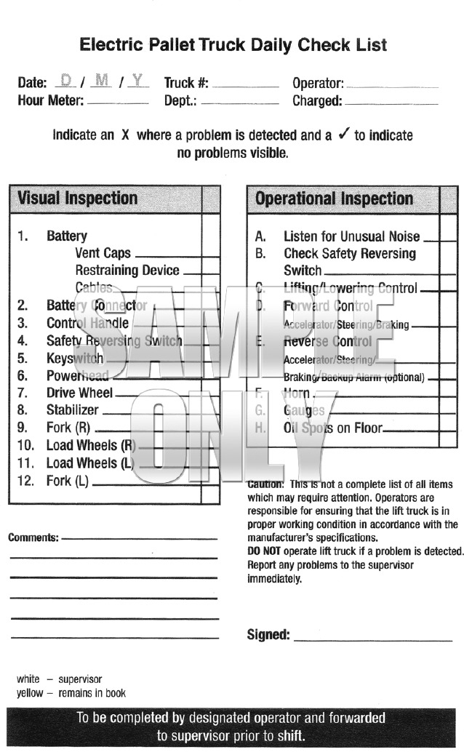
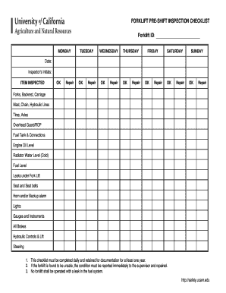
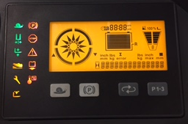
Electric Trucks

Slide 28
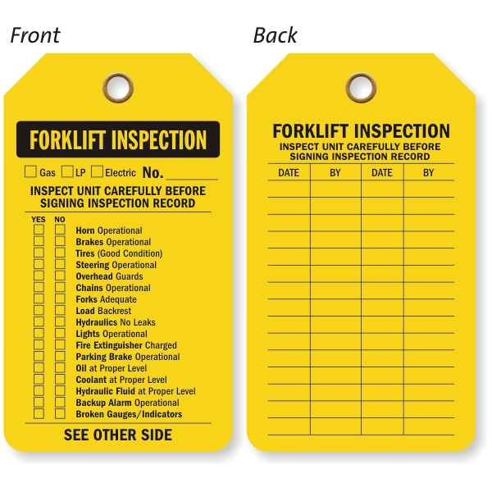
The Operational Inspection
Report any defects immediately
Never operate a truck in need of repairs
Repairs shall be made by authorized and trained personnel

Slide 29
Preoperational Inspection: Course Review
1) It is safe to change an LP tank inside a trailer at the loading dock?
True____ False____
2) Lift trucks should be inspected at the start of each shift?
True____ False____
3) Major leaks should be reported as soon as you spot one?
True____ False____
4) Forklift driver should check battery levels ?
True____ False____
5) You should operate a truck with a broken back-up alarm?
True____ False____

Slide 30
Section 4 General Rules Of The Road

Slide 31
Entering The Vehicle
3 point contact getting in or out of the vehcile

Slide 32
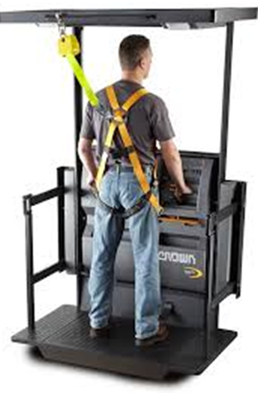
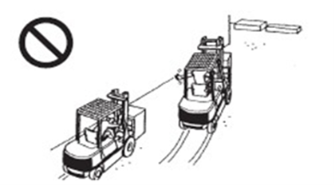
Safety Guidelines When Operating A Lift Truck
EE
Stay out of restricted areas that your truck in not rated for
Keep three truck lengths between you and them
It’s the law

Slide 33
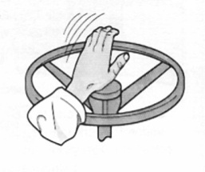
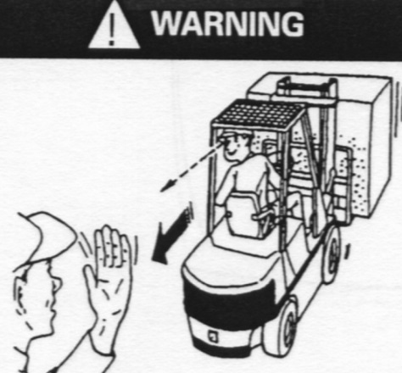
Pedestrian Traffic
Using the horn properly , when and where

Slide 34
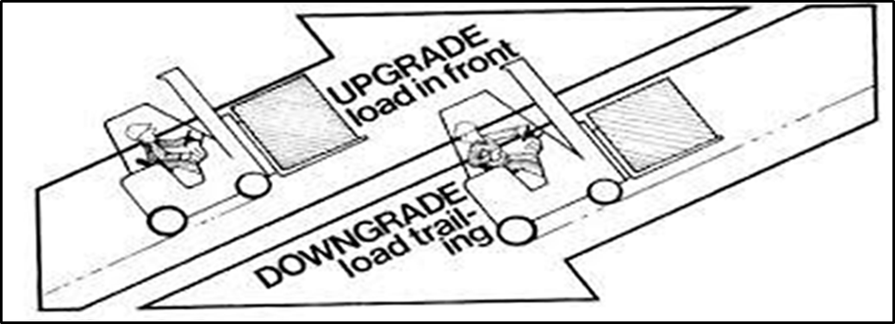
Traveling On Ramps
Heavy end up hill if traveling on a grade more then 10 per cent

Slide 35
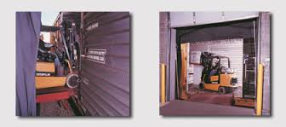
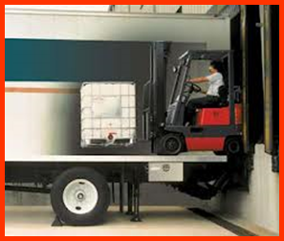
Tractor Trailers And Railcars

Slide 36
Parking Your Lift Truck
Attended Parking:
Driver is within 25 feet of the truck.
Unattended Parking:
Driver is more than 25 feet away. Truck is out-of- sight of the driver.

Slide 37
General Rules Of The Road: Course Review
When passing a pedestrian you should sound your horn, make eye contact.
True_____ False_____
It is okay to stick your leg outside the operator’s compartment when carrying a wide load.
True_____ False_____
Railroad tracks should be crossed straight on.
True_____ False_____
When you are driving a truck on a ramps you can drive any direction you want.
True_____ False_____
If the load you are carrying obstructs your vision, just raise the load to get a better view.
True_____ False_____

Slide 38
Section 5 Safe Load Handling Techniques

Slide 39
Causes Of Tip - Over
How to handle freight properly

Slide 40
Safe Load Handling
Assessing The Load
Fork Position
General Handling Techniques

Slide 41
Safe Load Handling
Engaging A Load 2-8 inches load height
Inching Pedal
Executing Turns
Rear End Swing
Deploying Loads
Elevating Personnel

Slide 42
Tip-Over Procedure
Always Fasten Seat Belt Anytime You Operate Your Truck
Never jump! Stay with the truck
Hold on tight
Brace your feet
Lean forward and away from the fall

Slide 43
Safe Load Handling Techniques: Course Review
1) Always keep your foot on the brake pedal while selecting a direction?
True____ False____
2) Lift trucks pivot at the steering wheel?
True____ False____
3) Check with your supervisor when a load looks to heavy for your truck?
True____ False____
4) Use a spotter to help you travel with an oversized load?
True____ False____
5) Tilt the load full forward before you move the truck when stacking loads?
True____ False____

Slide 44
Section 6 Refueling Gasoline, Diesel And LP Lift Trucks

Slide 45
Basic LP Fuel Guidelines
Types Of Fuel Used In Internal Combustion Lift Trucks
PPE Personnel Protection Equipment
Company Policies
Carbon Monoxide

Slide 46
LP Trucks

Slide 47
LP / Gas / Diesel
General Safety Rules
Gasoline And Diesel Fueling
Liquid Petroleum (LP) Fuel
Characteristics of fuel
Basic Fuel Guidelines
Replacing LP/Gas

Slide 48
Refueling Gasoline, Diesel, And LP Lift Trucks: Course Review
1. It is safe to change an LP tank inside a trailer at the loading dock.
True ____ False ____
2. Lift trucks should be inspected at the start of each shift.
True ____ False ____
3. Major leaks on your truck should be reported as soon as you spot one.
True ____ False ____
4. It’s not required to follow company policies.
True ____ False ____
5. You should operate a truck with a broken back up alarm.
True ____ False ____

Slide 49
Section 7 Battery Charging And Changing

Slide 50
Battery Charging And Changing
Battery Size Affects The Following:
Battery Hazards
Battery Safety
Changing Industrial Batteries
Charging an Industrial Battery in a truck
Watering Batteries
Ensuring Maximum Battery life

Slide 51
Battery Charging And Changing

Slide 52
Battery Charging and Changing: Course Review
1. Battery size affects:
a. Lifting capacity
b. Lift truck stability
c. Charge life
d. All of the above
2. If you are exposed to electrolyte, the first thing you need to do is:
a. Seek medical attention
b. Go to the nearest eyewash station and flush
c. Wait until the shift is over
d. None of the above
3. After charging the battery, always turn the charger off first before disconnecting the battery from the charger:
True___
False ___
4. Normally, you should add water to a battery only:
Before charging
It doesn’t matter when you add water
After charging
None of the above
Always follow your company polices:
True ___
False ___

