Slide 2
INFORMATION ON RETIREMENT
& LAYOFF

Slide 3
Topics
Unemployment & Layoff
Healthcare Benefits
COBRA
Retirement
Vacation Payouts
Sick Leave Conversion

Slide 4
Unemployment
State of Ohio Unemployment Website
https://unemploymenthelp.ohio.gov/
Employees who registered with the State of Ohio unemployment office will be required to use their username and password that was created.
New User Registration
Drivers License Number
Last Day Worked
The mass layoff code is no longer required for COVID-19 related claims

Slide 5
Health Care Benefits & Layoff ACE
On Lack of Work (LOW) layoff
During LOW layoff employee responsible for 15% portion of healthcare premium
Ends August 1, 2020 unless recalled sooner
Direct billing through August 1, 2020 from Bursar’s Office
Moved from (LOW) to Lack of Funds (LOF) layoff
Ability to maintain benefits by paying 15% employee premium share
Healthcare ends August 31, 2020, then COBRA eligible 9/1/2020
Bursar’s Office will bill for missed payroll deductions
Placed on LOF layoff (not previously on LOW layoff)
Layoff effective July 1, 2020
Healthcare coverage ends June 30, 2020
COBRA eligible July 1, 2020
Notes:
Fact Sheet #28: FMLA

Slide 6
Lack of Work Layoffs Premiums ACE Employees
5/24 through 6/6/2020 pay date 6/19/2020
June invoiced from Bursar
6/7 through 6/20 pay date 7/2/2020
6/21 through 7/4 pay date 7/17/2020
7/5 through 7/18 pay date 7/31/2020
7/2, 7/17, 7/31 pay dates invoiced by the Bursar
7/19 through 8/1 pay date 8/14/2020
8/2 through 8/15 pay date 8/28 /2020
8/16 through 8/29 pay date 9/11 pay date
8/30
8/14, 8/28 pay date will be invoices by the Bursar

Slide 7
Lack of Funds Layoff Premiums ACE Employees
The 7/17 pay date premiums for healthcare deductions will be adjusted to only include the healthcare coverage dates from 6/21 through 6/30.

Slide 8
Health Care Benefits & Layoff APAS
On Lack of Work (LOW) layoff
- During LOW layoff employee responsible for 15% portion of healthcare premium
-Health care coverage ends July 31, 2020, unless recalled
-Direct billing from Bursar’s office
Moved from LOW to Lack of Funds (LOF) layoff
LOF layoff begins August 1, 2020
Healthcare coverage ends July 31, 2020
Eligible for COBRA beginning August 1, 2020
Bursar’s Office will bill for missed payroll deductions
Placed on LOF layoff (not previously on LOW layoff)
Layoff effective July 1, 2020
Healthcare coverage ends June 30, 2020
Eligible for COBRA July 1, 2020
Notes:
Fact Sheet #28: FMLA

Slide 9
Flexible Spending Accounts and Health Savings Accounts
FSA
Employee must use their money by December 31, 2020 from their separation date.
Money will be forfeited if not used by December 31, 2020
Health Savings Accounts
Money stays with the employee.
No timeframe for the employee to use the money in the account.

Slide 10
COBRA
CHARD SNYDER
Third Party Administrator used for COBRA administration
Packets will be mailed to the address of file at YSU
Eligibility duration 18 months
Payment Information
Cost is 102% of the coverage elected
Do not have to elect all of your current coverage, may elect just medical, dental or vision coverage

Slide 11
Retirement
Employees are encouraged to contact their retirement system (OPERS, STRS) or alternative retirement plan(ARP) provider first to discuss their eligibility to retire.
Employees must notify the Office of Human Resources or their Manager of their intent to retire.

Slide 12
Retirement
OPERS
www.opers.org
800-222-7377
STRS
www.strsoh.org
888-227-7877
Alternative Retirement Plan
YSU Benefits Webpage to find contact information for your account representative

Slide 13
Vacation Payouts
Employees are entitled to receive a vacation leave payout of their accrued but unused vacation leave.
An employee’s final leave report or time sheet must be submitted before any vacation accruals are calculated for a final pay out.
Allow 4-6 weeks for the final payment to be processed.
Employees will receive their money in the same manner in which they received their paycheck.
Direct Deposit or Check
To change this payment method, you must call the payroll department.

Slide 14
Sick Leave Conversion Upon RETIREMENT
Employees may be eligible to receive sick leave conversion
Subject to Collective Bargaining Agreements and
University Policy 3356-7-13 Sick leave accrual, use and conversion, excluded professional/administrative and excluded staff

Slide 15
Sick Leave Conversion Upon RETIREMENT
YSU requires documentation from the retirement provider/system (OPERS,STRS, ARP) that
an employee applied for and
was granted retirement benefits (i.e. taking/receiving retirement payments)
Allow 4-6 weeks for the final payment to be processed.
Review the Summary of Eligibility on next slide

Slide 16
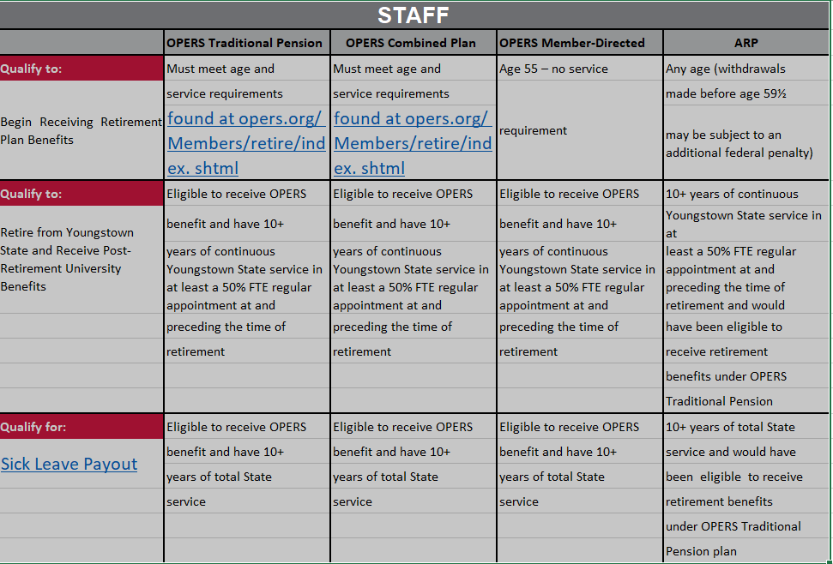

Slide 17
Submitted Questions:
What is the date the vacation payout will be paid?
Do we receive partial payout on sick leave?
What happens to employee’s sick leave bank while an employee is on recall?
When specifically should we expect COBRA in our mailboxes?
When will my coverage for life insurance end?
Are there any outplacement services?

Slide 18
Will I have to indicate to unemployment that I am now on a lack of funds layoff instead of lack of work layoff?
Please discuss the payment date for the invoices being received for lack of work layoffs?
Will my vacation payout effect my unemployment?
Am I still eligible for tuition remission while on recall?

Slide 19
CONTACT The Office of Human Resources 330-941-1508
Stacey Luce Seluce@ysu.edu
Manager; Employee Benefits
Retirement Questions
Linda Moore lkmoore@ysu.edu
Human Capital Management Analyst
Unemployment Questions
Linda Mazzocco lkmazzocco@ysu.edu
Benefits Analyst
Insurance Questions
Carrie Clyde crclyde@ysu.edu
Wellness Coordinator
Employee Assistance Program (EAP)

Slide 20
Presented by the
Offices of Human Resources

