Slide 1
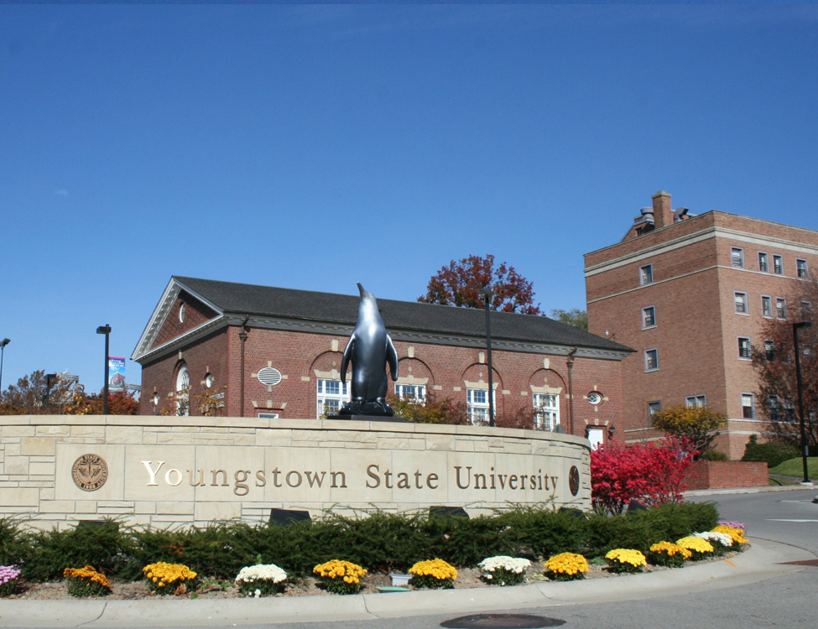


FIRST DAY® COMPLETE
An innovative course material model supporting student outcomes
through equitable access, convenience, and affordability

Slide 2

IMPROVING EQUITABLE ACCESS, CONVENIENCE & AFFORDABILITY AT
Youngstown State University
Full Time Student would now only spend
$345
(Based on 15 credit hours)
First Day Complete
Pricing per credit hour
$23

Slide 3



INTRODUCING FIRST DAY® COMPLETE
A proven solution that supports student success
by ensuring students have access to all their course materials on or before the first day of class
STUDENTS
AUTOMATICALLY
receive all their books and access to electronic materials on or before the first day of class
MATERIALS ARE INCLUDED
in tuition or applied as a charge to the student account
SIGNIFICANT STRESS REDUCTION & COST SAVINGS
for students versus the traditional model

Slide 4
SUPPORTS RETENTION &
IMPROVES COURSE COMPLETION RATES​
74 PERCENT
of students said the availability of the program increased their likeliness of continuing their education at the school**
Research shows students who participate in First Day Complete are 15.58% more likely to complete the course then students that are not in an equitable access program.*
* Inclusive/Equitable Access Research Study, University of New Hampshire, July 2022
** First Day Complete Spring 2022 Student Survey

Slide 5


SUPPORTS ENROLLMENT​
Increased Enrollment at Eastern Kentucky University
In Fall 2021, Eastern Kentucky University saw an enrollment increase of 8% among first-time freshmen – the only public four-year institution in Kentucky that saw a year-over-year increase.
The university considers First Day Complete an important resource for recruitment and retention.
25 PERCENT
Of freshman said that the course material program was a factor in their decision to attend their current school.*
* First Day Complete Spring 2022 Student Survey

Slide 6

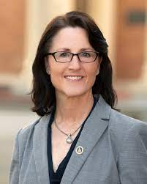
WORKING IN COLLABORATION WITH
ACADEMIC LEADERSHIP & FACULTY
Faculty maintain full Academic Freedom
Faculty can continue to select materials across all publishers, in any format
Faculty submission timeline remains unchanged
Early adoptions realize greater success
Easy to implement Student Opt-Out option
Student Centric Approach
“
Regarding [student] performance,
I’m seeing higher quality work, and a great boost in student engagement.
I think our institution has been more innovative [with this program] catering to a lot of first-generation students.
Scott Huff, Faculty
Lees-McRae College
”
“We've taken the worry out of being prepared for the first day of class, and it's been phenomenal for students.”
Dr. Allison Gillespie, Assistant Provost for Academic Affairs,
The University of Southern Mississippi

Slide 7
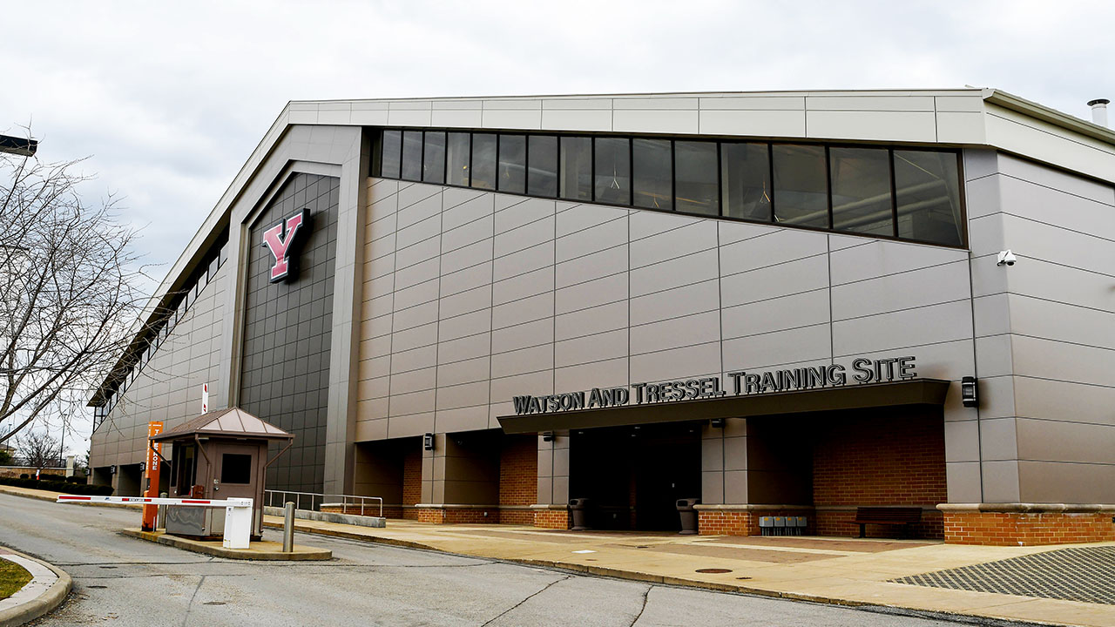
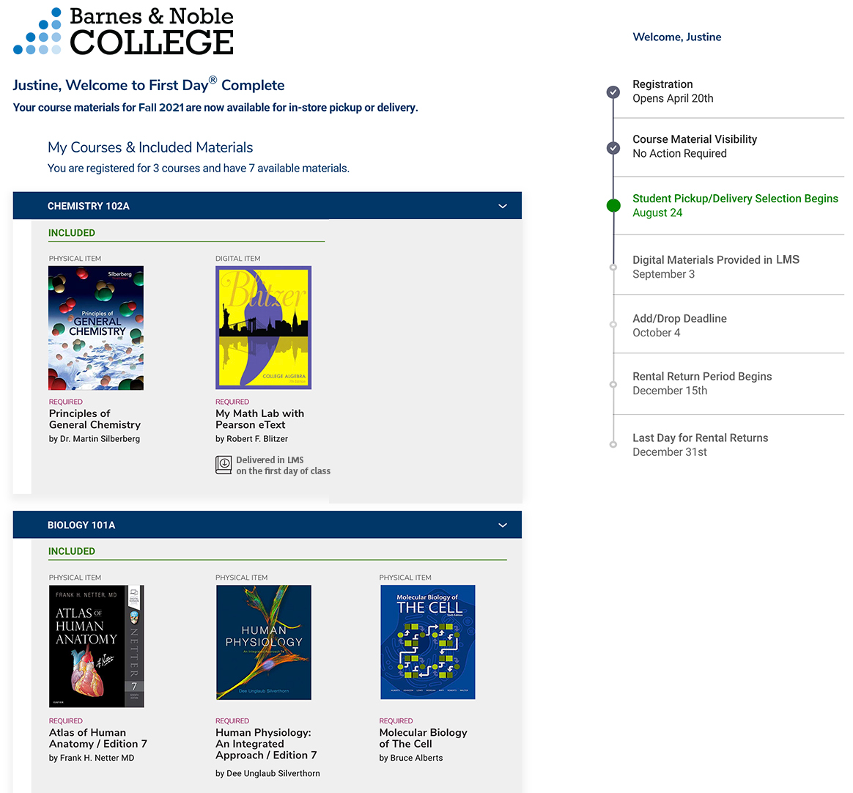
Personalized Student Experience
STEP 1 |
REGISTER FOR CLASS
VERIFY MATERIALS
STEP 2 |
STEP 3 |
SELECT FULFILLMENT METHODS
STEP 4 |
RECEIVE MATERIALS
STEP 5 |
END OF TERM:
RETURN MATERIALS

Slide 8
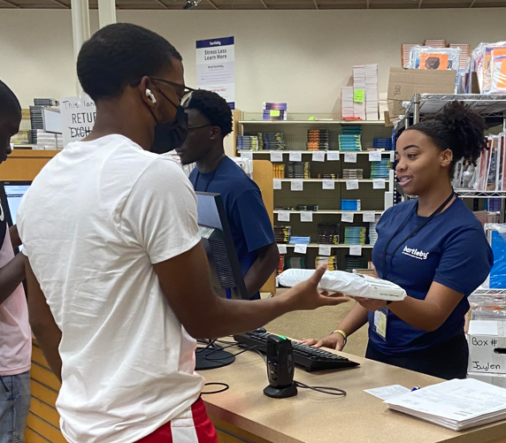
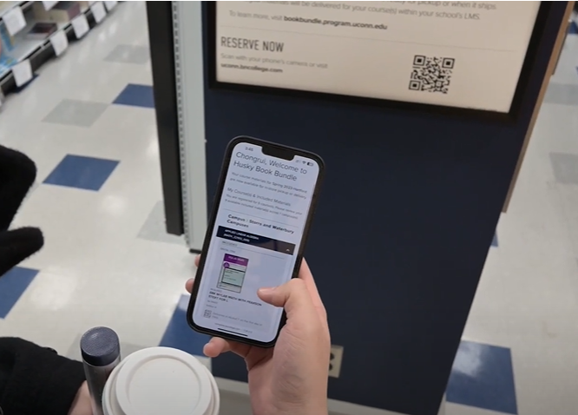
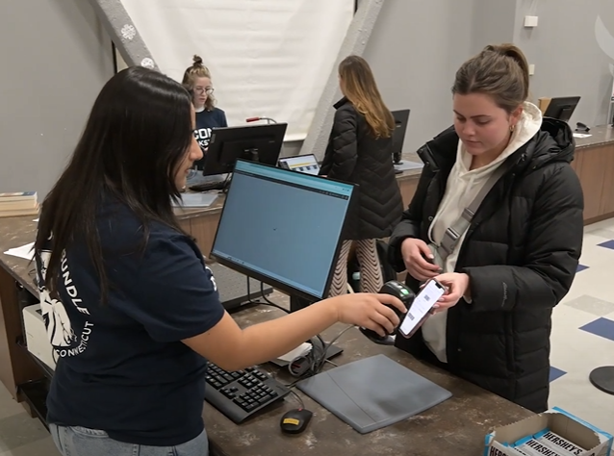
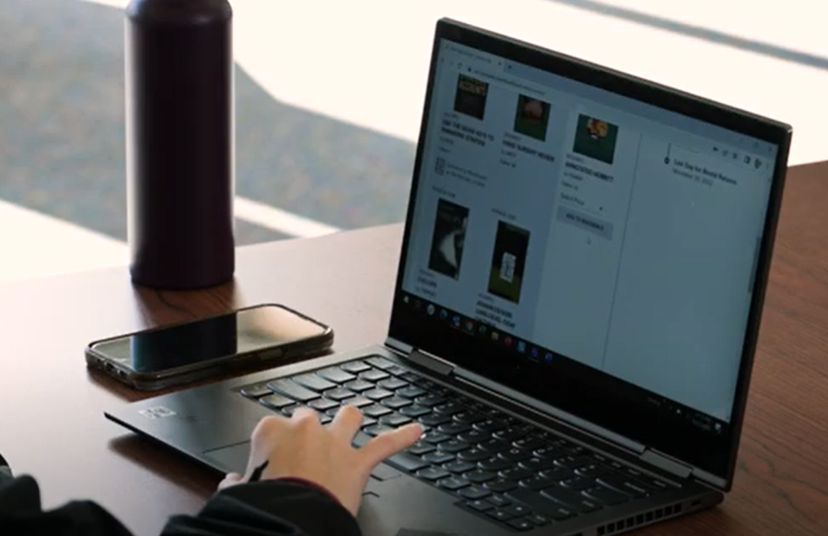
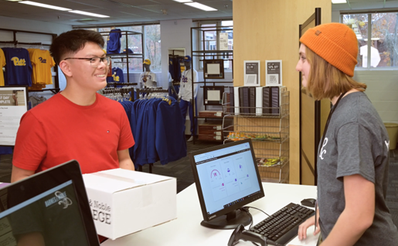
CONVENIENT IN-STORE PICK UP ​
Receive your materials
Make your selection
Show confirmation email with bar code

Slide 9

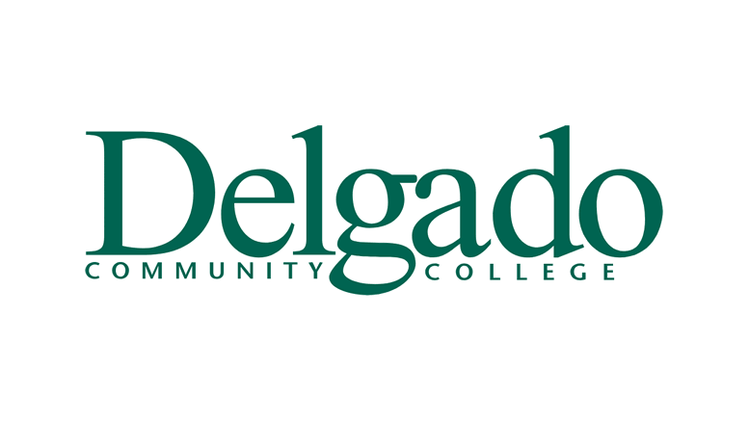





















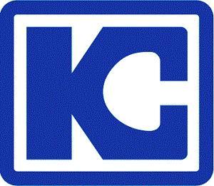






















































Over 157 CAMPUSES have moved to FIRST DAY COMPLETE, including:
BARNES & NOBLE COLLEGE ARE EXPERTS AT IMPLEMENTING
COURSE MATERIAL ACCESS PROGRAMS

Slide 10

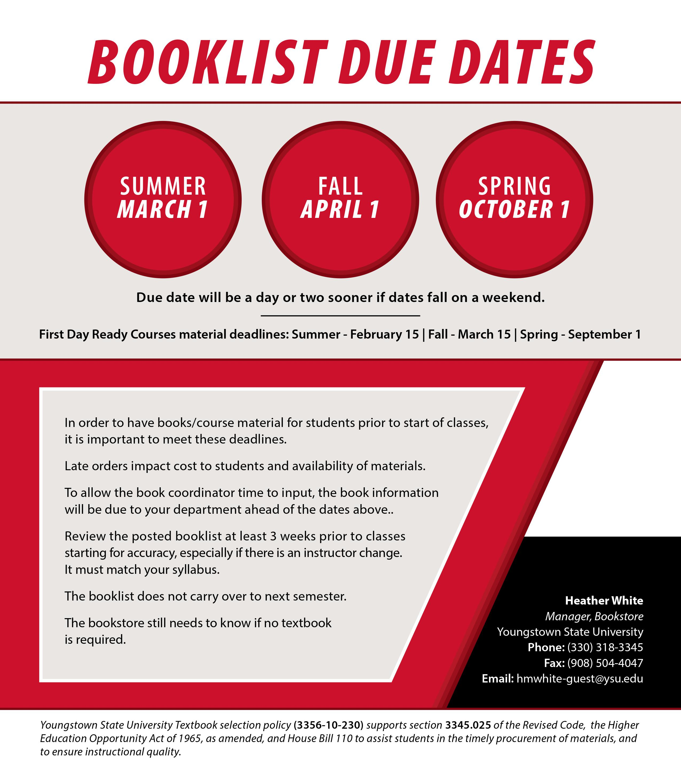
Booklist due dates will not change with the new program.
It’s more important than ever to designate required and recommended correctly and confirm the correct materials have been submitted for your course.
Faculty are able to designate whether they want a material in print or digital.

Slide 11
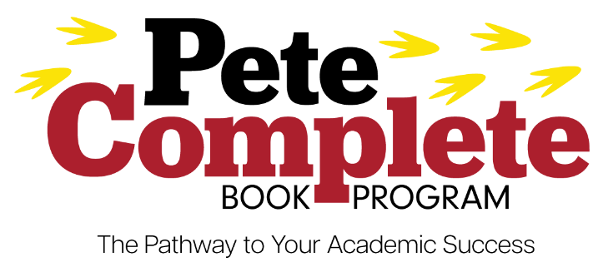
Schedule of Upcoming Open Forums
Pete Complete Book Program Information | YSU

