Slide 1
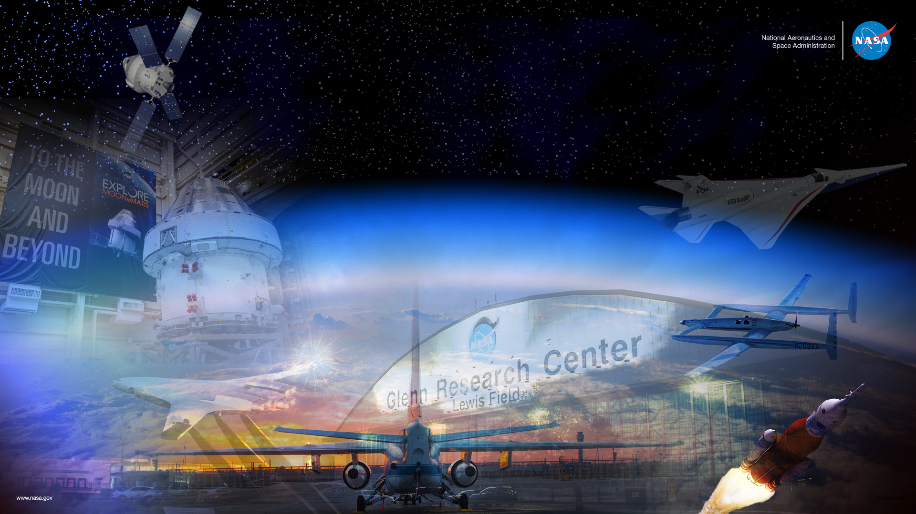
NASA Technology, Programs, and Partnerships
Tom Doehne
Office of Technology Incubation and Innovation
NASA Glenn Research Center

Slide 2

NASA Centers and Installations
10 Main NASA Centers
NASA Headquarters
4 Research Centers
5 Flight Centers
Glenn Research Center
Lewis Field
Cleveland, OH
NASA Neil A. Armstrong Test Facility
Sandusky, OH
Independent Verification
and Validation Facility
Fairmont, WV
Ames
Research Center
Mountain View, CA
Goddard Institute for
Space Studies
Goddard
Space Flight Center
Greenbelt, MD
NASA Headquarters
Washington, DC
Armstrong
Flight Research
Center
Edwards, CA
Wallops Flight Facility
Wallops Island, VA
Langley Research Center
Hampton, VA
Marshall Space Flight Center
Huntsville, AL
Jet Propulsion Laboratory
Pasadena, CA
Stennis Space Center
Stennis Space Center, MS
Johnson Space Center
Houston, Texas
Kennedy
Space Center
Cape Canaveral, FL
White Sands Test Facility
White Sands, NM
Michoud Assembly Facility
New Orleans, LA

Slide 3
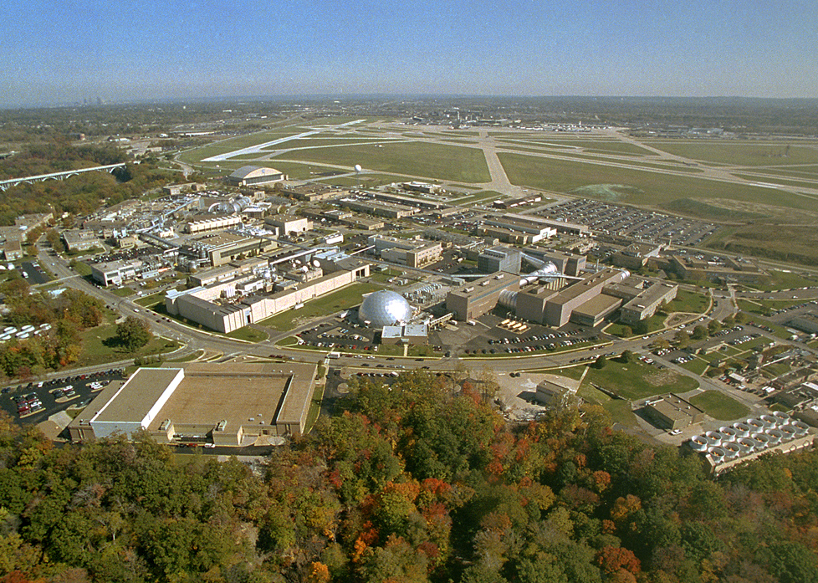
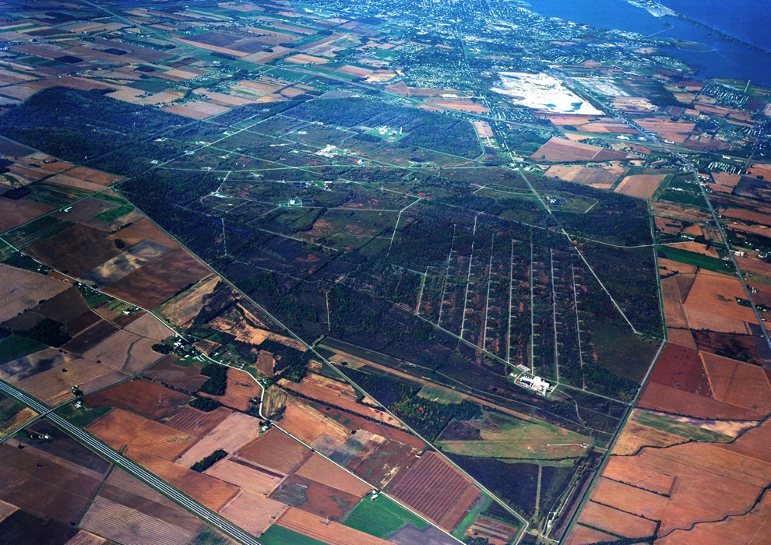
NASA Glenn Research Center - Campuses
GRC-Lewis Field
(Cleveland, OH)
  307 acres
  1,497 civil servants and 1,643 contractors
  56 Pathways Interns (not included above)
GRC-Neil Armstrong Test Facility (Sandusky, OH)
  6,740 acres
  21 civil servants and 100 contractors

Slide 4































NASA GRC - Core Competencies
Air-Breathing Propulsion
Communications Technology and Development
In-Space Propulsion and Cryogenic Fluids Management
Power, Energy Storage and Conversion
Materials and Structures for Extreme Environments
Physical Sciences and Biomedical Technologies in Space

Slide 5
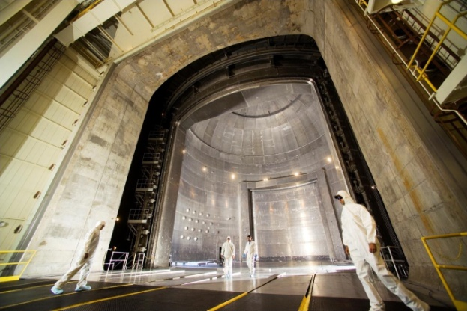
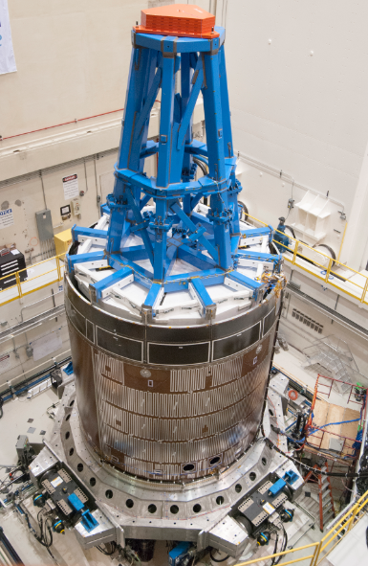
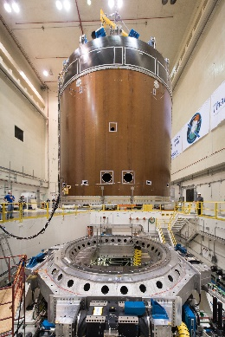
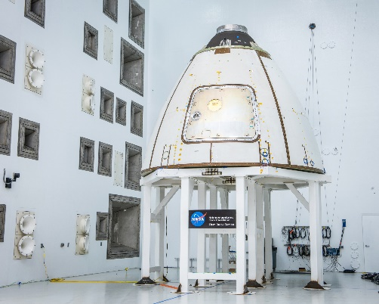
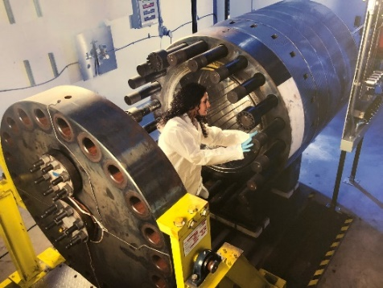
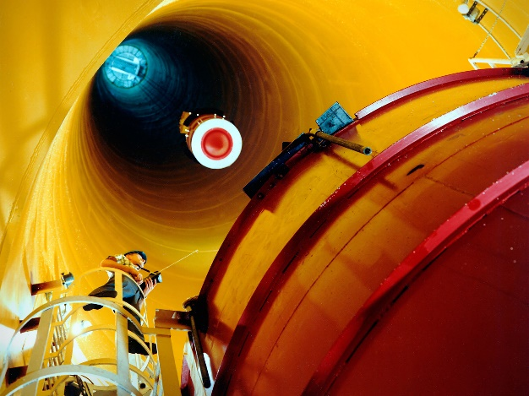
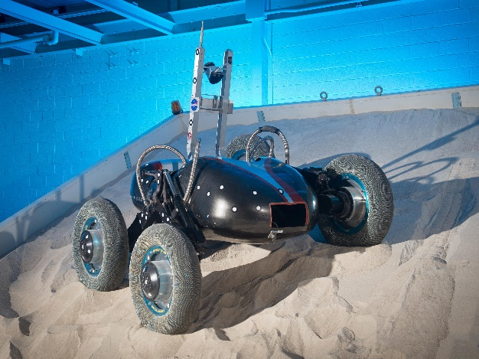
NASA Glenn - Unique Space Environmental Test Facilities
Vacuum Chambers
Mechanical Vibration Facility
Reverberant Acoustic Test Facility
Glenn’s Extreme Environment Rig
Zero Gravity Research Facility
Simulated Lunar OPErations (SLOPE) Facility
Notes:
Vacuum Chambers
Largest space simulation chamber
Highest pumping speed chamber
Thermal simulation capability
Mechanical Vibration Facility
3-axis, 6 degrees of freedom
Reverberant Acoustic Test Facility
Nitrogen atmosphere
Wide range of acoustic spectra
Glenn’s Extreme Environment Rig
High pressure, high temperature
Simulated Venus atmosphere
Zero Gravity Research Facility
> 5 seconds microgravity environment for research
Simulated Lunar OPErations (SLOPE) Facility
Lunar regolith testbed

Slide 6
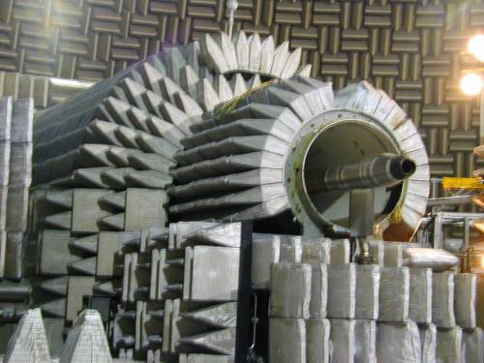
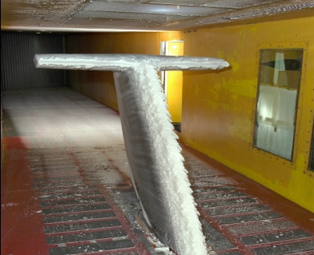
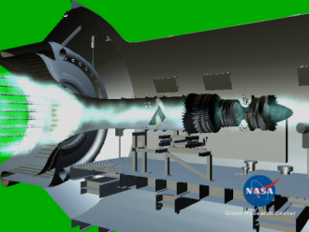
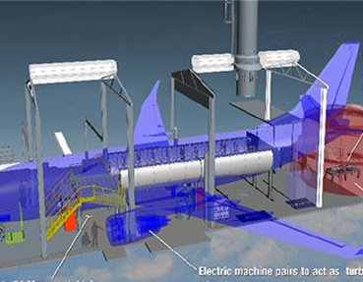
NASA Glenn - Unique Aeronautics Test Facilities
Transonic, Supersonic, and Subsonic Propulsion Wind Tunnels
Aero-Acoustic
Propulsion Lab
Icing Research
Tunnel
Propulsion Systems Laboratory
Engine Component
Facilities
NASA Electrified Aircraft Technology (NEAT)
Notes:
Subsonic Propulsion Wind Tunnels (9- by 15-Foot Wind Tunnel)
Noise suppression, Inlet/Airframe integration, STOVL hot gas ingestion
Transonic and Supersonic Propulsion Wind Tunnels (pictured: 8- by 6-Foot Wind Tunnel)
Advanced propulsion concepts, Inlet/Airframe Integration, Internal/external aerodynamics
Engine Acoustic Research Facility
Fan/nozzle acoustics research, Simulate hot engine nozzles in flight, Aerodynamic and Aeroacoustics measurements capabilities
Largest Icing Tunnel in U.S.
Aircraft icing certification, Ice protection systems development, Icing prediction/code validation
NASA’s Only Altitude Full-Scale Engine Facility
Jet Engine Icing Research, Engine operability/performance, Nozzle-engine development
Over 50 Versatile Engine Component Facilities
Combustor and Heat Transfer, Compressor and Turbine, Inlets and Nozzles
Electrified Aircraft Powertrain
Full-scale ground tests, Powertrain components, Enabling Materials and Devices

Slide 7







Ways to Partner with NASA
Technology Licensing
Commercial entities using NASA technologies & software to benefit commercial endeavors
  https://technology.nasa.gov/
Grant Solicitations
Directorate-level program funding provided through NSPIRES & displayed on Grants.gov
  https://nspires.nasaprs.com/external/
Small Business Funding & Awards
SBIR & STTR funding for small businesses & joint university small business ventures, respectively
  https://sbir.nasa.gov/
SBIR Ignite is a new way for small businesses that have a commercially-viable technology idea to use NASA as a steppingstone towards commercial success
  https://sbir.nasa.gov/ignite
Procurement
NASA purchases of services, consumables, equipment, etc. from commercial providers
  https://www.nasa.gov/office/procurement
NASA Facilities & Expertise
Accessing NASA’s facilities, equipment & SMEs through Reimbursable or non-reimbursable Space Act Agreements (SAA); these are similar to CRADAs
  https://www.nasa.gov/partnerships.html
University Grants
Space Technology Research Grants (STRG) provides funding to graduate students to tenured faculty members to advance space concepts to higher TRLs
  https://www.nasa.gov/directorates/spacetech/strg/about.html
Networks and Ecosystems
T2X & T2U programs for startups & university engagement, respectively
Regional resources, cluster mapping, etc. for entrepreneurs
  https://technology.nasa.gov/t2x

Slide 8
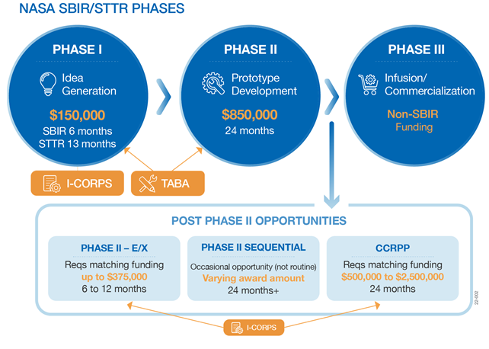
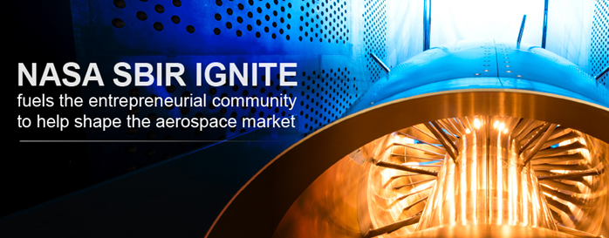
Traditional SBIR & STTR Solicitations / SBIR Ignite
.
GOAL: Fund early-stage tech to help make companies and their tech more attractive to private sector investors, customers, and partners.
2023 SUBMISSION PERIOD
Opens summer 2023
2023 PHASE I & II AWARD AMOUNT / PERIOD OF PERFORMANCE
Same as traditional NASA SBIR Solicitation
- 2023 SBIR/STTR Phase I Solicitation Period: Jan 10 - Mar 13
LEARN MORE
sbir.nasa.gov/ignite
SBIR Ignite Preparation| H4XLabs
- 2023 Phase I Award Announcement – Tentatively June 5th
Review The Previous Solicitation
- 2024 SBIR/STTR Phase I Solicitation Release: Early Jan. 2024
Questions? Contact a CTTL
8
Notes:
Phase I is what we like to call the “idea phase.” Beginning this year, our awardees received 20% more funding than in past years, with both SBIR and STTR awards increasing from $125,000 to $150,000! You’ll notice that STTR has a longer period of performance to account for the nature of the academic calendar.
Phase II is focused on the actual development, demonstration, and delivery of the innovation. Beginning with the 2022 Phase II awards, the award amount is increasing from $750,000 to $850,000.
Getting to a successful Phase III is tough. Phase I and II awards alone are not typically enough to support a company’s journey to commercialization. So, our program has created additional opportunities to help firms get there—and with more than just funding—through initiatives like the I-Corps entrepreneurial training program, TABA—Technical and Business Assistance funding to hire a commercialization-focused vendor, and our various Post Phase II vehicles. You can find out more about all of these opportunities on our website.
Phase III is the infusion and/or commercialization of innovative technologies, products, and services resulting from either a Phase I or Phase II contract.
This includes further development of technologies for transition into NASA programs, other Government agencies, or the private sector (Programs and project funded – Not SBIR)
Phase III is a contract mechanism in which no further competition is required after Phase I & II, no limit on the number, duration, type, or $ value of a Phase III and firms are accorded all SBIR Data Rights
Other Post Phase II Opportunities include:
Phase II-E where the firm, in the 2nd year of its Phase II contract, may seek investor funding from a NASA program or external entity and the SBIR program provides matching funding up to 375k
The primary objective of the NASA CCRPP is a near-term infusion and/or commercialization of technologies with strong relevance to NASA’s missions, as well as a strong potential near-term use by NASA and/or markets outside of NASA beyond the CCRPP investment.
Sequential is a more focused pilot offering and may be by direct invitation only
In addition to our traditional SBIR/STTR solicitations, we recently introduced the new NASA Ignite solicitation
Seeks commercially viable tech that will stimulate the market
Encourages participation from product-driven companies not looking at NASA as their primary customer
Features the same three phases and funding levels as the main NASA SBIR/STTR solicitations

Slide 9

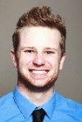
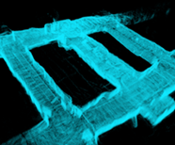
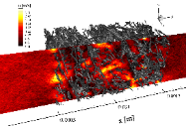


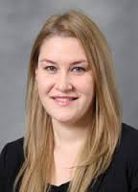

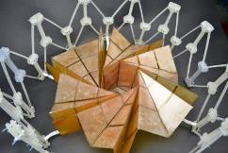



STRG Program Overview
Engage Academia: Tap into spectrum of academic researchers, from graduate students to senior faculty members, to examine the theoretical feasibility of ideas and approaches that are critical to making science, including climate change and clean energy, space travel, and exploration more effective, affordable, and sustainable.
NASA Space Technology Graduate Research Opportunities (NSTGRO)
  Graduate student research in space technology; research conducted on campuses and at NASA Centers and not-for-profit R&D labs
Early Career Faculty (ECF)
  Focused on supporting outstanding faculty researchers early in their careers as they conduct space technology research of high priority to NASA’s Mission Directorates
Early Stage Innovations (ESI)
  University-led, possibly multiple investigator, efforts on early-stage space technology research of high priority to NASA’s Mission Directorates
  Paid teaming with other universities, industry, and non-profits permitted
Lunar Surface Technology Research (LuSTR) Opportunities
  University-led efforts addressing high priority lunar surface challenges
  Short duration, high value grants with emphasis on technology development and potential infusion
  Paid teaming with other universities, industry, and non-profits encouraged
Space Technology Research Institutes (STRI)
  University-led, integrated, multidisciplinary teams focused on high-priority early-stage space technology research for several years
NASA’s STRG Program:
https://www.nasa.gov/directorates/spacetech/strg/about.html

Slide 10



NASA Office of Small Business Programs (OSBP)
Mission Statement
The mission of the NASA Office of Small Business Programs is to promote and integrate small businesses into the industrial base of contractors and subcontractors that support the future of space exploration, scientific discovery, and aeronautics research.
OSBP Office:
  Conducts outreach to assist Small Businesses (SB).
  Influences SB policy and procedures.
  Interacts with Executive and Legislative branches.
  Administers NASA SB Awards programs.
  Provides training for NASA Acquisition personnel on SB issues.
  Negotiates SB Goals with the Small Business Administration (SBA).
  Conducts Quality/Internal Control/Center compliance reviews.
  Administers NASA’s Mentor/Protégé Program.
  OSBP website: www. https://www.nasa.gov/osbp
We are on Social Media! Connect with us via:
NASA Vendor Database
OSBP Mobile App
OSBP is on Facebook!
OSBP in on Twitter!
Subscribe to Our Mailing List
Check out NASA’s LinkedIn page for OSBP updates!
https://www.linkedin.com/company/nasa/

Slide 11
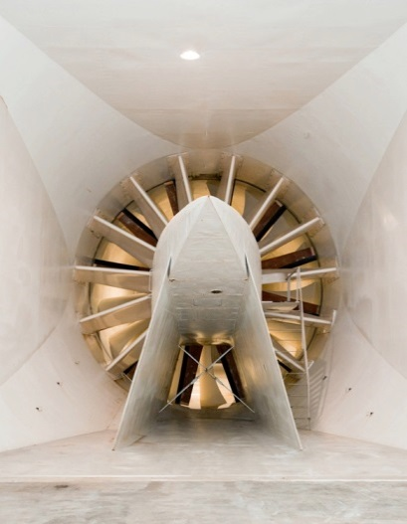

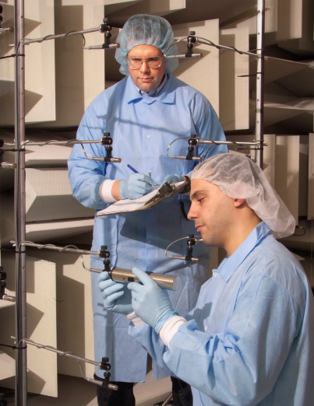
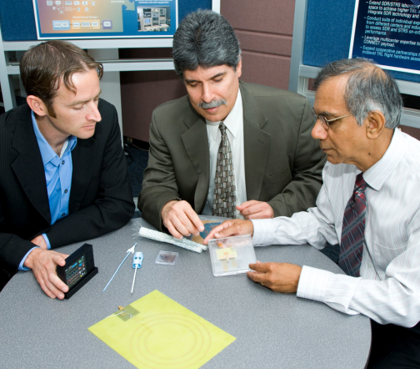
Glenn Key Products and Service Offerings to
Non-NASA Community
Space Act Agreements
Reimbursable Activities
Use of unique NASA services and expertise to advance commercial and academic interests.
Activity must be consistent with the NASA mission and involve services/facilities not reasonably available in the commercial market.
Partner responsible for all costs incurred by NASA to perform the activity.
Non-Reimbursable Activities
Partner does not reimburse NASA for the cost of work for services and expertise.
Work must be consistent with the purpose for which Congress appropriated the NASA funds.
Intellectual
Property
Facilities Test (FT) Services
Research, Development, Test and, Evaluation (RDT&E) Services
Subject Matter Expert (SME) Services

Slide 12
Employment Opportunities
NASA Career Opportunities - https://www.nasa.gov/careers
  NASA uses USAJOBS to advertise any job opportunities - https://www.usajobs.gov/
NASA Pathway Internship Program - https://www.nasa.gov/careers/students-and-recent-graduates
  Offers a direct pipeline to full-time employment at NASA upon graduation
  Types of Internships
    Engineering, Science, and Technology
      GS-899: Engineering
      GS-1399: Physical Sciences
    Business
      GS-0099: Safety & Occupational Health
      GS-299: Human Resources
      GS-399: Administration and Program Management & Analysis
      GS-599: Accounting & Budget
      GS-1099: Communication & Public Relations
      GS-1199: Procurement and Contracts
      GS-1599: Math & Statistics
      GS-2299: Information Technology

Slide 13
NASA Resources/Opportunities
General
NASA Homepage
NASA Centers and Facilities
Doing Business with NASA
NASA Partnerships
NASA Internships
Careers at NASA: Explore the Extraordinary, Every Day
NASA Technical Reports Server (NTRS) – public database of NASA technical reports
NASA Technology Transfer Portal Home
Space Station Research and Technologies/ISS Research Ops
Center for the Advancement of Science in Space (CASIS)
Citizen Science
Education & STEM Engagement
Explore NASA STEM
National Space Grant College and Fellowship Project – Space Grant Consortiums
Minority University Research and Education Project (MUREP)
MUREP Opportunities and Resources
Technology Transfer University (T2U)
NASA SBIR & STTR Program Homepage
Space Technology Research Grants (STRG)
Established Program to Stimulate Competitive Research (EPSCoR)
Solicitations & Challenges
Science Technology Mission Directorate (STMD) Solicitations and Opportunities
Aeronautics Research Mission Directorate (ARMD) Solicitations
NSPIRES - NASA Research Opportunities Online
Research Opportunities in Space and Earth Science (ROSES)
NASA SBIR & STTR Program Homepage
SBIR Ignite | NASA SBIR & STTR Program Homepage
Space Technology Research Grants (STRG)
NASA Innovative Advanced Concepts (NIAC)
NASA Solve: Prizes, Challenges & Crowdsource
Centennial Challenge
Game Changing Development Program
Space Tech Industry Partnerships - Tipping Point & Announcement of Collaboration Opportunities
Established Program to Stimulate Competitive Research (EPSCoR)
Astrobiology Funding Opportunities
Flight Opportunities
Small Spacecraft Technology Program
NASA Tournament Lab
NASA Unsolicited Proposal Handbook

Slide 14

Technology Transfer Program
Manages NASA Glenn Research Center’s Technology Patent Portfolio
Aligns GRC’s early-stage technology investment opportunities with long-term technology goals
Strategic partnering for NASA’s mission & economic development in the region
Transfer Glenn-developed technologies to private industry & academia

Slide 15
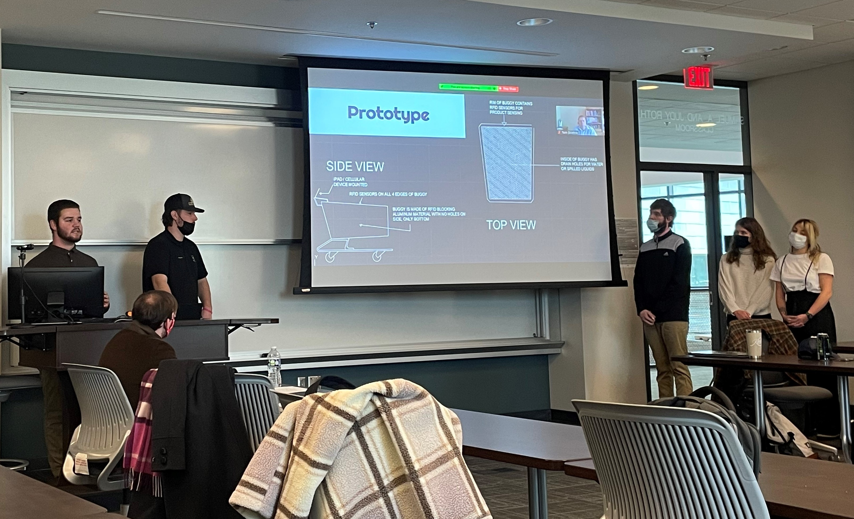
Technology Transfer Expansion (T2X) Program
T2X builds strategic partnerships across the nation with organizations and universities focused on building ecosystems for entrepreneurs and start-ups to commercialize NASA’s technologies.
Technology Transfer University (T2U): Student entrepreneurs at universities build case studies with NASA’s patent portfolio while learning about commercialization and licensing opportunities as part of an entrepreneurship course at the university
The GRC T2X program will work primarily with organizations and universities in the Midwest and Great Lakes Region of the United States.

Slide 16
Technology Transfer Expansion (T2X) Program
Awareness of NASA as a Resource: Increase awareness of GRC’s core competencies, facilities, research and technology development areas, and opportunities for partnerships and collaboration
Introductions to Regional Resources: Introduce licensees to organizations to assist with commercialization and regional business resources
Communicate Opportunities: Communicate NASA’s funded and unfunded opportunities to enable more diverse innovation
Maintain Relationships: Develop, host and/or attend events to create opportunities for organic collaborative relationship development

Slide 17

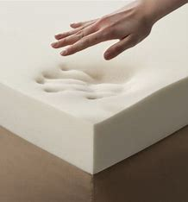
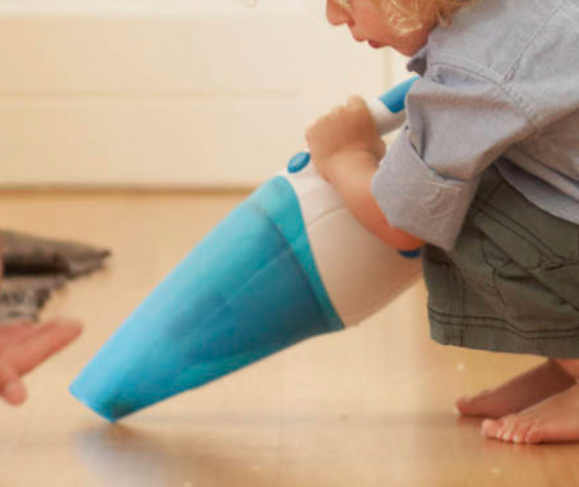
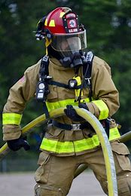

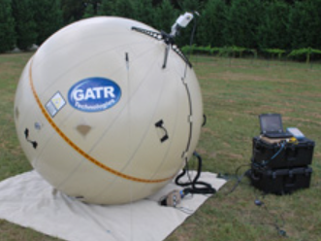
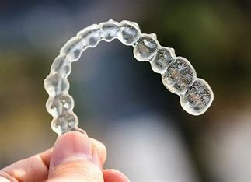
NASA Technology Spinoff Commercial Products
Memory foam Baby formula
Firefighters gear Dust buster
Wireless technology Invisible braces
GPS technology Cataract surgery Tool
Cell phone Image technology
Space/satellite communication
See the Spinoffs @ spinoff.nasa.gov

Slide 18
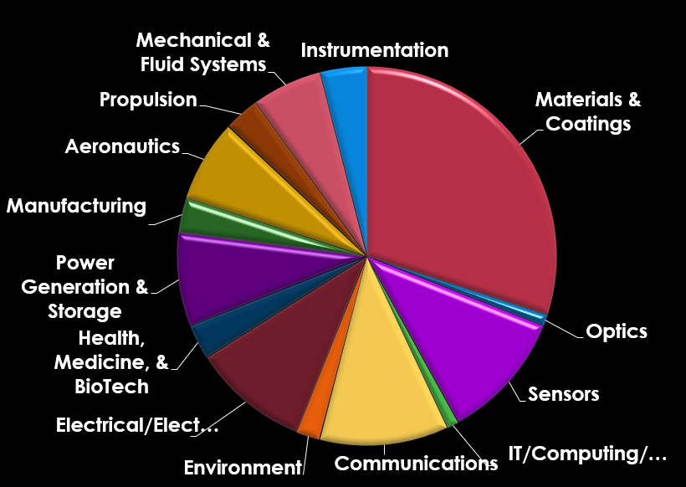
NASA Technologies Available for Commercialization
NASA GRC Has Over 200 Patented And Patent Pending Technologies For License
NASA’s Total Patents Approach 1500
Notes:
This pie chart shows you the different types of technologies that NASA has for licensing and commercialization.
GRC has over 200 patented and patent pending technologies for license & there are approximately 1500 NASA total patents in our system.
This pie chart identifies 14 different technology categories & some of the largest groups are in the areas of materials and coating, sensors, communications, electrical, and power and energy storage.

Slide 19
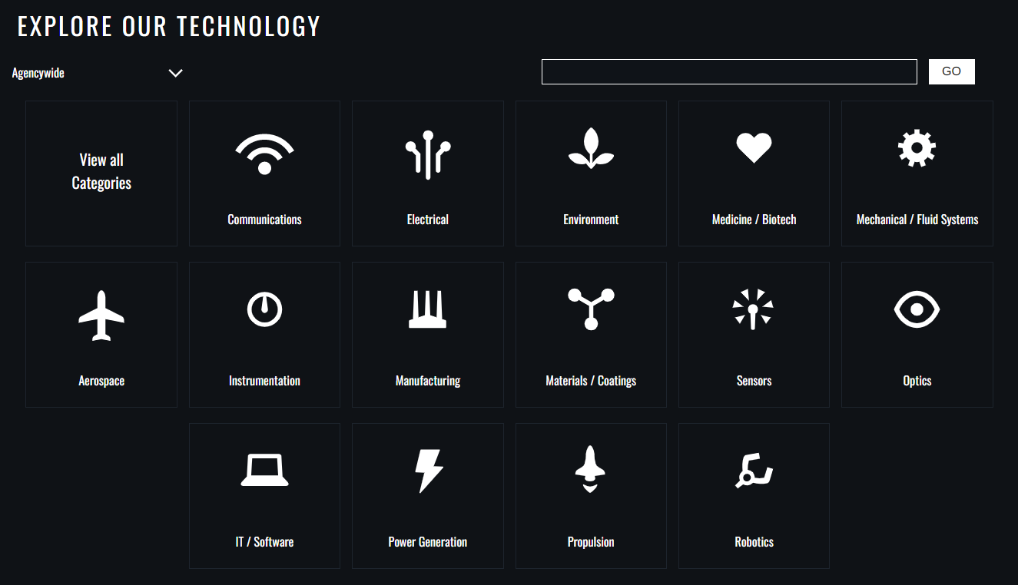
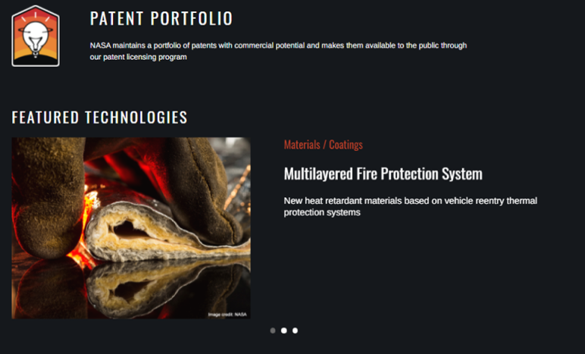
Searching the NASA Patent Portfolio
https://technology.nasa.gov/patents

Slide 20
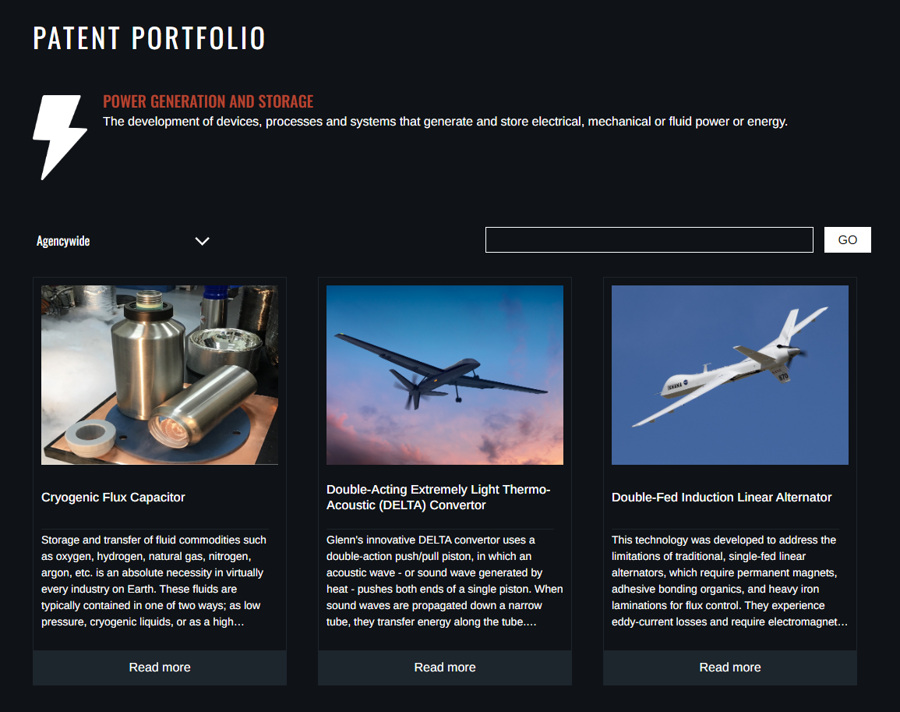
NASA Technologies

Slide 21
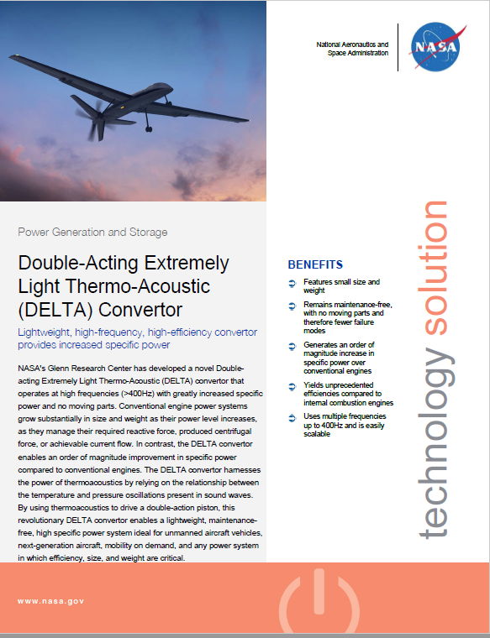
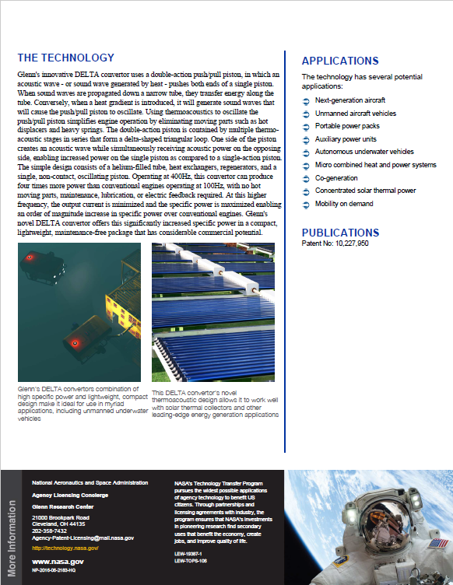
Technology Description Sheets

Slide 22
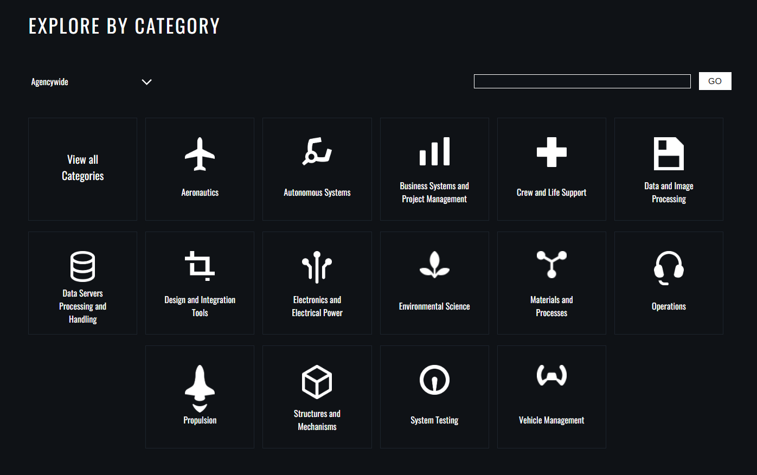
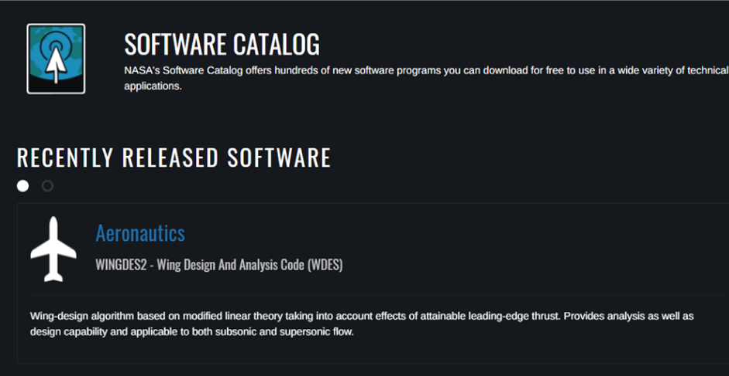
Searching the NASA Software Catalog
Software is free with registration
https://software.nasa.gov

Slide 23
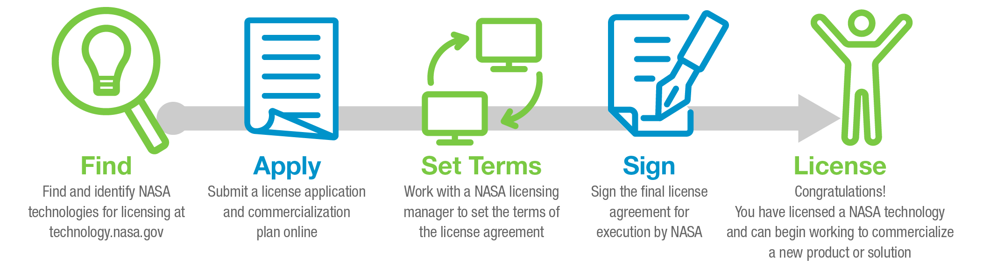
How to License NASA Technology
Evaluation License – “Test drive” the commercial viability of NASA technologies with minimal risk
License patented technologies with favorable terms for startups and universities
Government Use License – Leverage NASA technologies for government-funded projects
Commercial License – Secure rights to make and sell products based on NASA technologies

Slide 24
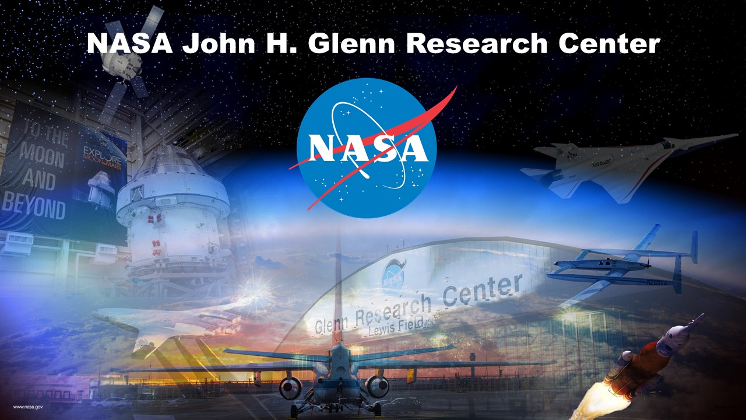
thomas.m.doehne@NASA.gov

