Slide 1
Talent Pipeline Program
Ken “Joey” Pettit, PMP, LSSBB
Pittsburgh Flag Network Coach
Data Analyst
kpettit@tmgva.com
757-262-8564
Date: October 6, 2023

Slide 2
OBJECTIVES
Share
The urgent need for Columbia and other Navy/DoD programs, and the manufacturing workforce challenges facing America
Educate
On the Talent Pipeline Program, how it works, and what you get/give
Discuss
Are you interested in participating as an Employer, Pipeline, or Facilitator Partner?

Slide 3
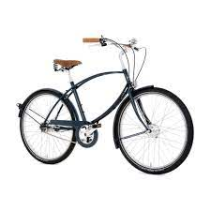
US MANUFACTURING PRE-WW2
Prior to the start of what would become WW2, US manufacturing was primarily focused on cars, small appliances, and children’s toys.
The perceived inability of the US to manufacture arms and munitions were contributing factors to Germany’s assessment that the US would not enter the conflict.
BGEN PATTON
Notes:
In the summer of 1939, just weeks before Germany invaded Poland, then Brigadier General George Patton took command of a US tank unit with 325 tanks that needed a specific nut/bolt combination to keep them working. Patton tried to order the parts through the standard channels without success. In the end, he ordered them from Sears Roebuck and paid for them out of his own pocket.

Slide 4
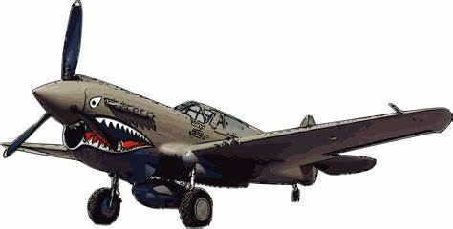
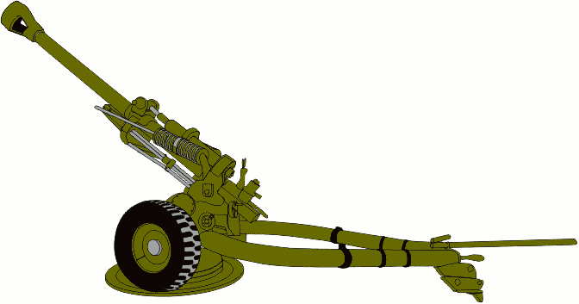
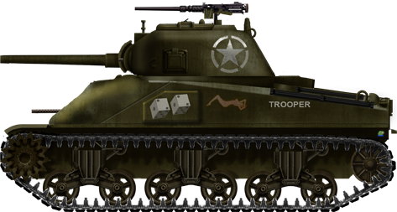
US MANUFACTURING IN WW2

Slide 5
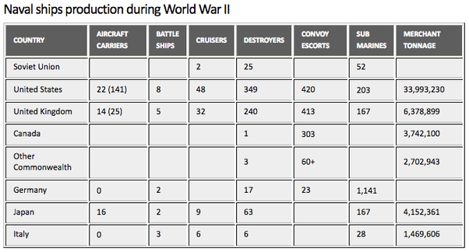
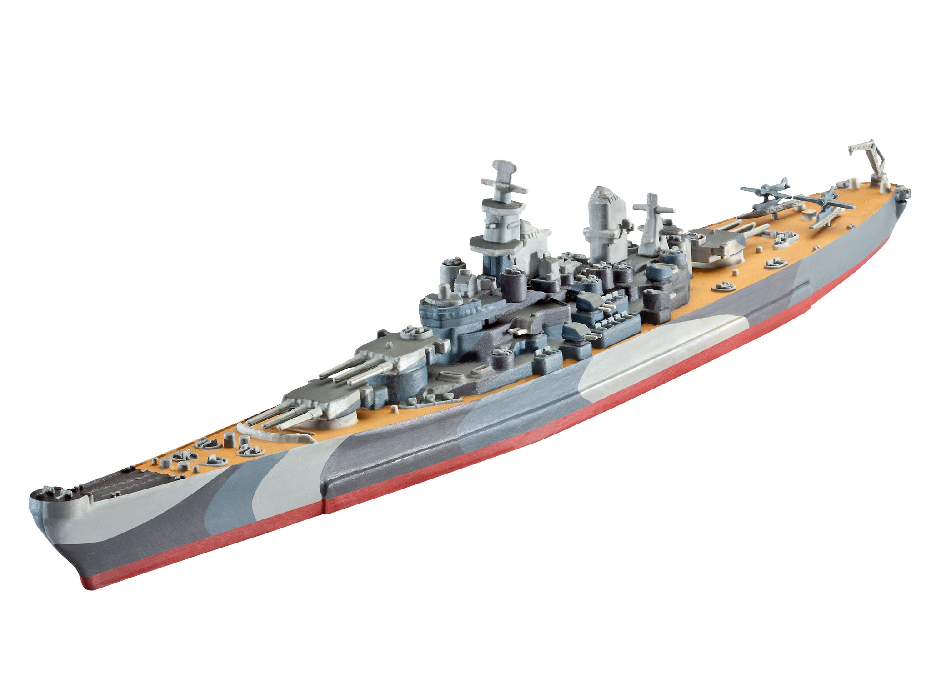
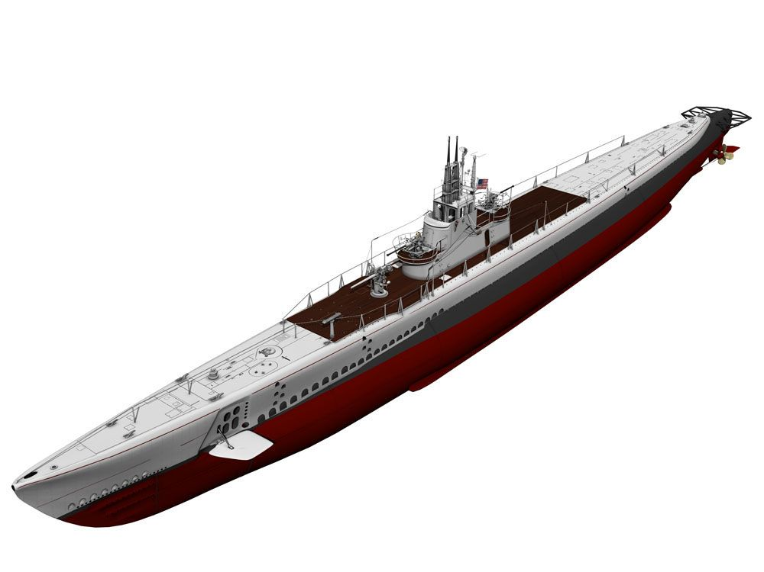
US MANUFACTURING IN WW2

Slide 6
US MANUFACTURING POST-WW2
1950 | 1960 | 1970 | 1980 | 1990 | 2000 | 2010 | 2020
Cold War | Korea | Space Race | Vietnam |  |  |  | Peace Dividend Tech Boom | GWOT |  | Rising China
Starting in the 1990s we began to see fewer numbers of Manufactures overall, and fewer in Defense Industrial Base
Today, roughly 720,000 manufacturers in US
In 1985, about 30% of manufacturing capacity was connected to the Defense Industrial Base, today that capacity is barely 10%
Notes:
After years of rationing, American’s were ready to spend
Massive conversion from Military to Consumer manufacturing as the focus
Cold war kept focus on Defense Industrial Base
This stayed constant through mid-90’s
The Cold War “Peace Dividend” shifted focus – enter High Tech
2000’s focus on Defense Industrial Base to support war efforts in Iraq and Afghanistan
Began to see fewer and few numbers of Manufactures overall, and fewer in Defense Industrial Base
Today, roughly 720,000 manufacturers in US
In 1985, about 30% of manufacturing capacity was connected to the Defense Industrial Base, today that capacity is barely 10%

Slide 7
THE RESPONSIBILITY
To defend the Nation and deter America’s adversaries, the DoD has the responsibility to ensure that the Nation is prepared to—with all possible speed—manufacture and deliver defense platforms and weapons systems to the armed forces.
Meeting that mission requires a healthy Defense Industrial Base built on resilient, diverse, and secure supply chains.
A vibrant manufacturing workforce enables significant resilience throughout supply chains.
COLUMBIA CLASS
Source: DoD Action Plan in response to EO 14017, America’s Supply Chains
Notes:
Persistent and Growing Workforce Gaps. In U.S. manufacturing, the gap between open positions and available workers is not expected to close, with an “estimated 2.1 million unfilled jobs by 2030”64 and a 2030 deficit of 383,000 highly skilled workers—over 10 percent of the highly skilled workforce. 65 Defense manufacturing will be competing with all industrial sectors for increasingly scarce workers.
Reduced Recruitment and Retention. In the past, manufacturing provided middle income jobs that supported local economies and provided stability to American families. This is no longer the case across all manufacturing skill levels. Wage growth depends on worker productivity growth, which depends on capital investments to adopt advanced manufacturing technologies and processes. U.S. worker productivity growth from 2010 to 2020 fell below 1 percent
Erosion of Skilled Manufacturing Workforce Development Pipelines. The increased employment opportunities in other sectors and the dwindling entry-level population continue the long-term erosion of the career and technical education (CTE) pipeline
Lack of Visibility into Manufacturing Workforce Supply and Demand. Sufficiently representative and detailed data are not yet available to understand and assess changing DIB workforce needs.

Slide 9
Program High-Level Summary
Submarine based strategic deterrence is the most survivable leg of the Nuclear Triad
COLUMBIA Class is the #1 Navy acquisition priority that must deliver on time; no further margin for delay without impacting strategic requirements
Executing full rate construction and ongoing design efforts
Design progress exceeded 83% design maturity at construction start
Construction is ongoing on all six super modules
Integrated Enterprise Plan supporting critical manpower, facilities, and supplier needs → supplier base remains top risk and is being proactively managed
Program issues are being aggressively acted upon
Continuing to drive costs and affordability

Slide 10
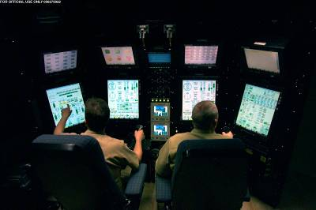
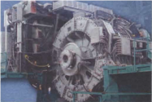
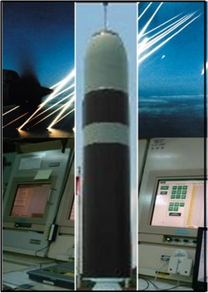
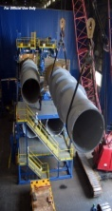
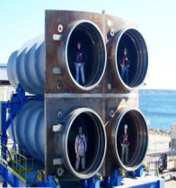
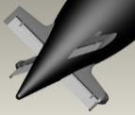
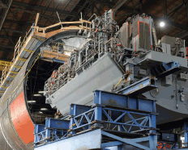
COLUMBIA Class Program A Holistic Plan to Deliver SBSD: “Aligned Execution of Multiple Discrete Elements”
Propulsor
Modular Construction
Updateable Electronics Systems
Electric Drive
Extended Service Life
Integrated Tube / Hull Construction
U.S. – UK
Common Missile Compartment
X-Stern Configuration
Strategic
Weapons
System (D5-LE)
Life of Ship Reactor Core
Survivability,
Essential Stealth
Improved Availability
SSBN Design
Coordinated Approach is Necessary to Provide a Credible and Affordable
Strategic Deterrent Capability NLT 1st Quarter FY 2031

Slide 11
COLUMBIA (CLB) Class Submarine - By The Numbers
Notes:
https://www.google.com/url?sa=i&url=https%3A%2F%2Fwww.nationaldefensemagazine.org%2Farticles%2F2020%2F1%2F31%2Fmilitary-facing-tight-deadlines-to-modernize-nuclear-triad&psig=AOvVaw3ZGr6MofoyARnoayRaKXv1&ust=1615395609749000&source=images&cd=vfe&ved=2ahUKEwj4jpnd16PvAhXM654KHZlfD18Qr4kDegUIARC8AQ
Program Initiation to Last CLB Delivered 2008-2042 = 34 years
Program Initiation to Decommissioning 2008-2084 = 76 years
Each military person symbol represents 10 people
2008-2022 = 5 PMs
2022-2084 = 62 years
62 years / 3 years = 20 PMs -> 25 PMs TOTAL
Each person symbol represents 25 people
Each $ symbol represents $10B dollars

Slide 12
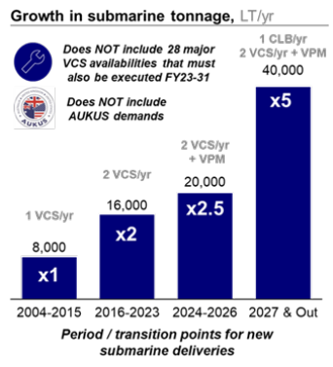
DEMAND
Submarine fleet’s largest recapitalization in 50 years
Current State
25-year post-Cold War atrophy
American manufacturing and shipbuilding capacity reduced 60%
Virginia Class current production rate 1.2 – 1.3 per year
Requirement
No Later Than 2028
1 Columbia class + 2 Virginia Class per year
1 Columbia = 2.5 Virginia effort and tonnage
Virginia Payload Module retrofit = 1.25 Virginia effort and tonnage

Slide 13
THE CHALLENGE
Persistent and Growing Workforce Gaps
In U.S. manufacturing, the gap between open positions and available workers is not expected to close, with an “estimated 2.1 million unfilled jobs by 2030” and a 2030 deficit of 383,000 highly skilled workers—over 10 percent of the highly skilled workforce.
Defense manufacturing will be competing with all industrial sectors for increasingly scarce workers.
Reduced Recruitment and Retention
In the past, manufacturing provided middle income jobs that supported local economies and provided stability to American families. This is no longer the case across all manufacturing skill levels.
Wage growth depends on worker productivity growth, which depends on capital investments to adopt advanced manufacturing technologies and processes.
U.S. worker productivity growth from 2010 to 2020 fell below 1 percent

Slide 14
THE CHALLENGE
Erosion of Skilled Manufacturing Workforce Development Pipelines
Dwindling entry-level population continue the long-term erosion of the career and technical education (CTE) pipelines.
The increased employment opportunities in other sectors.
Lack of Visibility into Manufacturing Workforce Supply and Demand
Sufficiently representative and detailed data are not yet available to understand and assess changing DIB workforce needs.
Notes:
AI Engineer
Driverless Car Engineer
Mobile App Developer
Podcast Producer
Uber Driver

Slide 15
Estimate | Jul-22 | Apr-23 | May-23 | Jun-23 | July 2023(p)
Openings | 441 | 393 | 372 | 351 | 321
Hires | 230 | 222 | 214 | 200 | 189
Total separations | 218 | 229 | 211 | 200 | 195
Quits | 121 | 126 | 141 | 132 | 132
Layoffs & discharges | 86 | 85 | 57 | 56 | 53
Footnotes: (p) Preliminary (in thousands) Ohio Job Openings and Labor Turnover — July 2023 : Midwest Information Office : U.S. Bureau of Labor Statistics (bls.gov)
Hired 1055 New Teammates
Lost 1053

Slide 16
Talent Pipeline Program
Executive Overview

Slide 17
OUR MISSION
The Talent Pipeline Program TEAM will energize and engage the AMERICAN economy by creating and sustaining maritime and defense industrial base focused talent pipelines that enable EMPLOYERS to re-capitalize their workforce through recruiting, hiring, training, and retaining skilled workforce members with critical trade skills for 1-year as productive and engaged new employees.
Employers
Facilitators
Pipelines

Slide 18
CORE METRIC OUTCOME
# of EMPLOYERS with a reliable year over year Talent Acquisition and Retention Pipelines to run a better business and increase defense industrial capacity.

Slide 19
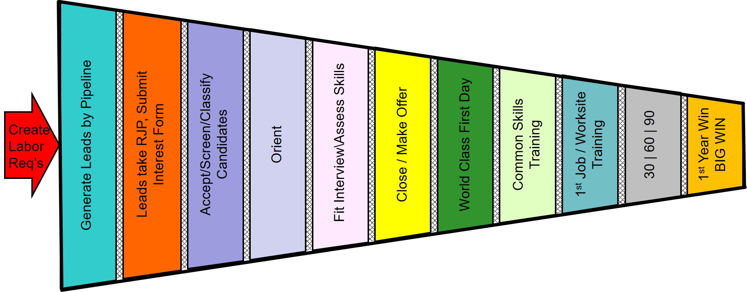
Best Practice Model Talent Acquisition and Retention System
Perfect Process: 1 Recruit = 1 Life Long Engaged and Productive Teammate
HIRE FOR FIT – TRAIN FOR SKILL
Pre-1st Day – HR Lead
Post Hire – Operations Lead
Recruiting
Hiring
On-Boarding
1st Year Retention
DEMAND DRIVEN
Pipelines |  | Tools
1. CTE Programs (HS & CC) 2. Employee Referral Program 3. ATDM 4. Adult Education 5. Temp Agencies 6. Social Media | 7. Recruiting Agencies 8. Military & Veterans 9. Employment Commissions 10. College Departures 11. Recovered/Returns 12. Retiree’s | 1. TA&R Value Stream Mapping and Performance Improvement Plan Development 2. Realistic Job Preview & Candidate Tracking System 3. Recruiting Training 4. Recruiting & Offer Day/New Hire Orientation 5. Behavioral Based “Fit” Interviews | 6. World Class First Day 7. Common Skills Training 8. Leader New Hire Retention Training 9. 30-60-90 day & 1 Year Fit/Skills Assessment 10. 5th Metric “People” Scorecard Data Driven Program Management System

Slide 20
Philly Cohort 1 (‘21-’23) – Retention Data
Total Employers at 12/1/21 | 36
Deferred | 4
Withdrew | 1
Without Accepted Offers | 2
With Accepted Offers | 29
# Accepted Offers | 267
# Started | 259
# Retained | 165
# Departed | 95
Overall Retention Rate | 64%
Employers with New Hire Starts | 29
Employer Performance
100% Retention | 14
Lost 1 | 4
Normal Data Variation | 11
Appears to be Abnormal Data Variation & In Discussions | 0
Total | 29
Ave Days to Departure: 150
# Reached 1 Year: 164*
(* 1 person has not yet reached 1 year)

Slide 21
PITTSBURGH FLAG SCORECARD
EMPLOYERS
Goal: 30 | Actual: 32 | Deferred: 4 | Actual: 28
Demand Signal: 330
VSMA Complete: 27
Pipeline Visits |  | 94
Offers |  | 436
Hires |  | 372
Started First Day |  | 371
Departures |  | 98
Ave Days to Departure: 82.6
# Reached 1 Year: 11
(Additions locked 30 Jun 23)
as of 10/4/23

Slide 22
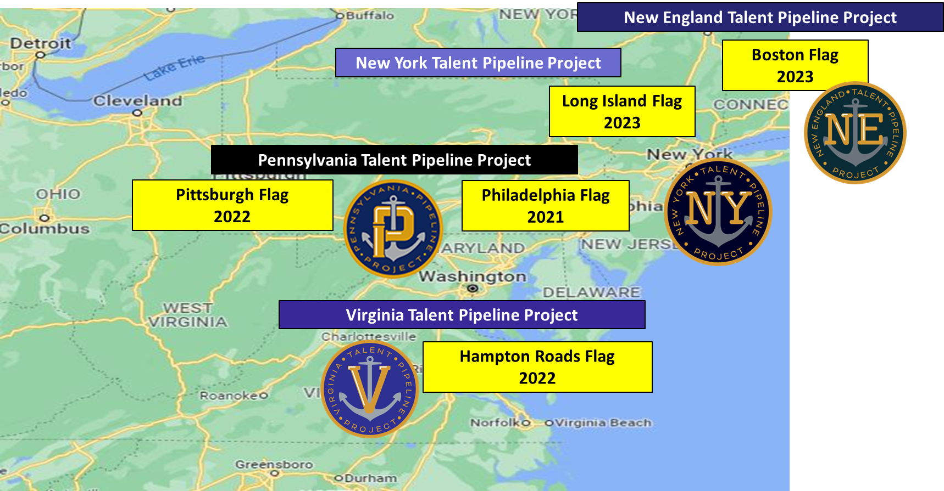
Talent Pipeline Program

Slide 23
OUR TARGET AUDIENCE
COLUMBIA CRITICAL SUPPLIERS
COLUMBIA/VCS ALL OTHER SUPPLIERS
DEFENSE INDUSTRIAL BASE SUPPLIERS AND OTHER TIER 2/TIER 3 SUPPLIERS

Slide 24
EMPLOYERS WE SUPPORT
Small
Single Site
Under 50 people
Hires ~ 10 people/year
Hires on an as-needed basis
No HR- Office Manager;
Little formal New Hire Training
Medium
Single Site
Between 51 – 300 people
Hires 10 – 50 people/year
Episodically hires as needed
1-2 HR Staff; Some New Hire Training
Large
Single Site or Multiple Sites
Between 301 – 1,000 people
Hires 51 – 200 people/year
Has a consistent/predictable Annual Hiring and Retention Forecast (monthly)
HR plus Recruiter; New Hire Training on a case-by-case basis
Enterprise
Single or Multiple Sites
Over 1,000 people
Hires over 200 people/year
Has a consistent/predictable Annual Hiring and Retention Forecast (monthly)
HR, Recruiters; Formal New Hire Training and Support
~65%
of capacity

Slide 25
PITTSBURGH FLAG ECO:SYSTEM
28 Employer Partners
+250 potential
17 Pipeline Partners
Unknown Potential
16 Facilitator Partners
Notes:
91 SIB Suppliers $1.8B

Slide 26
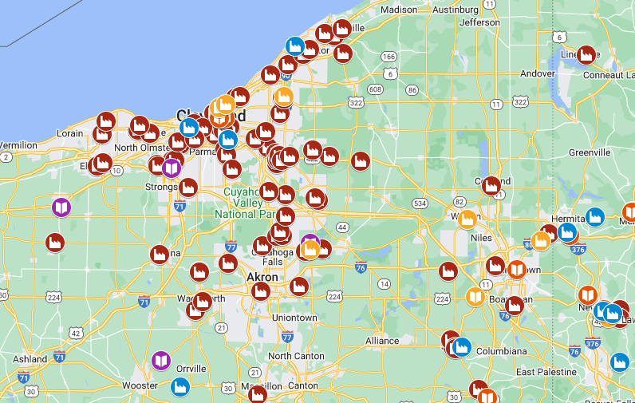
NE OHIO ECO:SYSTEM POTENTIAL
8 CRITICAL SUPPLIERS
85+ SUPPLIERS

Slide 27
EMPLOYER QUALIFYING CRITERIA
Do you have a Hiring Demand for Summer 2024?
Are High School/Community College CTE completers part of your Talent Acquisition and Retention Pipeline Strategy?
Do you offer Full Time Employment with benefits?
Do you accept responsibility to ensure the New Hires are productive and trained to meet your specific job requirements?
Are you willing to substantively begin your Talent Acquisition and Retention system during a High School student’s CTE program?
Will you allow Talent Pipeline Project Program Management access to New Hire 1st Year performance information?

Slide 28
PIPELINE QUALIFYING CRITERIA
Do you have a Critical Shipbuilding Skills Curriculum with students?
Is interacting with Employers to provide work opportunities part of your mission/charter?
Will you allow for substantive engagement with Employers to allow recruiting, hiring, and on-boarding activities during the school day?
Will you pre-screen students to develop a Candidate Pool of those desiring to enter the workforce upon graduation/ completion?
Will you support candidate preparation for the Hiring Process and engagement with Employers?
Are you willing to make adjustments to your curriculum to meet employers new hire requirements?
Will you allow Talent Pipeline Project Program Management access to Student/Candidate performance information?

Slide 29
FACILITATOR QUALIFYING CRITERIA
Will you identify and advocate to your constituent employers to the Program Management Team to participate in the Pipeline?
Will you allow for Pipeline Project access during your normal communications and events to share and communicate?
Program Wide Facilitators
NDIA, SIBC, ACIBC, Marine Machining Association, Shipbuilders Council of America
General Dynamics-Electric Boat, Newport News Shipbuilding
Notes:
Rie

Slide 30
PARTNER SUPPORT SERVICES
Employer
Training
Support
Improved
Tools
Coaching
Keep Score
Employers
Facilitators
Pipelines

Slide 31
PITTSBURGH FLAG MILESTONES
August 9, 2023 | Pennsylvania Talent Pipeline Program: Pittsburgh Flag Partner Orientation and Networking Conference
September 26, 2023 | Pennsylvania Talent Pipeline Program: Pittsburgh Flag Team Kick-off
December 1, 2023 | Pennsylvania Talent Pipeline Program: Pittsburgh Flag Cohort 2023-2025, New Partner Cutoff Date
January 25, 2024 | Pennsylvania Talent Pipeline Program: Pittsburgh Flag Mid-Year Team Update and Sharing
May 14, 2024 | Pennsylvania Talent Pipeline Program: Pittsburgh Flag Signing Day Ceremony and New Hire 1 Year Anniversary Celebration, at the Carnegie Science Center
June 30, 2024 | Pennsylvania Talent Pipeline Program: Pittsburgh Flag Reporting data for Cohort 2 freeze
July 1, 2023 | Pennsylvania Talent Pipeline Program: Pittsburgh Flag Employers continue or start reporting data START DATE and RETENTION DATA
July 13, 2023 | Pennsylvania Talent Pipeline Program: Pittsburgh Flag Cohort 2024 – 2026 Partner Orientation and Networking Event

Slide 32
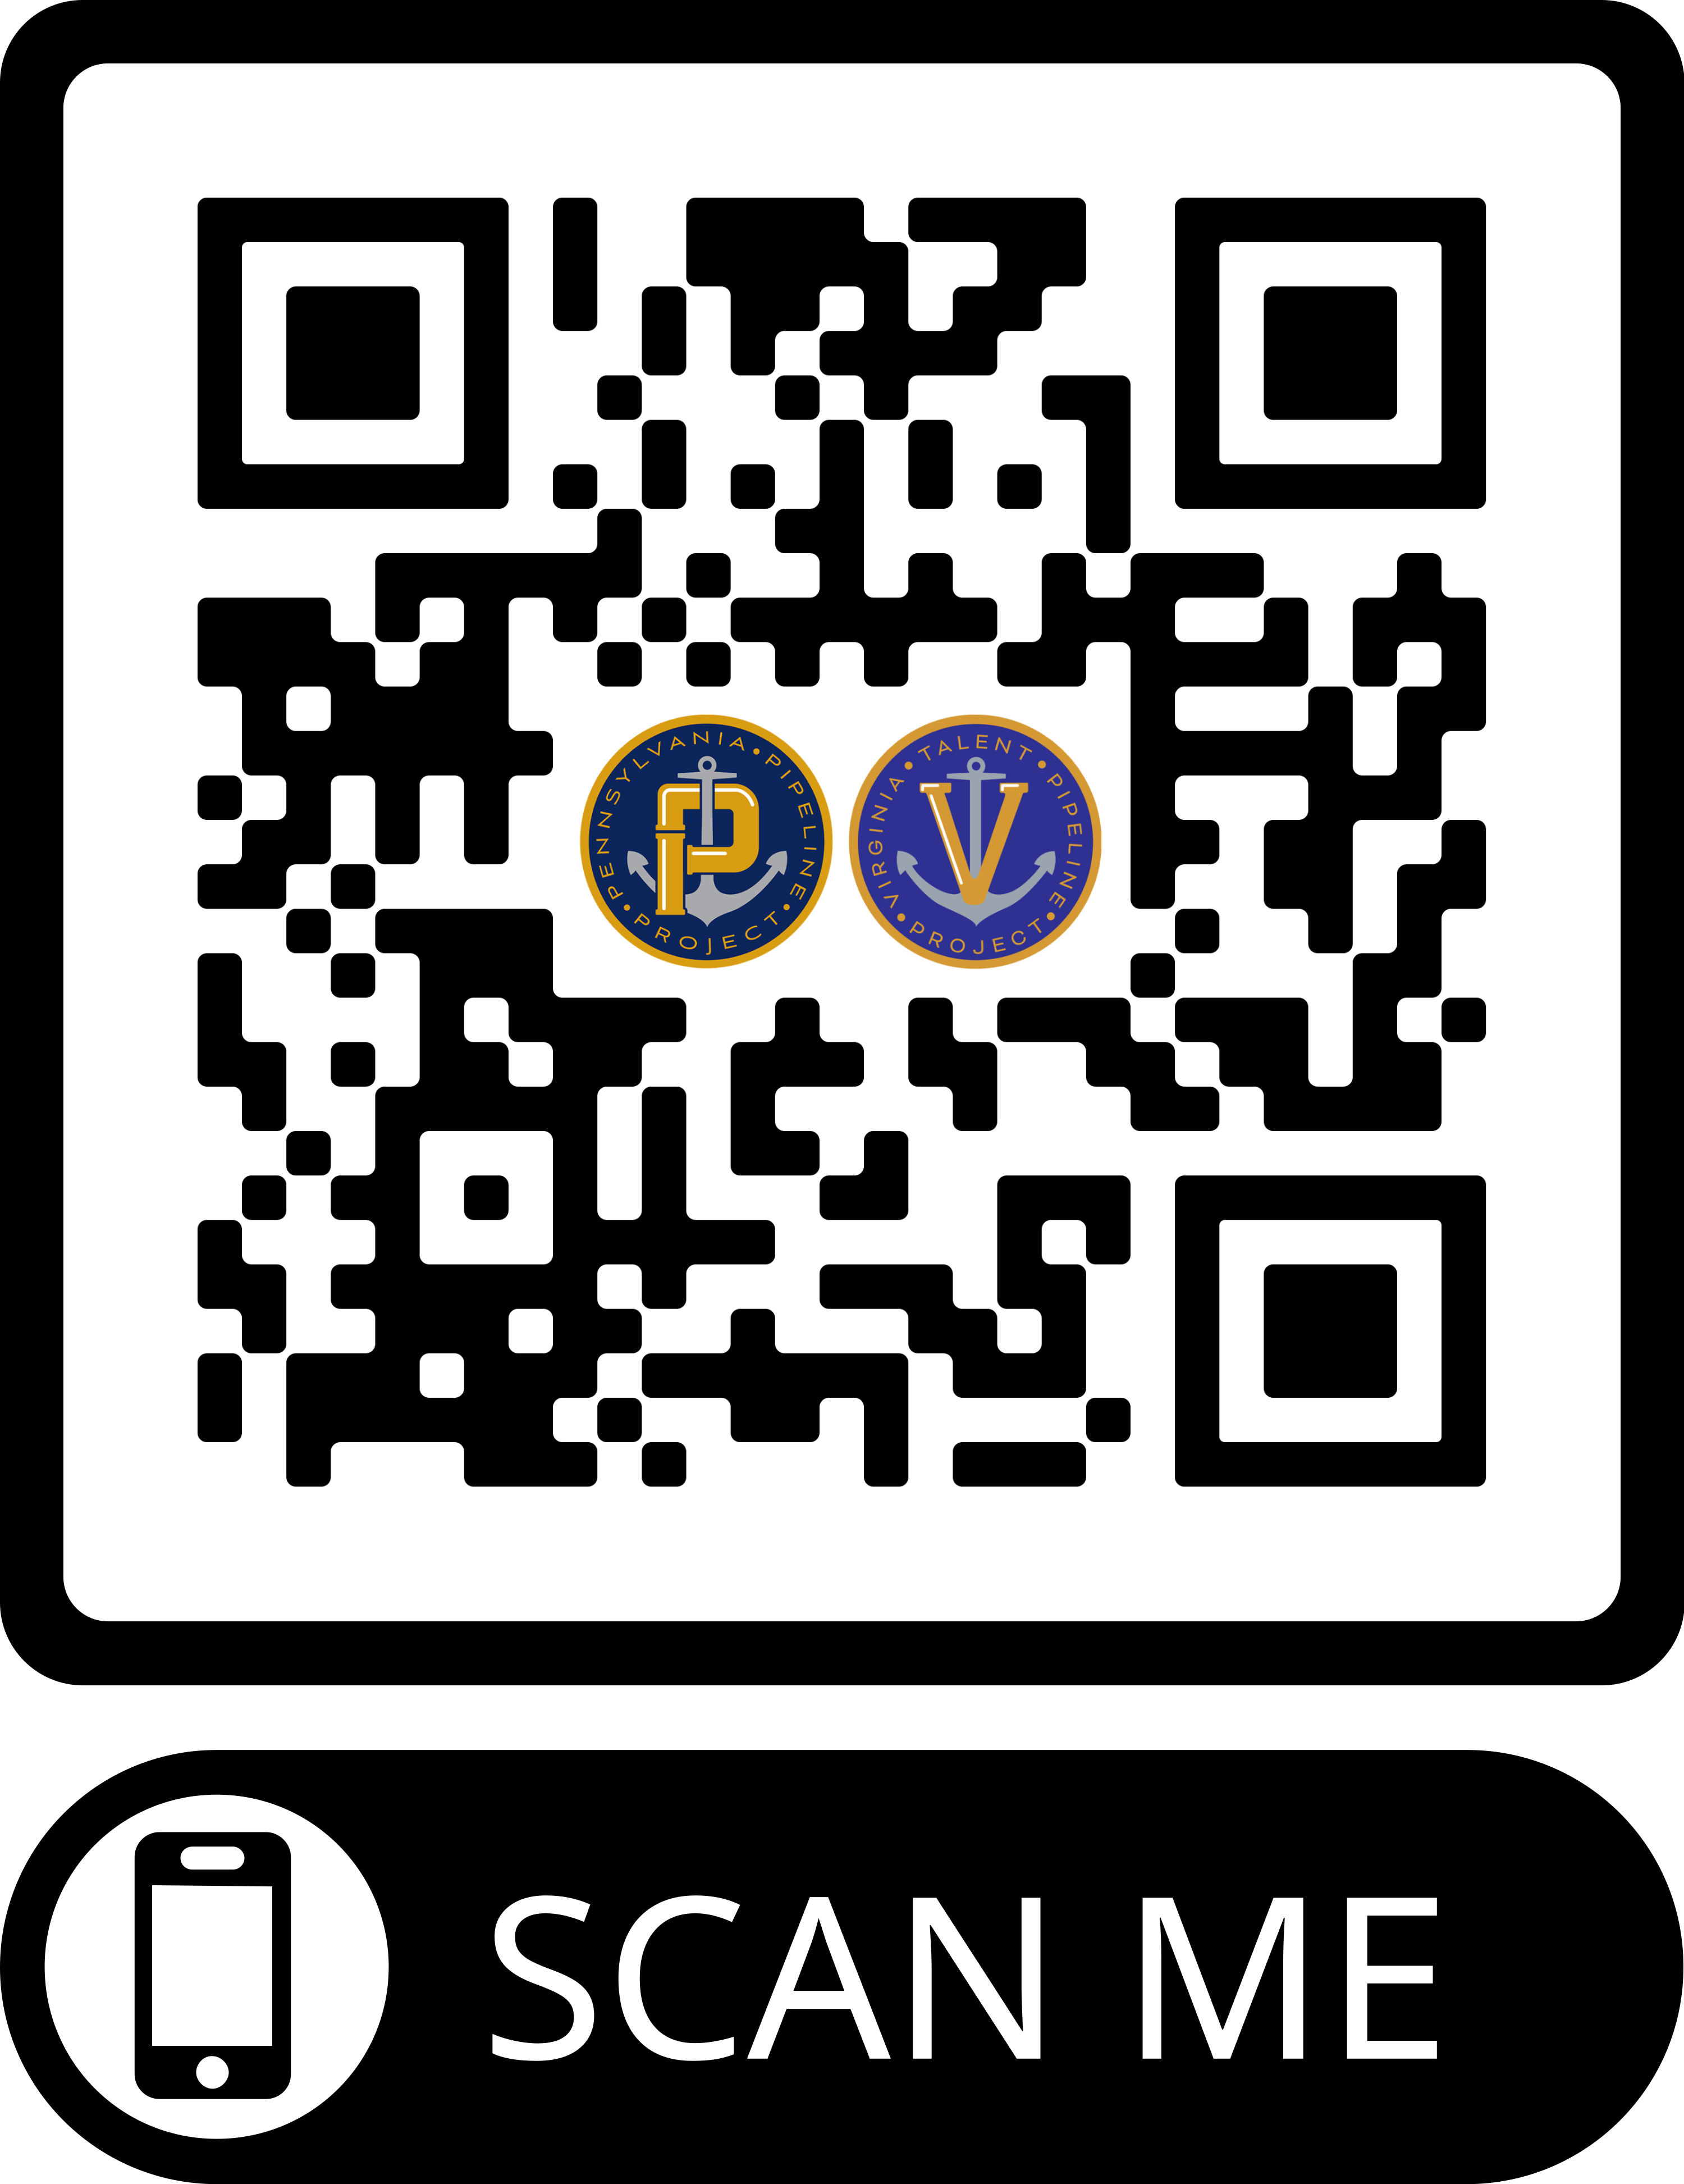
NEXT STEPS
Take the Program Preview
www.realisticjobpreview.com/mast
Based on increased EMPLOYER demand interest in NE Ohio, we will determine how we can best support
When we work out the details, we will then…
Set up a F2F meeting with you over the next few months to:
Plant Tour
Value Stream Mapping Activity + Perf. Improvement Plan = TAR Improvement
Establish 2023-2024 hiring demand estimate
Identify POC (HR + OPS required)

Slide 33
Questions, Comments, Concerns?

Slide 34
Core Outcome Metric
# of EMPLOYERS with a reliable year over year Talent Acquisition and Retention Pipelines to run a better business and increase defense industrial capacity.

Slide 35
WE are on a Mission!
1 Employer
1 Job
1 Lifelong, Productive,
Engaged Teammate at a Time

Slide 36
TALENT PIPELINE PROGRAM
For more information on the program scan the QR code to view the
Program Preview.

Slide 38
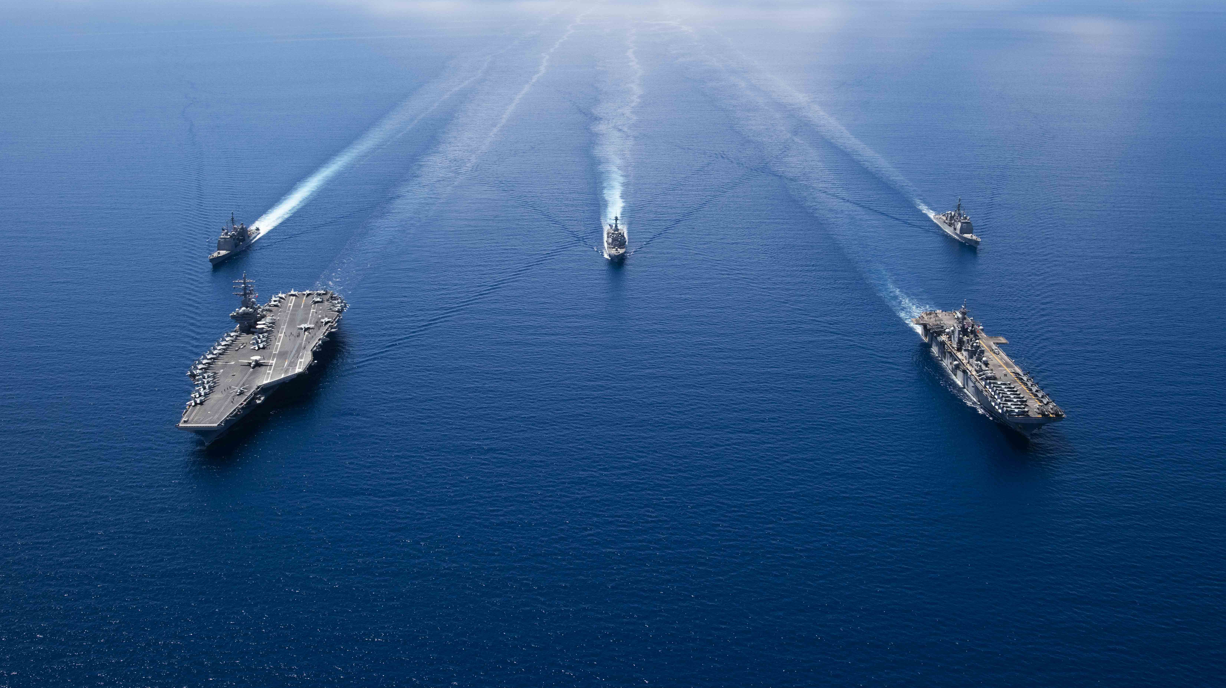
DEPARTMENT OF THE NAVY
Small Business Innovation Research (SBIR)
Small Business Technology Transfer (STTR)
6 October 2023
NAVY SBIR/STTR programs provide opportunities for domestic small businesses and start-ups to deliver solutions to meet naval needs through Federal Research/Research and Development (R/R&D). These competitive, three phase, awards-based programs advance innovations with an aim toward transitioning the resulting technologies to the Force/Fleet and commercialization in private markets.

Slide 39
Welcome
Robert Smith
DON SBIR/STTR Program Manager
Robert.L.Smith42.civ@us.navy.mil
DISTRIBUTION STATEMENT A. Approved for public release: distribution unlimited.

Slide 40
Authorities
United States Code
15 U.S. Code § 638. Research and development
https://www.govinfo.gov/content/pkg/USCODE-2011-title15/pdf/USCODE-2011-title15-chap14A-sec638.pdf
SBIR/STTR Policy Directive
Provides guidance from SBA to the participating Federal agencies for the general operation of the SBIR and STTR programs.
https://www.sbir.gov/about/about-sbir
DISTRIBUTION STATEMENT A. Approved for public release: distribution unlimited.

Slide 41
Federal SBIR/STTR Org Chart
SBA
DoD
HHS
NASA
DOE
NSF
USDA
EPA
DHS
ED
DOC
DOT
Army
Navy
Air Force
MDA
DARPA
OSD
DHA
SOCOM
CBD
DTRA
DLA
DMEA
NGA
NAVAIR
Kristi DePriest
NAVSEA Jason Schroepfer
ONR
Lore-Anne Ponirakis
NAVWAR Shadi Azoum
SSP
Mike
Pyryt
NAVSUP Chris Espenshade
DON STTR
Steve Sullivan
MCSC
Jeff Kent
NAVFAC
Tim Petro
DISTRIBUTION STATEMENT A. Approved for public release: distribution unlimited.

Slide 42
Federal SBIR/STTR Program Goals
Small Business Innovation Research (SBIR) Program
Program Goals
Stimulate technological innovation
Increase small business participation in federally funded R&D
Foster participation by socially and economically disadvantaged firms in technological innovation
Increase private sector commercialization of federal R&D
11 Federal agencies and 13 DoD components participate
Small Business Technology Transfer (STTR) Program
Program Goals
Create vehicles for moving ideas from research institutions to market
Enable researchers to pursue commercial application of technologies
Bridge funding gap between basic research and commercial product
5 Federal Agencies and 7 DoD Components Participate
DISTRIBUTION STATEMENT A. Approved for public release: distribution unlimited.

Slide 43
Differences between SBIR and STTR
 | SBIR | STTR
Partnering Requirement | Permits partnering | Requires a non-profit research institution partner
Principal Investigator | Primary employment (>50%) must be with the small business | PI may be employed by either the research institution partner or small business
Work Requirement | May subcontract up to: 33% (Phase I) 50% (Phase II) | Minimum: 40% Small Business 30% Research Institution Partner
Program Size | 3.2% | 0.45%
Majority VC Ownership | Allowed by some agencies | Not allowed
Participating Agencies | 11 Agencies (extramural R&D budget >$100M) | 5 Agencies (extramural R&D budget > $1B)
The small business is ALWAYS the applicant and awardee.
DISTRIBUTION STATEMENT A. Approved for public release: distribution unlimited.

Slide 44
Delivering Innovation to the Warfighters*
Naval Research
Enterprise Needs
Feasibility
Study (Phase I)
Commercialization
(Phase III)
National Defense Strategy, Acquisition, Sustainment,
Modernization
Scientific or technical
merit of an idea
Sales to defense and private sector markets
1,859 Proposals
242 Awards
138 Topics
386 Awards
$1.1B
Innovative
Proposals
Technology
Development (Phase II)
Start-ups and Small Businesses
Build and test prototypes
*FY22 Data
DISTRIBUTION STATEMENT A. Approved for public release: distribution unlimited.

Slide 45
When to Participate DoD FY23 BAA Schedule*
Program | Pre-Release | Open | Close
DoD SBIR/STTR 23.2/B | 4/19/2023 | 5/17/2023 | 6/14/2023
DoD SBIR/STTR 23.3/C | 8/23/2023 | 9/20/2023 | 10/18/2023
DoD SBIR/STTR 23.4/D | 6/15/2023 | 7/13/2023 | 8/15/2023
DoD SBIR/STTR 24.1/A | 11/29/2023 | 1/03/2024 | 2/07/2024
*Dates subject to change
DISTRIBUTION STATEMENT A. Approved for public release: distribution unlimited.

Slide 46
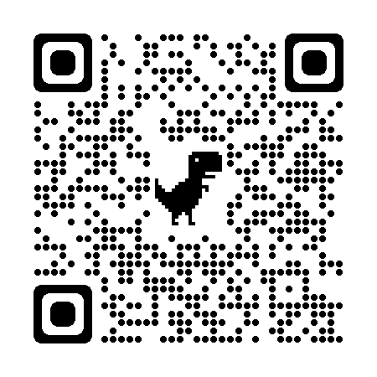
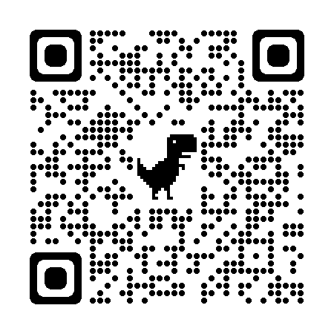
How to Participate
Determine eligibility
https://www.sbir.gov/faqs/eligibility-requirements
1
Research topics consistent with your business strategies
https://www.dodsbirsttr.mil/submissions/login
2
Read and understand the DoD Broad Agency Announcement (BAA) and Component-specific (e.g. Navy) BAA instructions https://www.dodsbirsttr.mil/submissions/login
3
Use templates as instructed by BAA and submit a proposal that meets the stated need of the topic https://www.dodsbirsttr.mil/submissions/login
Navy-specific templates https://www.navysbir.com/links_forms.htm
4
DISTRIBUTION STATEMENT A. Approved for public release: distribution unlimited.

Slide 47
OUSD(R&E) Critical Technology Areas
FutureG
Trusted AI and Autonomy
Biotechnology
Advanced Computing and Software
Integrated Sensing and Cyber
Directed Energy (DE)
Hypersonics
Microelectronics
Integrated Network Systems-of-Systems
Quantum Science
Space Technology
Renewable Energy Generation and Storage
Advanced Materials
Human-Machine Interfaces
DISTRIBUTION STATEMENT A. Approved for public release: distribution unlimited.

Slide 48
Navy Needs. . . TOPICS
Focused Topic
Open Topic
Seeking innovative solutions to specific Naval needs
Phase I approach to proving feasibility of an innovative solution
Phase II is the development and testing of prototype
Seeking commercial solutions to meet mission critical Naval needs
Phase I approach to adapting commercial solution
Phase II will develop a functional prototype and transition plan (production and fielding)
Topics are Developed by the Government, not industry
DISTRIBUTION STATEMENT A. Approved for public release: distribution unlimited.

Slide 49
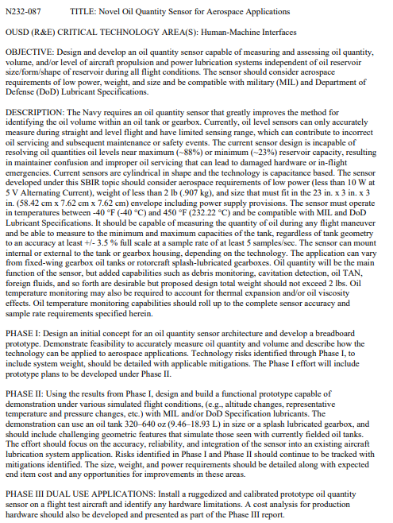
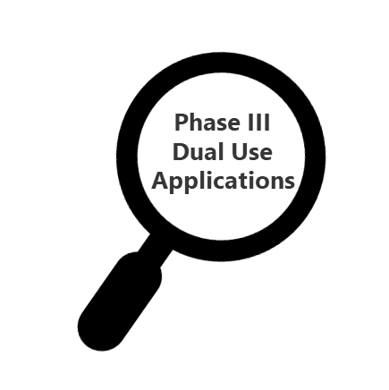
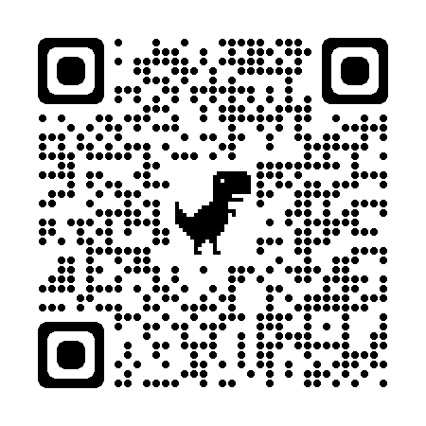
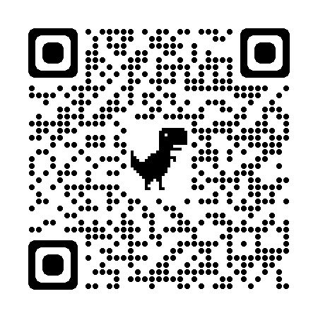
Topic Search
Navy Topics
Tied to acquisition, modernization, and sustainment programs
Identify specific Naval needs
Defined transition targets
https://www.defensesbirsttr.mil/SBIR-STTR/Opportunities/
sbir.gov/solicitations/open
DISTRIBUTION STATEMENT A. Approved for public release: distribution unlimited.

Slide 50
About Our Program
Accept proposals from firms who are majority-owned by venture capital operating companies, hedge funds or private equity firms
Navy-specific Phase I instructions are provided in each DoD BAA
Guidelines for proposal preparation
Proposal template (10-page limit) (available at navysbir.com)
Template for Supplemental information (available at navysbir.com)
Topics: Objective and descriptions for Phase I and II; Phase III Dual Use Applications
Phase I/II evaluation criteria: technical merit, personnel, and commercialization potential
Phase I NTE $240K and 12 months
Phase II NTE $1.8M and 18-24 months
DISTRIBUTION STATEMENT A. Approved for public release: distribution unlimited.

Slide 51
About Our Program
Navy usually makes 3 Phase I awards per topic
All Phase I awardees compete for Phase II at the end of Phase I
Two-Step Phase II competitive process:
Step One - Initial Phase II Proposal
Submitted at end of Phase I Base
Due date and submission requirements in Phase I contract
Instructions and a template at https://navysbir.com/links_forms.htm
Same evaluation criteria as Phase I
Step Two - Full Phase II Proposal
If selected, notified to submit a full Phase II proposal
SYSCOM-specific full Phase II proposal instructions/templates
Submission of a full Phase II proposal does not guarantee Phase II award
DISTRIBUTION STATEMENT A. Approved for public release: distribution unlimited.

Slide 52
Support During Phase II – Unique to Navy
SBIR/STTR Transition Program (STP) 23 years strong!
Annual 11-month Navy-funded Program for Phase II awardees
Services to assist with transition of technologies through business mentoring, education, and networking
Information at NavySTP.com
DON SBIR/STTR Experimentation Cell (DON-SEC) 4 years young!
Connects SBIR innovators with the DON experimentation community to test innovative solutions
Full spectrum of end-to-end facilitation, mentoring, and training in all aspects of experimentation
Information at NavySBIR.com/SEC
NAVY Launch New!
10-month program to Educate + Accelerate + Scale beyond traditional defense markets; entrepreneur-first startup strategies
Prioritize markets, explore private funding, discover customers, and engage for new growth
Information at h4xlabs.com/NavyLaunch
Phase II
Support to firms to deliver solutions at scale
DISTRIBUTION STATEMENT A. Approved for public release: distribution unlimited.

Slide 53
Benefits of SBIR/STTR Programs
Introduction to government contracting
Small businesses retain intellectual property rights
Funding is stable, predictable and not a loan
Capital is non-dilutive
Awardees receive commercialization assistance at no charge
Any SBIR/STTR Phase I or Phase II funding agreement provides:
the right to sole source contracts;
exemption from SBA size standards for a procurement;
no limits on the dollar size of a Phase III procurement;
a right to the Phase III mandate, by which the SBIR firm has a right to be awarded a future Phase III award to the greatest extent practicable;
the right to receive subcontracts for Phase III work on a sole source basis;
and the ability to pursue research, research and development, services, products, production, or any combination of those under a Phase III.
DISTRIBUTION STATEMENT A. Approved for public release: distribution unlimited.

Slide 54
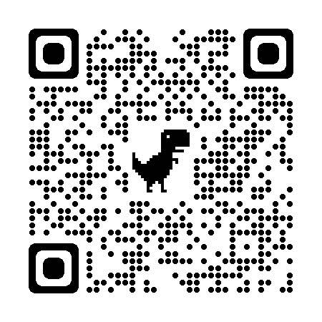
Stay in Touch
SBIR SOUNDINGS
Quarterly E-Newsletter
Email
navy-sbir-sttr@navy.mil
Subscribe to SBIR SOUNDINGS and receive updates delivered to your inbox every quarter!
Use the QR code to the left or the link below
http://eepurl.com/hv0ARX
Website
www.navysbir.com
Twitter
SBIR/STTR Transitions
Quarterly Newsletter
@donsbir
Read Transitions using the QR code to the left or the link below
https://navystp.com/transitions-newsletters/
LinkedIn
www.linkedin.com/company/donsbir
DISTRIBUTION STATEMENT A. Approved for public release: distribution unlimited.

