Slide 1
Department Chair Observation of Distance Learning Courses

Slide 2
A New Environment
You likely have experience observing faculty in a classroom.
How do you observe an online course?

Slide 3
What We’ll Look at Today
When observing, what should you look for?
Quick tour of an especially well designed Blackboard course.
Course evaluation rubrics used in Distance Ed:
Quality Matters
Internal YSU reviews

Slide 4
Getting In
To see the course, the instructor needs to add you.
There are various roles.
Course Builder is good for this purpose:
Allows you to see all content, even if not currently available to the student.
You could be added as Instructor ... but then students would see you listed as an instructor for the class.
Procedure for this may be worth discussing in your department.

Slide 5
Getting In
How do you get added to a course?
Instructors do the following in Blackboard …

Slide 6
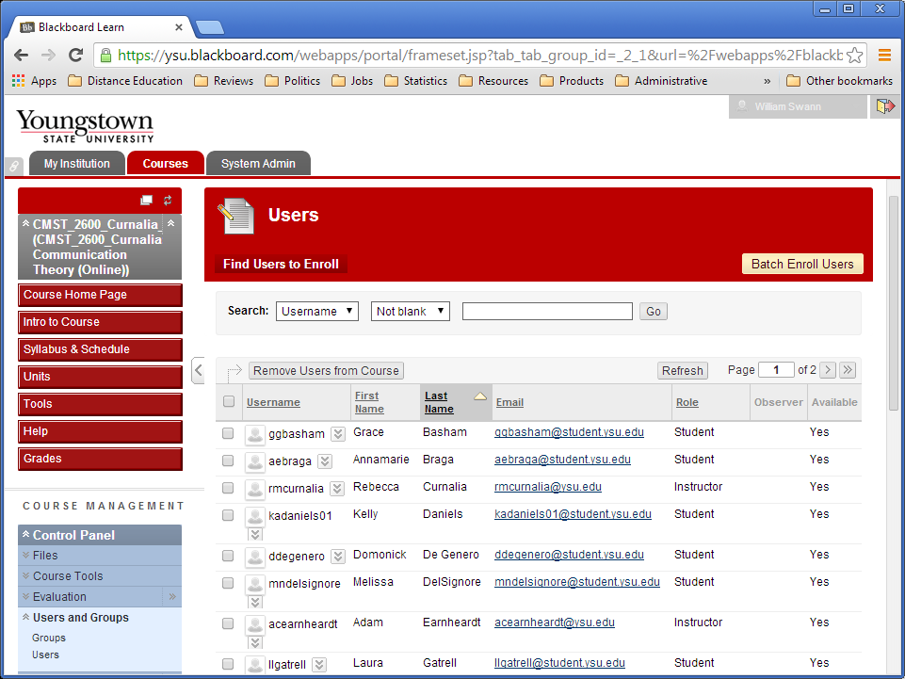

Slide 7
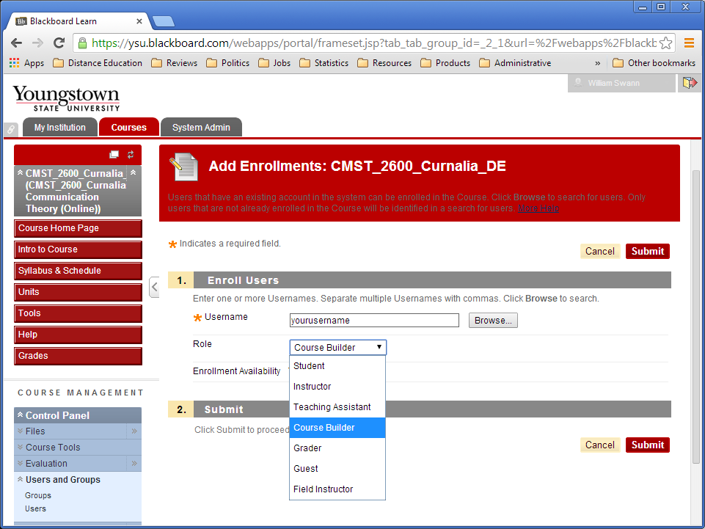

Slide 8
Getting In
Your username:
YSU email address minus the “@ysu.edu”
wswann@ysu.edu (email) translates to …
wswann (Blackboard ID)

Slide 9
Getting In
Once you’ve been added …
Log in to Blackboard: ysu.blackboard.com

Slide 10
Course Tour
Dr. Rebecca Curnalia, CMST 2600: Communication Theory.
Another course tour:
Dr. Stephanie Smith, ART 1541: Survey of Art History 1.
Linked from our Distance Education web page:
web.ysu.edu/de
Button: What’s it like to take an Online Class?
Interactive tour.

Slide 11
What’s it Like to Observe a DE Course?
You’re coming into an online environment.
Difference between this and observing in person:
Visiting a classroom, you see a limited piece of a course (one day, or maybe a few).
Online, you see most of it.
Everything except for whatever discussions or interactions haven’t happened yet.

Slide 12
This Means …
Observing online, you can’t look at everything.
There’s too much.
Look at a little content, some discussion, a couple assignments, etc.
It’s like you’re taking a sample of the course.
One strategy:
Sample a bit one day ... then come back the next.

Slide 13
What are You Looking For?
Broadly speaking:
Content items (convey the information):
Some variety:
Readings
Web resources
Audio or video lectures
Powerpoints
Video demonstrations
Some classes (Econ, Stats, and Business) do video demos of case studies in an Excel spreadsheet.

Slide 14
What are You Looking For?
Broadly speaking:
Content items (convey the information):
Some variety.
Quality:
Materials are substantive, have merit.
You know your discipline:
What are the excellent materials?
Are we channeling students towards them?

Slide 15
What are You Looking For?
Broadly speaking:
Content items (convey the information):
Some variety.
Quality.
Quantity:
Is it a full course?
Are they getting exposure to a substantial set of information? (corresponds with credit hours for the class)

Slide 16
A Closer Look at Variety
Broadly speaking:
Content items (convey the information):
Some variety.
Quality.
Quantity.

Slide 17
A Closer Look at Variety
Broadly speaking:
Content items (convey the information):
Some variety:
Some courses have narrower range of types of material, some broader.
Not always bad.
Example: Communications
Use a broad range of media.
Bread-and-butter of communications discipline.
Example: English
A discipline focused on reading and writing.

Slide 18
A Closer Look at Variety
So, on one hand, we never want to limit the range:
We have English classes use a lot of multimedia.
Can be a terrific enhancement to courses in any field.
But we don’t want to require really broad range for the more focused disciplines.

Slide 19
What are You Looking For?
Broadly speaking:
Content items.
Interactive items:
We want to interact a lot.
Give the course a lively, active feel, with a sense of personal connection.
Can be used to teach as well as to assess.

Slide 20
What are You Looking For?
Broadly speaking:
Content items.
Interactive items:
Frequency of use.
Some variety:
Discussions
Quizzes
Essays
Papers
Tests
Student presentations
Group work
Synchronous interaction? (video IM, Skype, Google Hangouts, Oovoo)

Slide 21
What are You Looking For?
Broadly speaking:
Content items.
Interactive items.
Clarity:
Structure is clear and consistent:
Sometimes content is strewn around course.
Not consistently laid out.
Content is clearly written, spoken, or displayed:
Written items clear, use good grammar.
Quality recordings of audio and/or video.

Slide 22
What are You Looking For?
Broadly speaking:
Content items.
Interactive items.
Clarity.
Learning Objectives & Alignment:
Important for instructor to define goals of class.
Can have objectives at course level and module level.
Course level required.
Alignment: The rest of the class (content, assignments) geared towards meeting those objectives.

Slide 23
Alignment – Closer Look
From the broadest perspective:
What you’re aiming for should line up with your content, assignments, and assessment.
You might be aiming for “lower” levels of knowledge (factual information, comprehension).

Slide 24
Alignment – Closer Look
From the broadest perspective:
What you’re aiming for should lime up with your content, assignments, and assessment.
You might be aiming for “lower” levels of knowledge (factual information, comprehension).
You might be aiming for “higher” levels of knowledge (application of concepts, analysis, synthesis).

Slide 25
Alignment – Closer Look
From the broadest perspective:
What you’re aiming for should line up with your content, assignments, and assessment.
You might be aiming for “lower” levels of knowledge (factual information, comprehension):
Readings
Lectures
Quizzes
Exams

Slide 26
Alignment – Closer Look
From the broadest perspective:
What you’re aiming for should lime up with your content, assignments, and assessment.
You might be aiming for “lower” levels of knowledge (factual information, comprehension).
You might be aiming for “higher” levels of knowledge (application of concepts, analysis, synthesis):
Discussions
Case Studies
Essays
Student Presentations

Slide 27
What are You Looking For?
Those are four main things:
Content items.
Interactive items.
Clarity.
Learning Objectives & Alignment.
You have a handout listing these items.

Slide 28
How DE Courses are Evaluated
An aside, before we talk about formal rubrics …
Our office does a lot of informal reviews of courses:
Work with faculty on design and development.
You, and folks in your department, are encouraged to take advantage of this.
Call me (Bill) at x-1535.

Slide 29
Course Evaluation Rubrics
We also do formal course reviews/evaluations.
Qualifies faculty for development compensation tied to DE courses.
Can use either of two processes:
Quality Matters:
Set of standards broadly used in academia.
Internal eYSU Development Review:
We created this.
Launched in Fall, 2013.
35 courses have been reviewed & approved, 9 in process.

Slide 30
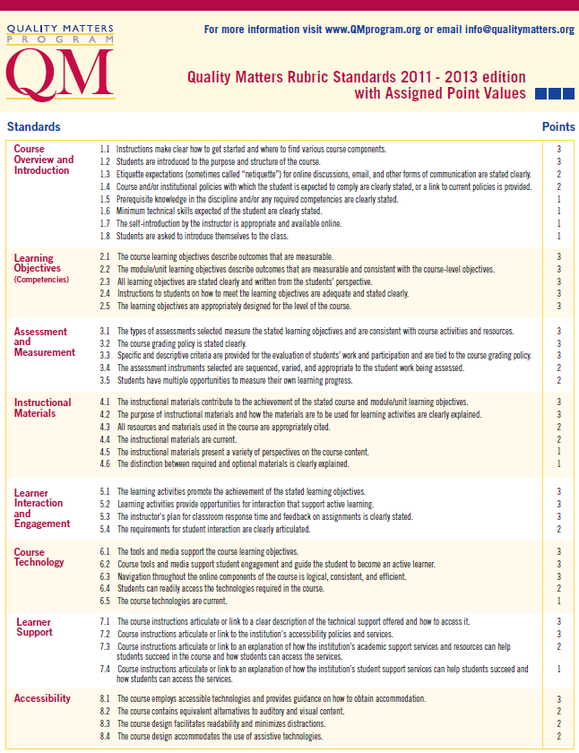
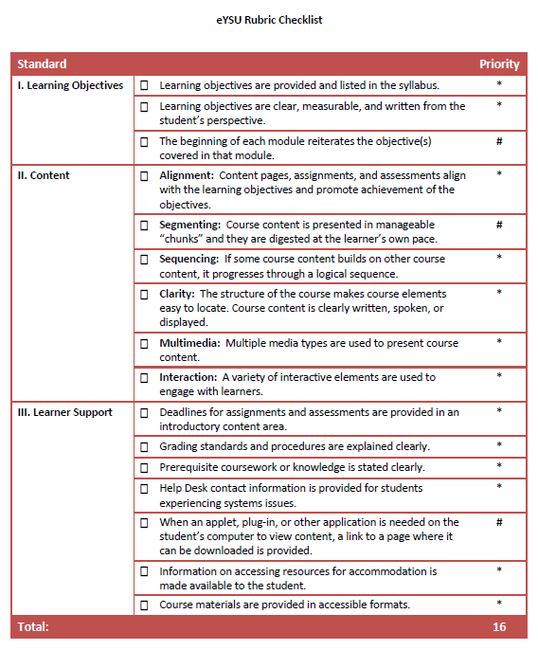
Course Evaluation Rubrics
Each process has a rubric:
Quality Matters.
eYSU Development Review.

Slide 31
Course Evaluation Rubrics
Your observations don’t need to go into the depth of these formal DE reviews.
But you’ll hear about course reviews.
You may wonder how the four “things to look for” we’ve talked about today relate to formal review rubrics.
We’ll take a quick peek at the rubrics ... ...

Slide 32
Course Evaluation Rubrics
The fundamentals that we’ve talked about ...
Content
Interactivity
Clarity
Learning Objectives/Alignment
... are covered in both formal rubrics.

Slide 33
Course Evaluation Rubrics
Also covered:
Course introduction & overview (required by QM).
Segmenting (recommended in eYSU):
Breaking up content into easily digestible chunks.
Sequencing (both):
If you cover lower-level skills and higher-level skills, and the lower skills are needed for the higher, you do lower first.

Slide 34
Course Evaluation Rubrics
Also covered:
Course introduction & overview (required by QM).
Segmenting (recommended in eYSU).
Sequencing (both).
Learner support information (both):
Tell them assignment deadlines.
Explain your grading standards/procedures.
Help Desk contact information.
Information on requesting disability accommodations.

Slide 35
Questions
Questions?
Thoughts?
Concerns?

