Slide 1
Office of University Bursar

Slide 2
Office of University Bursar
What we do:
The Office of University Bursar is responsible for billing of student and non-student accounts and payment processing functions.
Location: Meshel Hall, Room 227 / Telephone No: 330-941-3133 / Email: accounts@ysu.edu / Hours: Monday through Friday, from 8 a.m. – 5 p.m.
University Registrar
Financial Aid
University Bursar
Created 4/9/18

Slide 3
Office of University Bursar
YSU Penguin Tuition Promise:
Assures a fixed tuition (Instructional and General) rate for the pursuit of an undergraduate degree at Youngstown State University. Please note there will be additional fees not included as part of the Tuition Promise.
Examples of costs not included in the Tuition Promise:
Non-resident surcharges
Program fees
Lab and Material fees
College fees
Tuition rate is established based on first enrollment and remains unchanged for twelve consecutive semesters.
Designed to make the cost of college predictable and affordable, and encourages students to complete degree programs within twelve consecutive semesters.
Find the Frequently Asked Questions and Tuition Estimator on YSU.edu

Slide 4
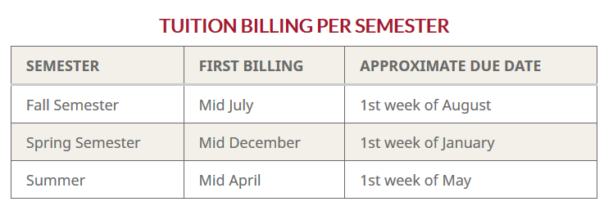
Office of University Bursar
Billing Statements:
Student accounts are billed each semester.
Payment in full is due by the specified due date.
YSU sends billing notifications electronically via the student’s YSU email address.
Please do not expect to receive a billing statement by mail.
Email comes from accounts@ysu.edu.
Parents can also receive billing notifications and make payments via the Authorized User option.

Slide 5
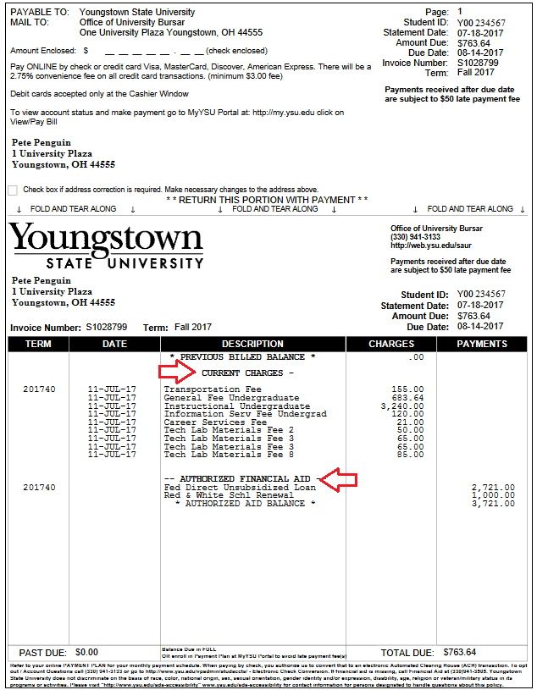
Office of University Bursar
Sample Bill:
Payment address
Amount due
Due date
Term
Charge description
Charge amounts
Authorized Financial Aid
How to Pay:
Online:
2.85% convenience fee on CC transactions (min. $3.00 fee); web check payments (no fee).
Cashier Window
Monday through Friday, 10:00 a.m. to 2:00 p.m.
Mail
$50 late payment fee if not paid timely

Slide 6
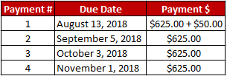
Office of University Bursar
Payment Plan:
A monthly payment plan option is available if you cannot pay your balance in full by the payment due date.
The monthly payment installments are based on the total account balance divided by the number of remaining due dates for the semester (either four, three, or two).
There is also a $50.00 enrollment fee due with the first payment effective Fall 2018.
Fall 2018: Example - $2,500.00
*Summer balances can be divided into 3 payments (depending on when the student registers)*
You can view payment plan information and account details, including the payment amounts and future due dates, and enroll in the payment plan, through the YSU Bill Payment Suite via YSU Portal or the Authorized Parent User Access.

Slide 7
Office of University Bursar
Tuition Refund:
For most efficient processing of tuition refunds, YSU encourages all students to enroll into our direct deposit program.
Students can sign up for direct deposit through their MyYSU Portal. Step-by-step instructions are available online via Sign Up for Direct Deposit (refer to Web Links). Under the Quick Links heading, click Online Instructions, then sign up for Direct Deposit. Students also can visit the Bursar Office in Meshel Hall, Room 227 for one-on-one help.
Students can expect to receive refund process confirmations via their YSU email address.

Slide 8
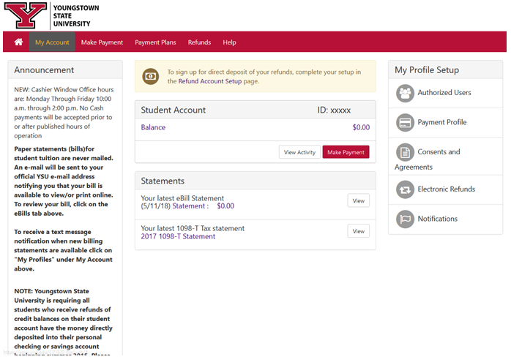
Office of University Bursar

Slide 9
Office of University Bursar
Course Withdrawal Guidelines:
Students seeking to cancel courses should be aware of the Last Day to Withdraw for a 100% Refund (see Tuition Refund Dates).
Students who do not formally withdraw in accordance with policy remain financially responsible for semester fees and charges.
Students must complete official withdrawal processes through their YSU Portal and should verify process completed successfully. Failure to attend, ceasing attendance or giving notice to an instructor or department would not considered official withdrawal.
Withdrawing Financial Aid recipients should consult a Financial Aid Counselor to assess impacts of withdrawal on awarded Financial Aid.
Federal Financial Aid may be reduced after Official or Unofficial Withdrawal and cause a balance immediately due to university.
The Last Day Withdraw for a 100% Refund and the Last Day to Withdraw with a “W” (a grade of “W”) are not the same.
The Last Day to Withdraw with a “W” occurs much later in the semester.
Note that separations from courses outside of the Last Day to Withdraw with a “W” generally result in failing grade(s).

Slide 10
Office of University Bursar
Web Links:
Penguin Promise FAQ:
http://www.ysu.edu/ysu-penguin-tuition-promise/frequently-asked-questions
Tuition Estimator:
http://cfweb.cc.ysu.edu/finaid/tuition/est_tuition.cfm
Payment Plan:
https://cms.ysu.edu/administrative-offices/penguin-service-center/enroll-payment-plan
MyYSU Student Portal:
www.ysu.edu/viewmybill
Tuition Refund Policy:
https://cms.ysu.edu/administrative-offices/university-bursar/tuition-refund-policy
Direct Deposit:
http://cms.ysu.edu/administrative-offices/penguin-service-center/sign-direct-deposit
University Bursar:
http://cms.ysu.edu/administrative-offices/university-bursar/university-bursar
Power Point Presentation:
https://ysu.edu/sites/default/files/bursar/Orientation.pptx

Slide 11
Office of University Bursar
Questions?

