Slide 1
What is Spirituality, Anyway?
Y-Wellness

Slide 2
Groundwork
What is spirituality?
”In general, it includes a sense of connection to something bigger than ourselves, and it typically involves a search for meaning in life.”
Do you agree?
Spirituality may vary
Many forms, common and not
Can be individual or communal
Can be experienced in different ways

Slide 3
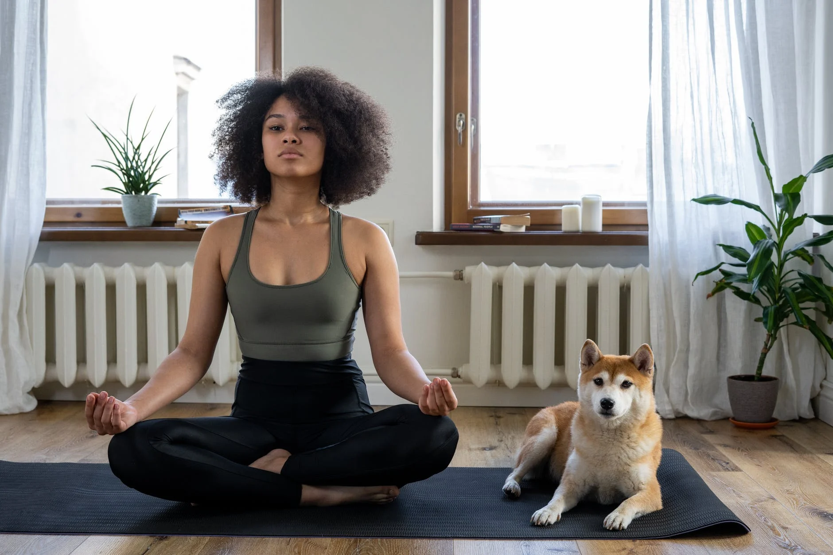
Connections To Wellness
Part of the Wellness Wheel/Pillars of Wellness
If some parts are lacking, it can often be felt
Can be a place to find resolve in the face of difficult questions
Can bolster other aspects of wellness

Slide 4
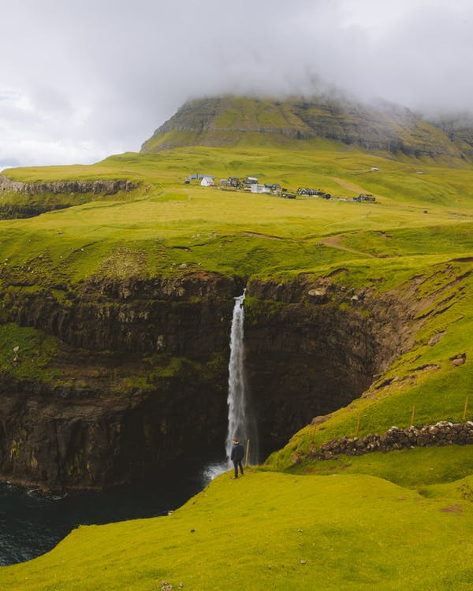
Ways to Engage With Spirituality
Be in nature
Volunteer/Donate
Go to church
Meditate
Spend time with loved ones
Express yourself
Go new places

Slide 5
Discussion
How do you think of spirituality?
Are you satisfied with your relationship to spirituality?
How do you connect to your spiritual self?

Slide 6
Reference
https://www.goodtherapy.org/learn-about-therapy/issues/spirituality/support#:~:text=Spiritual%20therapy%20is%20a%20form,areas%20of%20conflict%20in%20life.
https://www.takingcharge.csh.umn.edu/what-spirituality

