Slide 1
Making your way back to the classroom: addressing challenges you and your students may be facing
Dr. Amy Williams, Assistant Professor, counseling program
Dr. Kristin bruns, associate professor, counseling program

Slide 2
Session goals
Describe how the COVID-19 pandemic has affected college student mental health
Provide strategies for you to support students
Describe strategies for self-care
Provide resources for faculty wellness

Slide 3
What do you hope to take away from today’s workshop?

Slide 4
Impact of covid 19 on college student mental health
Increased stress and anxiety due to the COVID-19 outbreak (71%)
Fear and worry about their own health and of their loved ones (91%)
Top Reported Negative Impacts of the Pandemic,
difficulty in concentrating ( 89%)
disruptions to sleeping patterns (86%)
decreased social interactions due to physical distancing (86%)
increased concerns on academic performance (82%)
Son, Hegde, Smith, Wang, & Sasangohar, 2020)

Slide 5
Stress and learning (common reactions to stress)
Having trouble thinking clearly and concentrating
Having difficulty communicating or listening
Having trouble remembering things
Having difficulty making decisions
Feeling anxious or worrying excessively
Feeling depressed or overwhelmed by sadness
Increased substance use or abuse
Having trouble relaxing or sleeping
Stomachaches, headaches, and other physical aches and pains
All of these symptoms impact your students' ability to learn and participate in your classes.

Slide 6
CCMH cOVID-19’s Impact on College Student Mental Health (5 series report)
Mental health was consistently the most reported negative impact of COVID-19
Colleges and universities should be actively preparing to support student mental health needs in the coming year.
Interventions should be targeted on improving:
students' experience of mental health
supporting their ability to motivate/focus
fostering social connections
alleviating academic distress caused by COVID-19
helping students make up for missed experiences and opportunities
facilitating their transition back to pre-COVID-19 routines
attending to areas of basic need, including food/housing insecurities
https://ccmh.psu.edu/index.php?option=com_dailyplanetblog&view=entry&year=2021&month=02&day=01&id=9:part-1-of-5-covid-19-s-impact-on-college-student-mental-health
Notes:
If there is one stand-out result across all analyses, it is that mental health was consistently the most reported negative impact of COVID-19 across 37 of 38 demographic identities even though only 1/3 of students in this sample sought mental health services because of COVID-19. The only exception to this trend was among African American students who identified “motivation or focus” as the most common concern, followed by mental health. While the general mental health impact of COVID-19 was made clear in Blogs 1 and 2, this consistent result across demographic groups suggests that colleges and universities should be actively preparing to support student mental health needs in the coming year.
Across the other variables examined, it is important to note that both large and small differences were discovered between the various identity groups, but the lowest rates of negative impact were often associated with majority identity statuses. There is no question that COVID-19 is profoundly impacting all students. With that being said, the data reviewed here highlight that the negative impacts of COVID-19 are often reported disproportionally by students with minority identities, which is likely to be heightened for students with multiple intersecting minority identities.

Slide 7
Using a developmental approach: who are you working with?
First year students appear to be coping with more significant impacts of missed experiences than their peers
This could have institutional consequences for years to come.
Seniors report being most impacted in career/employment. They also reported elevated impacts in the areas of finances and food/housing,
They can benefit from focused support during the end of their academic career to support their career and financial needs.
Programming could emphasize providing sophomores with some of the experiences missed in Fall 2020 (that help to anchor them to the institution).
https://ccmh.psu.edu/index.php?option=com_dailyplanetblog&view=entry&year=2021&month=02&day=15&id=11:part-3-of-5-mental-health-impact-of-covid-19-on-various-demographic-groups
Notes:
In addition, the Academic Status variable suggests that colleges and universities should be attending to the needs of students in a developmentally differentiated manner during the transition into the 2021-2022 academic year. Specifically, first-year students appear to be coping with more significant impacts of missed experiences than their peers, and this could have institutional consequences for years to come. Conversely, seniors report being most impacted in career/employment and will benefit from focused support during the approaching end of their academic career. It is also worth noting that senior students reported elevated impacts in the areas of finances and food/housing, which could be an important focus this spring. These trends suggest that colleges and universities would be wise to explore interventions that specifically attend to student-needs based on their developmental levels. For example, assuming a return to campuses in Fall 2021, programming could emphasize providing sophomores with some of the experiences missed in Fall 2020 (that help to anchor them to the institution) and seniors with programming to support their career and financial needs.
Across the other variables examined, it is important to note that both large and small differences were discovered between the various identity groups, but the lowest rates of negative impact were often associated with majority identity statuses. There is no question that COVID-19 is profoundly impacting all students. With that being said, the data reviewed here highlight that the negative impacts of COVID-19 are often reported disproportionally by students with minority identities, which is likely to be heightened for students with multiple intersecting minority identities.

Slide 8
What can you do?
1. Offer support outside of class (to your comfort level)
Reach Out
Communicate Care For Your Students
Give them a safe space to check-in (utilize google form created by ITL)
Listen to their concerns, reflect what you heard, connect them to campus resources
2. Consider how classroom goals and expectations may need to/can shift
If possible, be flexible
3. Avoid assumptions about students’ views
4. Assume good intentions
5. Encourage and role model self-care and vulnerability
6. Promote social connection
7. Know the Campus Resources
https://www.brandeis.edu/health/promotion/covid/faculty-guide.html
https://www.northeastern.edu/uhcs/faculty-and-staff-information-about-supporting-students-during-covid-19/
Notes:
Putting time and energy into supporting students through this crisis will result in better outcomes for students and for colleges and universities. The types of outreach described here will help students feel connected and committed to their institution. In turn, they will be more likely to endure this crisis with their education and health intact, complete their degrees, and repay their loan
are humans first. The more a student feels connected to and understood by their college or university, the more likely they are to stay enrolled and engaged. The language you use to communicate about the response to COVID-19 matters—it must convey care along with urgency. Communicate the need for physical distance as opposed to social distance to emphasize that you are still a community while observing recommended prevention practices.

Slide 9
What have you done that has worked well? What might you try?

Slide 10
Personal Wellness: Taking Care of Yourself so you can care for others

Slide 11
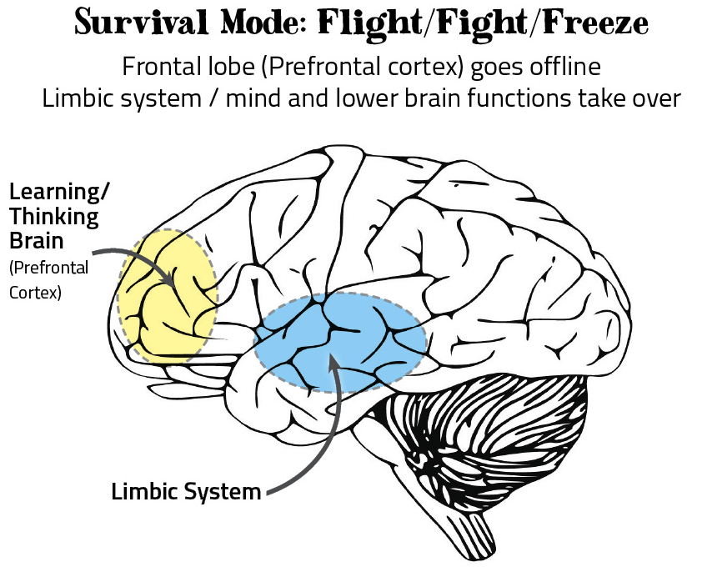
The Neurobiology of Survival
Image Source: http://communityresiliencecookbook.org/your-body-brain/

Slide 12
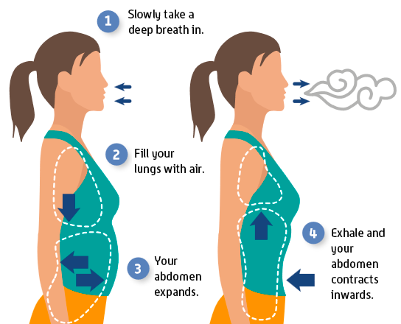
Grounding Activity: Diaphragmatic Breathing
Image Source: https://onepointhealth.com.au/wp-content/uploads/2018/11/How-to-breathe-deeply-1.png

Slide 13
Wellness and Stress Management

Slide 14
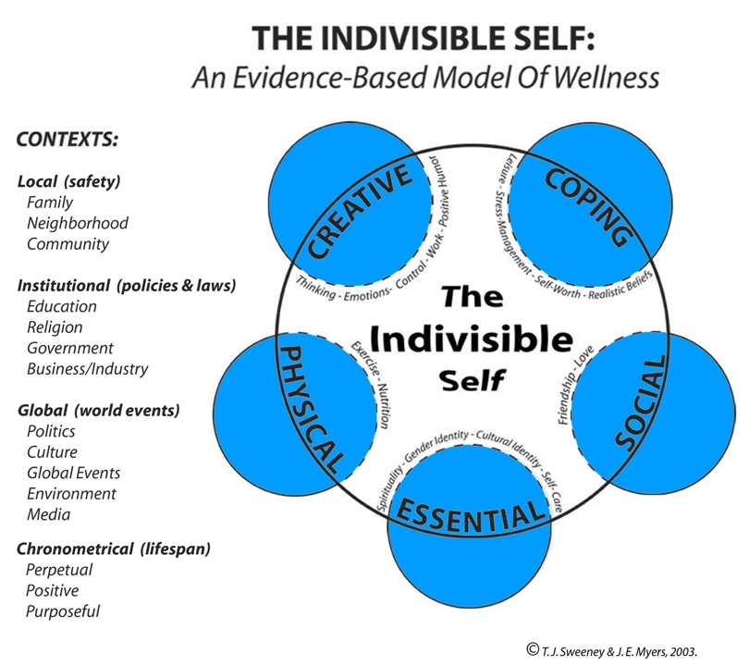
What is wellness?
Source: http://www.csi-net.org/members/group_content_view.asp?group=162835&id=573510

Slide 15
What are your wellness strengths and needs?
Identify the strengths you possess on the outside and your needs on the inside of the large circle for each domain.
Select the top 3 most important needs you would like to address.
Consider ways you might want to address these needs and why doing so is important to you.

Slide 16
Preparing to Plan
Using the handout, identify the areas you most want to focus on
1
Describe what data you plan to collect and how you will use them
2
Identify what else you need to be successful in goal setting
3

Slide 17
Processing the Process

Slide 18
Developing a Wellness-Oriented Lifestyle
Seek and give support
Set small, manageable, meaningful goals that accrue over time
Cultivate a culture of wellness
Consider professional support, especially when coping is difficult

Slide 19
In Summary…
Stress impacts the brain and body
The breath can be used to help manage stress
Wellness is multifaceted and individualized
Identifying and working toward wellness goals over time supports stress management and overall wellbeing
Creating a culture of wellness and giving and seeking support can promote lifelong wellness

Slide 20
In Summary…
Stress impacts the brain and body and may affect both learning and engagement (for us and students alike)
Wellness is multifaceted and individualized
Identifying and working toward wellness goals over time supports stress management and overall wellbeing
Using a wellness framework to support student learning goals and objectives provides cohesion and supports overall coping
Activities that facilitate connection, meaning-making, and personalization support learning and overall wellness

Slide 21
References
COVID 19S IMPACT ON COLLEGE STUDENTS
https://ccmh.psu.edu/index.php?option=com_dailyplanetblog&view=entry&year=2021&month=02&day=01&id=9:part-1-of-5-covid-19-s-impact-on-college-student-mental-health
https://ccmh.psu.edu/index.php?option=com_dailyplanetblog&view=entry&year=2021&month=02&day=08&id=10:part-2-of-5-mental-health-changes-after-the-onset-of-covid-19
https://ccmh.psu.edu/index.php?option=com_dailyplanetblog&view=entry&year=2021&month=02&day=15&id=11:part-3-of-5-mental-health-impact-of-covid-19-on-various-demographic-groups
Son, C., Hegde, S., Smith, A., Wang, X., & Sasangohar, F. (2020). Effects of COVID-19 on College Students' Mental Health in the United States: Interview Survey Study. Journal of medical Internet research, 22(9), e21279. https://doi.org/10.2196/21279

