Slide 1
2017-2018 Fact Sheet
CSP Student Tutorial Services
61% Increase in Student Utilization!
Visits | Fall 2017 | Fall 2016 | Difference
Tutoring Sessions | 7911 | 5875 | 35%
Final Exam Reviews | 715 | 250 | 186%
E-tutoring | 17 | 15 | 13%
POTA | 860 | 780 | 10%
Total Visits | 9503 | 6920 | 61%
Top 5 High Demand Subject Areas
Student Survey Results
458 students completed a 11 question mid-term survey asking them to rate their experience with tutoring.
98%-100% agreed or strongly agreed that they benefitted from tutoring, would use the service again and would recommend the service to other students.
36% Increase in Students Served!
Students | Fall 2017 | Fall 2016 | Difference
Tutoring Sessions | 806 | 711 | 13%
Final Exam Reviews* | 483 | 222 | 118%
E-tutoring | 6 | 11 | -45%
POTA | 27 | 25 | 8%
Total Students | 1322 | 969 | 36%
*This number includes students who had already been coming in for weekly tutoring sessions. This service brought in an additional 205 students who had not been using the CSP.
F17 Grade Outcomes/Re-enrollment % Comparison
Students attending 10+ sessions earned a higher percentage of passing grades (87% passed with A, B, or C), higher avg. grades in the course tutored (2.72) and re-enrolled in the subsequent semester at higher rates (96%) than students attending 0-9 sessions. This is consistent with outcomes from previous semesters.
All services provided with just 8 additional tutors!
Scheduling | Fall 2017 | Fall 2016 | Difference
Tutors on Staff | 64 | 56 | 14%
Requests Scheduled | 1172 | 1121 | 42%
Unmet Requests | 9 | 95 | -91%
Review Sessions Offered | 35 | 16 | 119%
# of visits | # of students/ % of Total | Avg. Grade | DFW | Re-enrolled S18 | Avg. Term GPA
10+ | 368/ 33% | 2.72 | 13% | 96% | 3.08
5-9 | 370/ 33% | 2.38 | 24% | 92% | 2.90
1-4 | 294/ 27% | 2.24 | 33% | 85% | 2.65
0 | 79/7% | 1.68 | 53% | 81% | 2.53
Prepared By:
Michael Greco, MA
Assistant Director
Student Tutorial Services
(330) 941-2956
magreco01@ysu.edu
Some Quick Notes About the Spring Semester: | Data through Week 12 | Spring 2018 | Spring 2017 | Difference
 | Visits | 5250 | 3101 | 69%
 | Students | 809 | 461 | 75%
 | Requests Scheduled | 1144 | 682 | 68%
 | Tutors on Staff | 64 | 58 | 10%

Slide 2
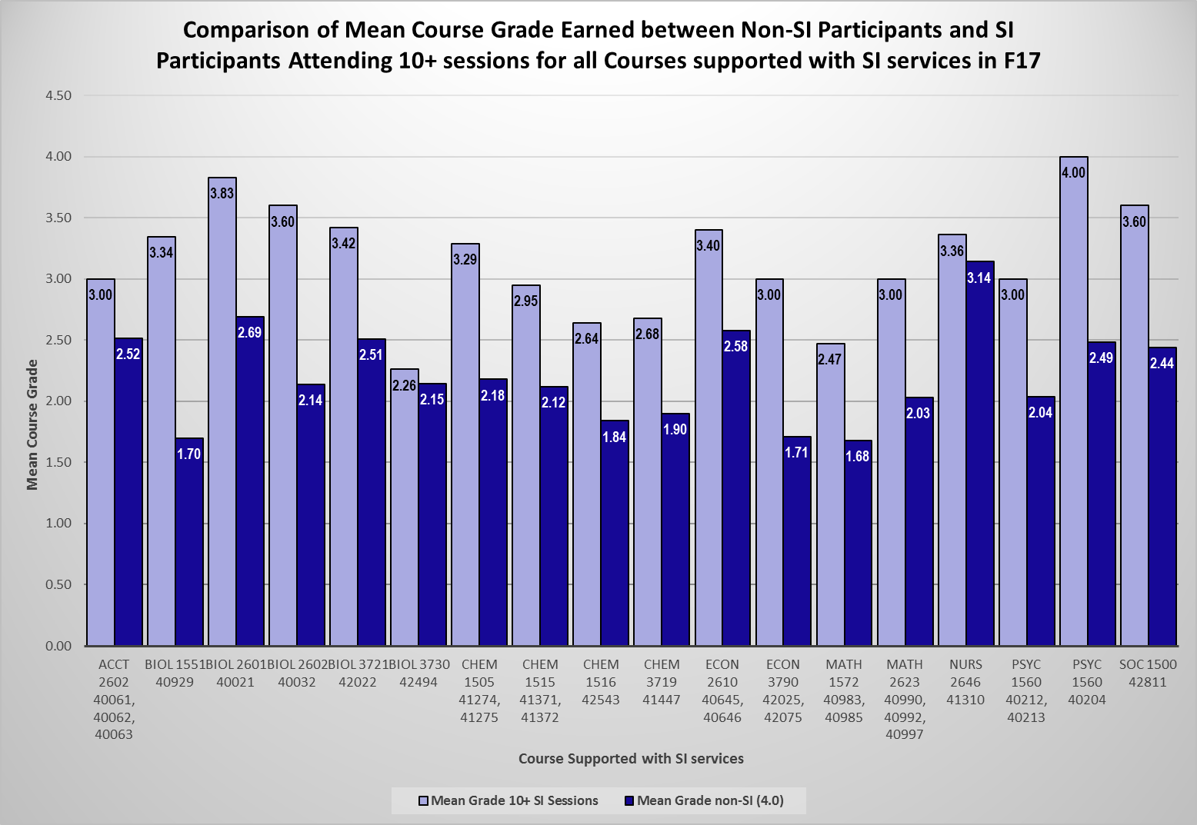
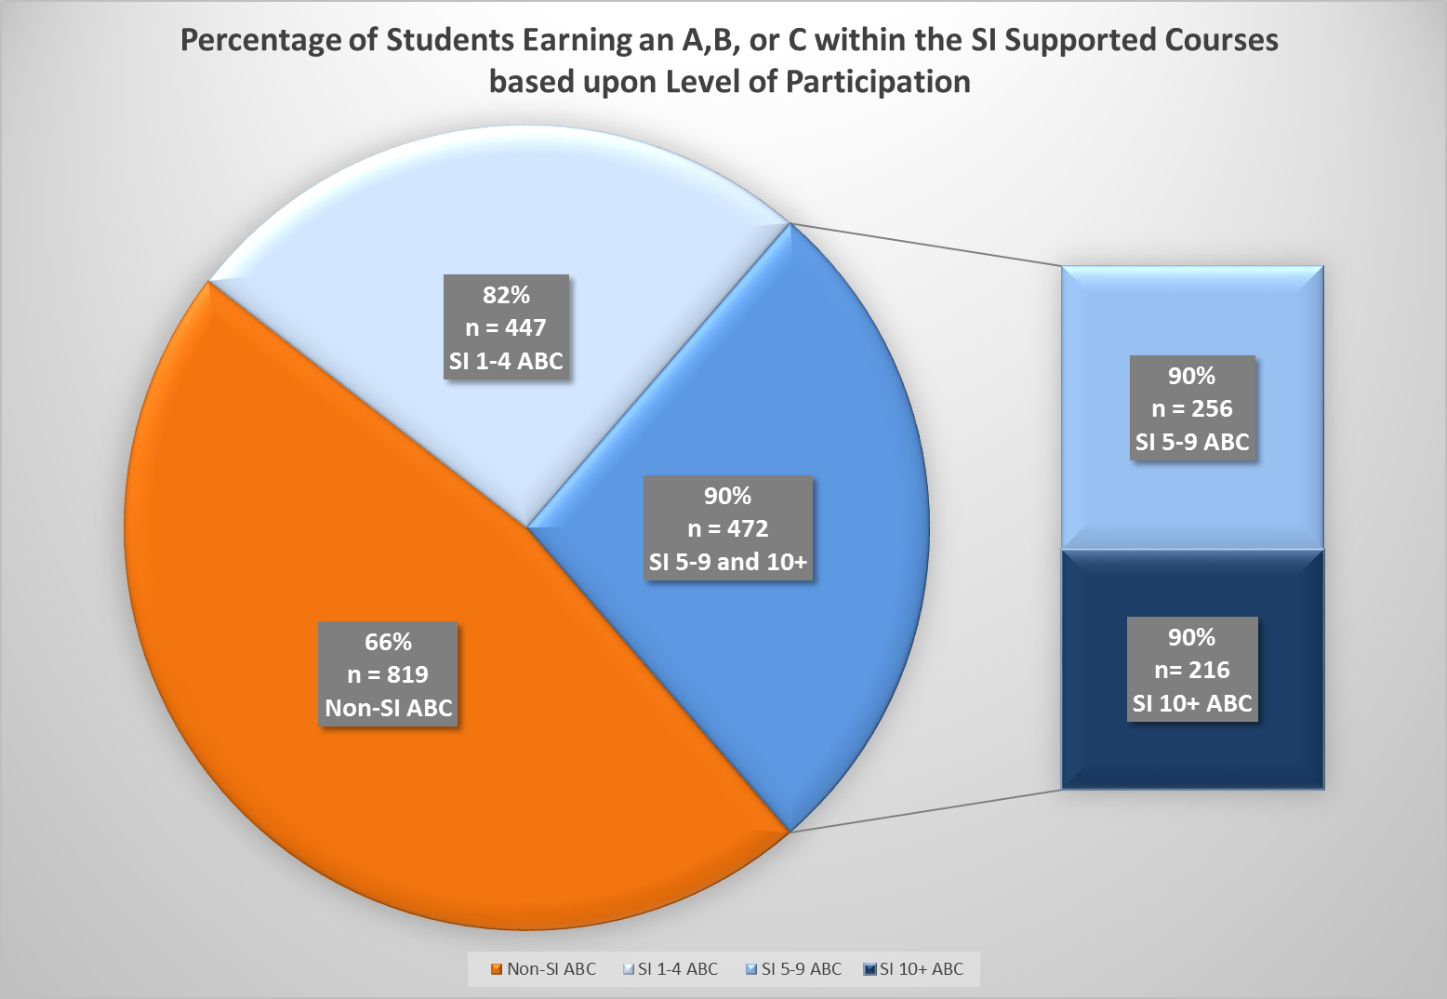
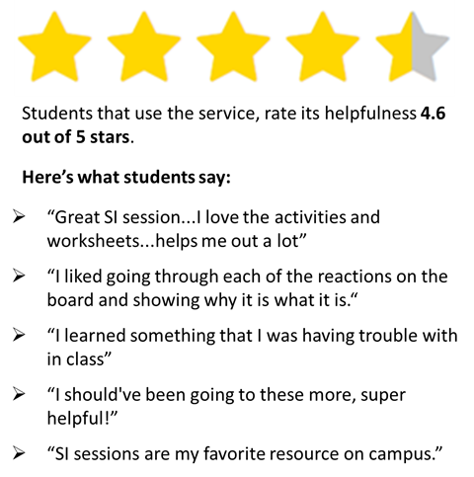
2017-2018 SI Highlights
CSP Supplemental Instruction Services
Sue Mark-Sracic, Assistant Director
symarksracic@ysu.edu (330) 941-2375
Within SI sessions, students learn how-to-learn not just what to learn! Study skills are modelled and integrated into the collaborative learning process, created and facilitated by the peer SI Leader.
In Fall 2017, with 20 SI Leaders on staff:
Offered support to 21 courses, 33 CRNs, within 8 departments (Accounting, Biology, Chemistry, Economics, Mathematics, Nursing, Psychology and Sociology)
Assisted 1236 students, accounting for 7636 face-to-face contacts
In Spring 2018 (to date), with 14 SI Leaders on staff:
Offered support to 14 courses, 17 CRNs, within 4 departments (Biology, Chemistry, Mathematics, and Psychology)
Assisted 767+ students, accounting for 4452+ face-to-face contacts
In F17, students who regularly and actively participated in SI services outperformed non participants by an average of .94 letter grade!
In F17, 90% of the regularly attending SI participants earned an A, B or C in the course!

