Slide 1
Discussion on Mask Mandates at YSU
Mike Costarell, P.E.
Mechanical Engineering Technology
10.6.21

Slide 2
Scientific Method
Asking questions
Observing data
Forming a model or data analysis
Drawing conclusions or theories

Slide 3
Question 1 – Did the March 2020 Prediction of 2,200,000 deaths in America Come True?

Slide 4
Question 1 – Did the March 2020 Prediction of 2,200,000 deaths in America Come True?

Slide 5
Question 1 – Did the March 2020 Prediction of 2,200,000 deaths in America Come True?
“In total, 182 patients were treated aboard USNS Comfort; 70% of them were COVID-19 positive cases.”
“No patients had been referred to USNS Comfort after April 21, and the last patient aboard was discharged on Sunday, April 26.”

Slide 6
Question 1 – Did the March 2020 Prediction of 2,200,000 deaths in America Come True?
Conclusion: This model was not accurate

Slide 7
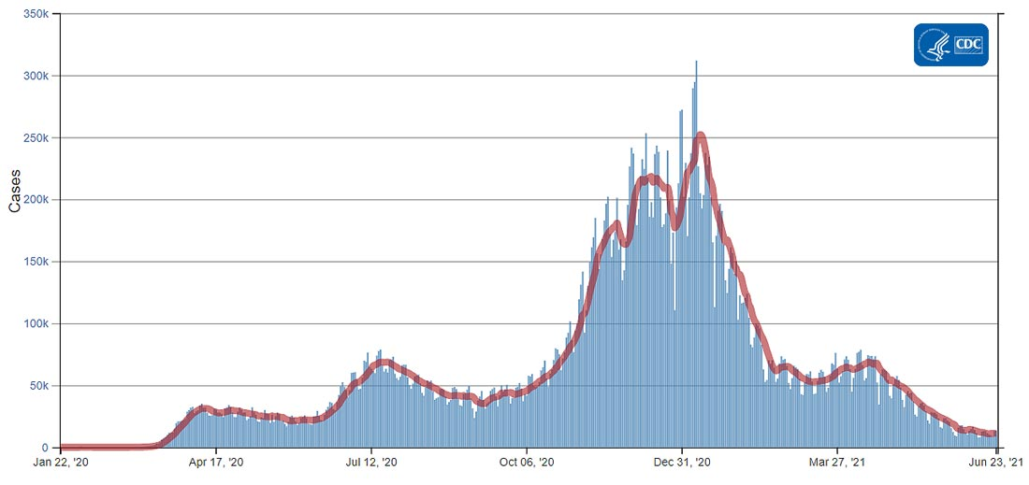
Question 2 – Is the Vaccine the Only Path to Lower COVID Numbers?

Slide 8
Question 2 – Is the Vaccine the Only Path to Lower COVID Numbers?
Dividing 35 million positive cases (June 2021) over the 331 million Americans figures at 10.5%.
As of June 2021, only 53% of the population was vaccinated.

Slide 9
Question 2 – Is the Vaccine the Only Path to Lower COVID Numbers?
Somehow, 90% of the population has never tested positive for COVID-19, only half of the population vaccinated, yet the infection levels dropped to very low levels.
This indicates that other factors are in play, including natural immunity, or that people may get the infection and not have severe symptoms.

Slide 10
Question 3 – What is the Collateral Damage of Our National Policy?

Slide 11
Question 3 – What is the Collateral Damage of Our National Policy?
“Overall, an estimated 40.9% of U.S. adults have avoided medical care during the pandemic because of concerns about COVID-19”

Slide 12
Question 3 – What is the Collateral Damage of Our National Policy?

Slide 13
Question 3 – What is the Collateral Damage of Our National Policy?

Slide 14
Question 3 – What is the Collateral Damage of Our National Policy?
“The persistence and scope of this deadly disease has caused much stress and anxiety and taken a terrible toll on the mental health of so many across the nation and the world, including college students whose lives both on and off campus …,” said Ann Jaronski, director of Student Counseling Services. Nov 2020

Slide 15
Question 4 – How Effective is the Vaccine in Israel?

Slide 16
Question 4 – How Effective is the Vaccine in Israel?

Slide 17
Question 4 – How Effective is the Vaccine in Israel?

Slide 18
Question 5 – How Effective is the Vaccine at Harvard?

Slide 19
Question 5 – How Effective is the Vaccine at Harvard?

Slide 20
Question 5 – How Effective is the Vaccine at Harvard?

Slide 21
Question 6 – Are College-Age Students Going to the Hospital?

Slide 22
Question 6 – Are College-Age Students Going to the Hospital?
Conclusions:
The age group for traditional college students has hospitalization rates that are 1/4 to 1/3 of the national average.
Compared to seniors over 65, 110x less chance of going to the hospital for COVID 19.

Slide 23
Question 7 – At What Rate are College-Age Students Dying??
Death from all causes
2020 Death from all causes
 | Total deaths | Deaths per 100K | Times less likely to die
Age | 3,358,814 | 828.7
15–24 | 35,470 | 83.2 | 10.0
25–34 | 72,678 | 157.9 | 5.2

Slide 24
Question 7 – At What Rate are College-Age Students Dying??
Death from all causes
2020 Death from COVID
 | COVID-19 deaths | Deaths per 100K | Times less likely to die
Age | 337,883 | 91.5
15–24 | 587 | 1.4 | 65.4
25–34 | 2,527 | 5.5 | 16.6

Slide 25
Question 8 – Is it Valid to Reason that a COVID Vaccine is just like any other vaccine?
The date discovered:
Small Pox 3,000 years ago
COVID 19 1.5 years ago

Slide 26
Question 8 – Is it Valid to Reason that a COVID Vaccine is just like any other vaccine?
The time that a vaccine has been available
Small Pox
o First use 1801 (2,640 months ago)
o Global use – eradicated in 1975 (552 months ago)

Slide 27
Question 8 – Is it Valid to Reason that a COVID Vaccine is just like any other vaccine?
The time that a vaccine has been available
COVID 19
o Emergency use Dec 2020 (10 months ago)
o Full approval August 2021 (3 months ago)

Slide 28
Question 8 – Is it Valid to Reason that a COVID Vaccine is just like any other vaccine?
The lethality of each disease
• Small Pox 30% death rate
• COVID 19 <1% death rate

Slide 29
Question 8 – Is it Valid to Reason that a COVID Vaccine is just like any other vaccine?
Conclusions:
• COVID is a new virus
• COVID is 30 x less lethal than Small Pox
• COVID vaccines have been around for months, Small Pox vaccines have been around for decades.

Slide 30
Question 9 – Are Underlying Conditions Factors in Hospitalizations?

Slide 31
Question 9 – Are Underlying Conditions Factors in Hospitalizations?
Hypertension and disorders of lipid metabolism were the most frequent, whereas obesity, diabetes with complication, and anxiety disorders were the strongest risk factors for severe COVID-19 illness. Careful evaluation and management of underlying conditions among patients with COVID-19 can help stratify risk for severe illness.”

Slide 32
Question 9 – Are Underlying Conditions Factors in Hospitalizations?
Conclusions:
Masks and vaccines are not the only variables in reducing COVID infections, hospitalizations and deaths.
Other factors, such as Body Mass Index are of great concern.
Most individuals have some control over diet and exercise.

Slide 33
Summary of Variables
1. Vaccinations
2. Masks
3. Isolation
4. Age
5. Body mass index 25+
6. Presence of comorbidities
7. Personal hygiene
8. Population density
9. Climate
10. Local and international travel

Slide 34
Recommendations
I agree with the recommendations as listed in the Great Barrington Declaration, prepared by notable medical and epidemiology scholars from Harvard, Stanford, and Oxford.
Focused Protection is the proper balance between caution and continuing with normal life.

Slide 35
Recommendations
COVID Spreads like the Flu. Mask use indoors should be based on Ohio or Mahoning County hospitalizations, not infections.
Vaccinations should be an option based on a person’s individual circumstances.

Slide 36
Recommendations
Promote individual actions:
Check your temperature daily
Stay at home if you have symptoms
Wash hands
Diet
Exercise
Limit smoking and alcohol

Slide 37
Recommendations
Promote individual actions:
Check your temperature daily
Stay at home if you have symptoms
Wash hands
Diet
Exercise
Limit smoking and alcohol

