Slide 1
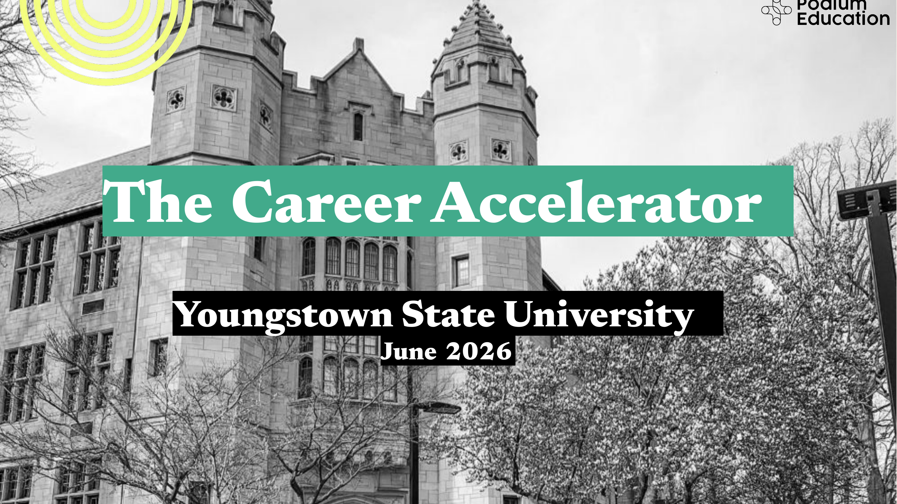
The Career Accelerator
Youngstown State University
June 2026

Slide 2
Experiential is essential.
Podium
Education
1
For students,
experience is a
ticket to ROI.
Recent research by the Burning Glass Institute and Strada Education Foundation found that students who have an internship while in college are at substantially lower risk of long-term underemployment compared to those without one.
2
For universities,
experiential boosts
student success.
Our partners at ASU measured a 10-14% increase in persistence for students who completed Podium experiences. This is consistent with broader research from NACE and SUNY, correlating high-impact practices (HIPs) with higher GPA as well as increased retention.
3
But, HIPs are
difficult to scale…
HIPs (e.g., internships, study abroad) are not widely scalable or accessible - Gallup reported that only 4 in 10 college grads landed an internship before graduation (and just 27% for first gen students).
4
…and supply is
shrinking
BHEF reports that there are 8M students that want an internship this year, and only 2M internships available. We expect AI to continue to compress entry-level hiring.

Slide 3
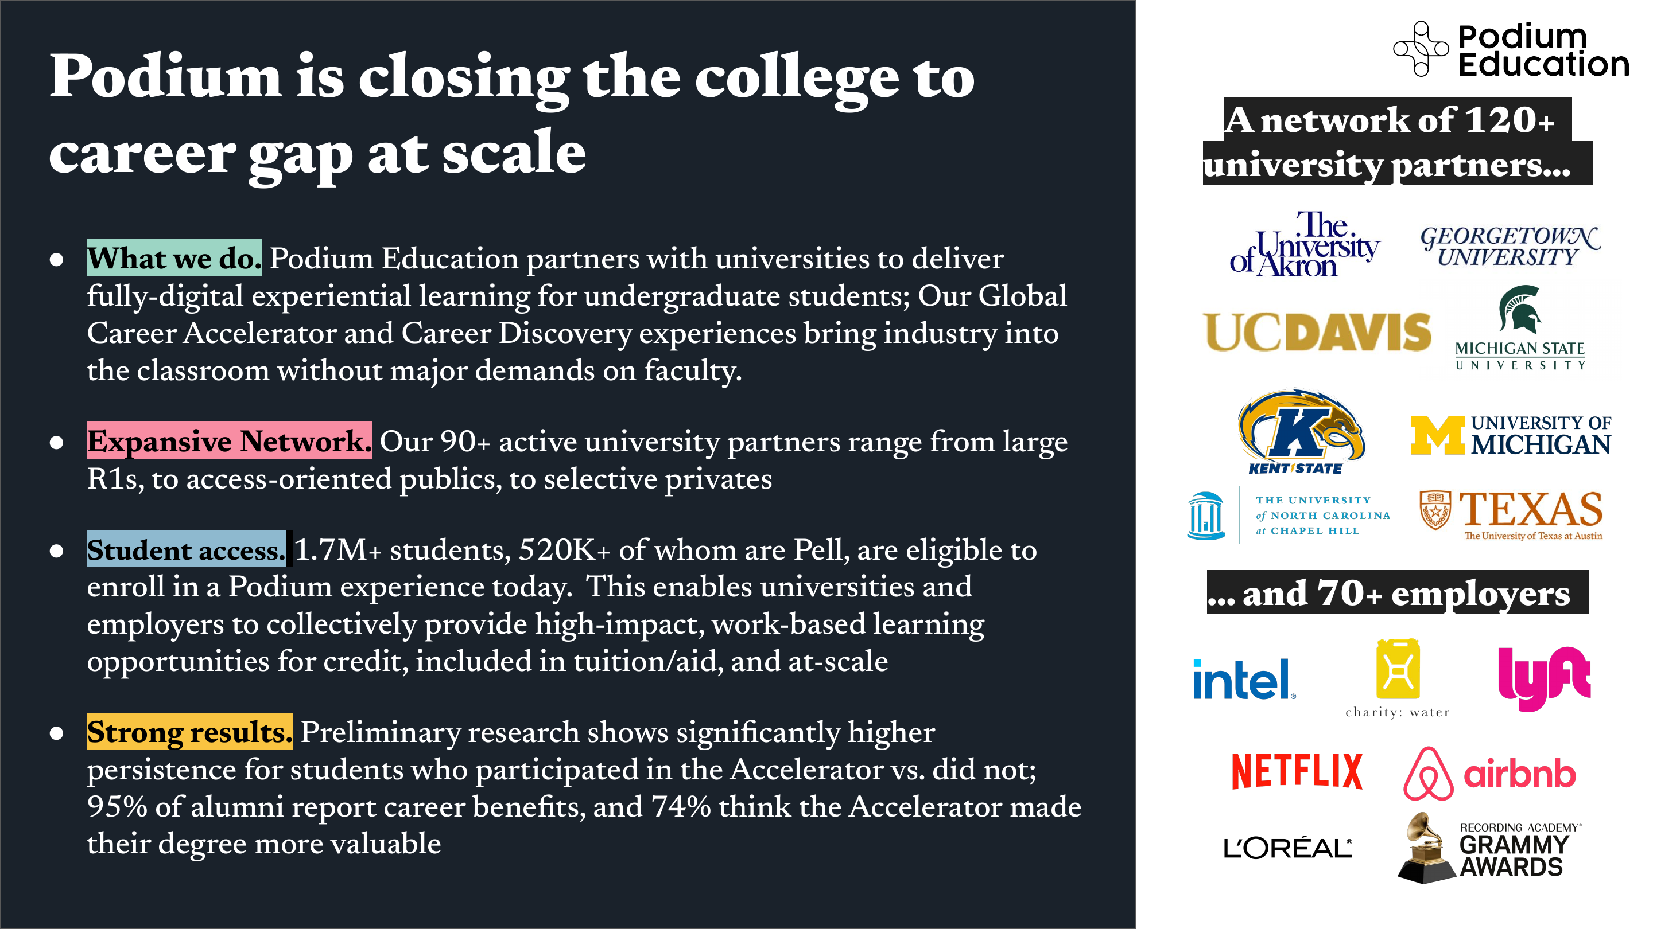
Podium is closing the college to
career gap at scale.
Podium
Education
A network of 120+
university partners…
•
What we do.
Podium Education partners with universities to deliver fully-digital experiential learning for undergraduate students; our Global Career Accelerator and Career Discovery experiences bring industry into the classroom without major demands on faculty.
•
Expansive Network.
Our 90+ active university partners range from large R1s, to access-oriented publics, to selective privates.
•
Student access.
1.7M+ students, 520K+ of whom are Pell, are eligible to enroll in a Podium experience today. This enables universities and employers to collectively provide high-impact, work-based learning opportunities for credit, included in tuition/aid, and at-scale
•
Strong results.
Preliminary research shows significantly higher persistence for students who participated in the Accelerator vs. did not; 95% of alumni report career benefits, and 74% think the Accelerator made their degree more valuable

Slide 4
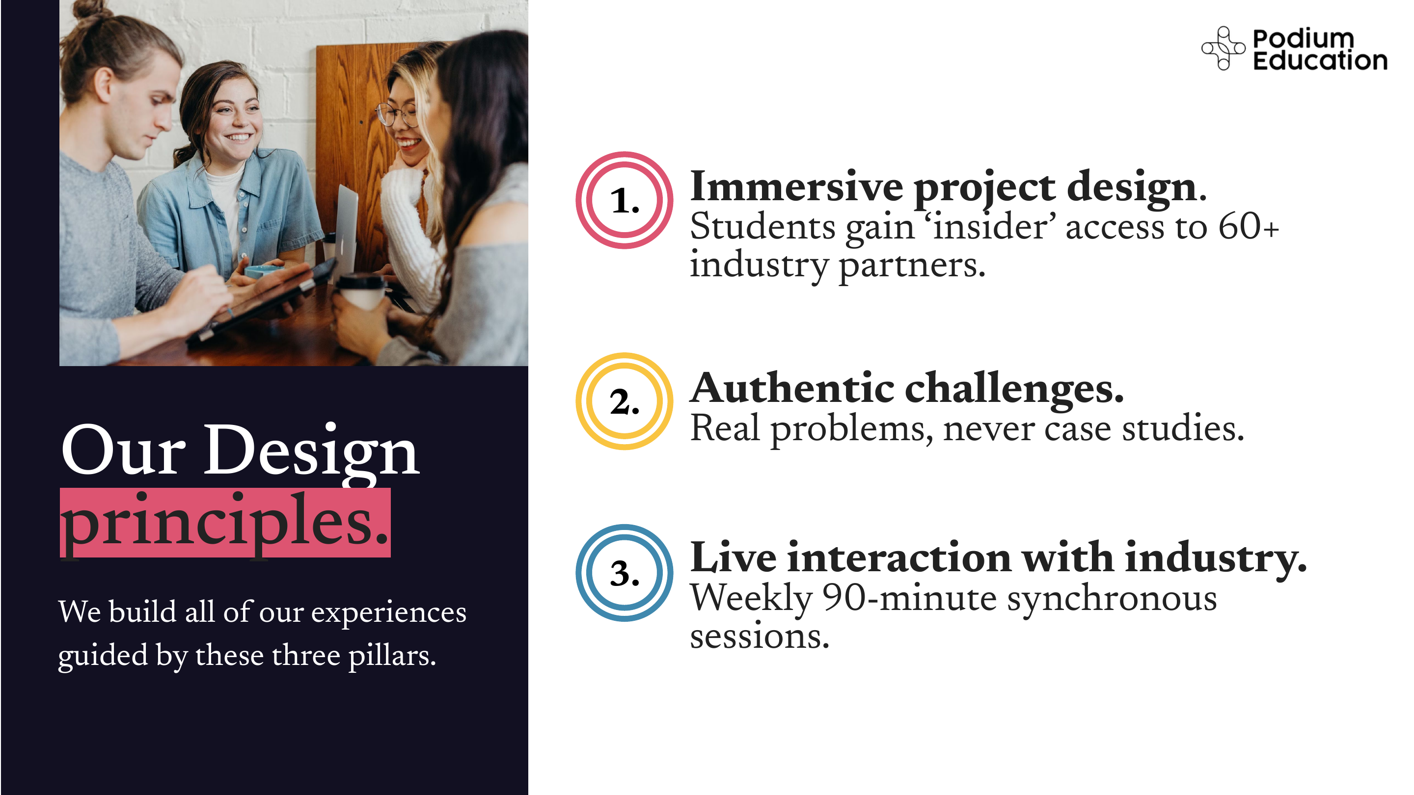
Podium
Education
Immersive project design.
1.
Students gain ‘insider’ access to 60+ industry partners.
Authentic challenges.
2.
Real problems, never case studies.
Our Design
principles.
Live interaction with industry.
3.
We build all of our experiences
guided by these three pillars.
Weekly 90-minute synchronous sessions.

Slide 5
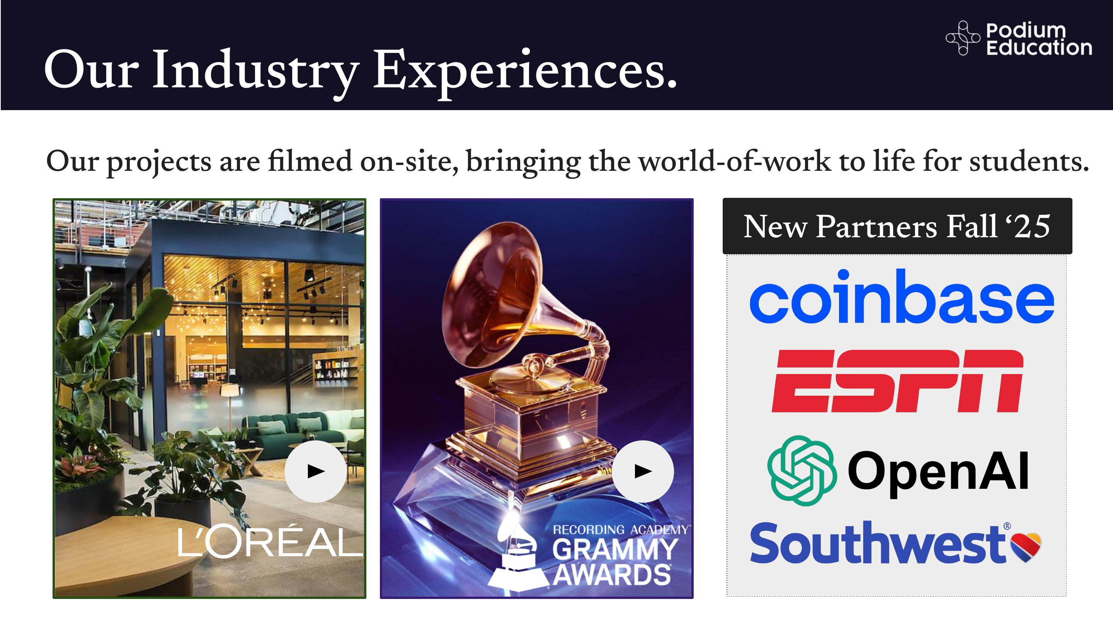
Our Industry Experiences.
Podium
Education
Our projects are filmed on-site, bringing the world-of-work to life for students.

Slide 6
Our Offerings.
Podium
Education
1.
The Career Discovery
Experience
2.
The Global Career
Accelerator
Exploration-focused First Year seminar or success experience.
Resume-building field experience through co-designed industry projects.
Designed to inspire students and help build a sense of purpose through hands on exposure.
3-6 credit course. Open to all but most popular with upperclassmen.
3 credit course.
Regional or state-specific employer opportunities.
Retention-specific goals.

Slide 7
Accelerator. How it Works
Podium
Education
Real-world Projects
Our flagship offering is called The Global Career Accelerator and is offered across the institution.
Students have direct interaction as they work on projects with companies like L’Oreal & OpenAI
Fully-digital, semester-long experience that runs year-round and aligns with the academic calendar.
Weekly LiveLabs
Students collaborate in hand-formed teams and interact directly with industry in a weekly session.
The university a) identifies a special topics or experiential course code to offer the Accelerator under and b) a faculty member to serve as the Instructor of Record.
Industry Tools
Students gain proficiency & earn micro-credentials in employer-demanded tools
Financials: the university pays Podium a percentage of its tuition & fees for each student that signs up; alternatively we offer a flat fee for a large cohort of students.

Slide 8
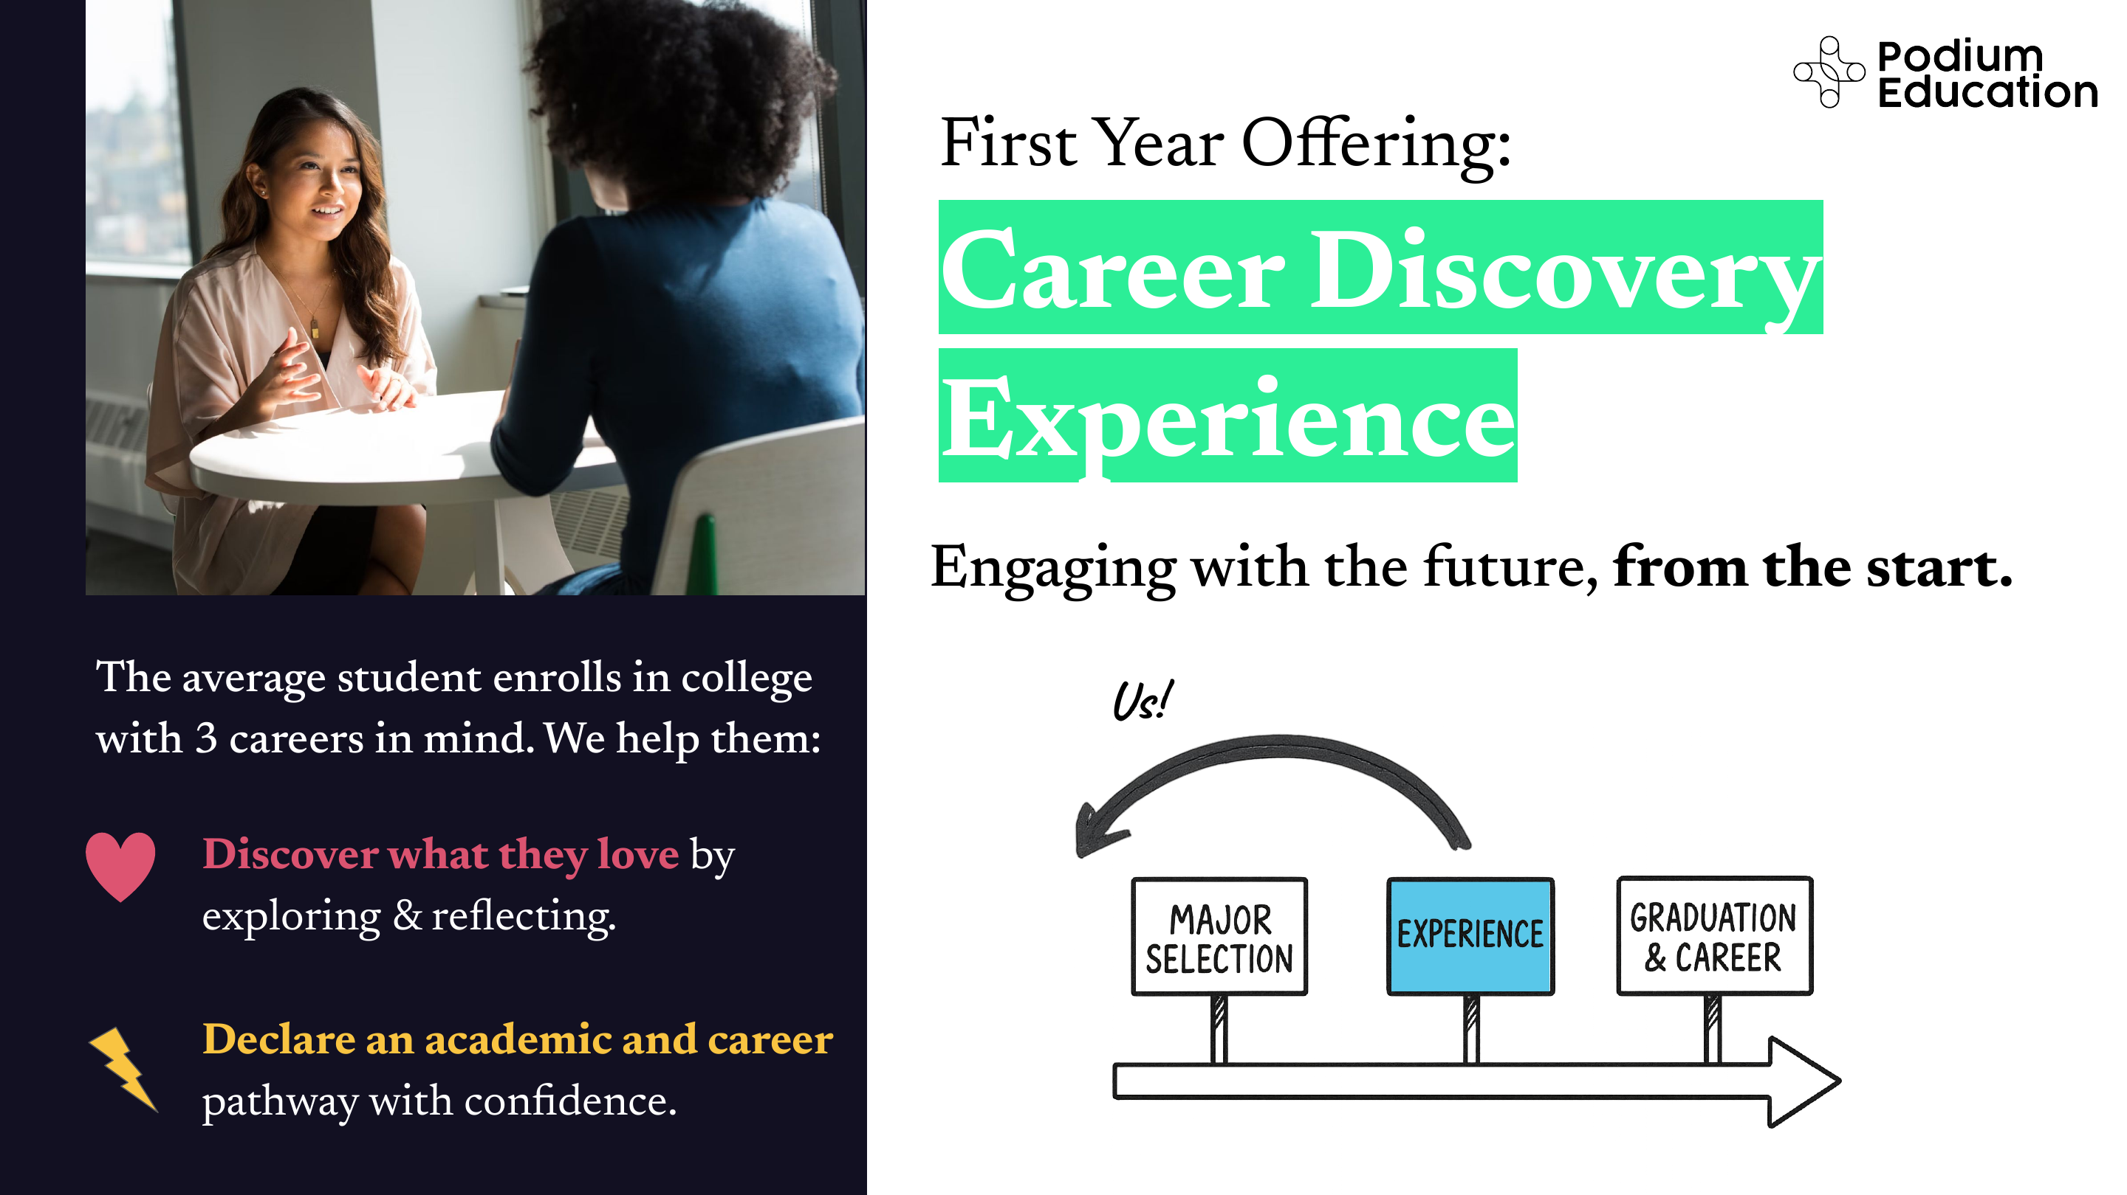
Podium
Education
First Year Offering:
Career Discovery
Experience
Engaging with the future, from the start.
The average student enrolls in college
with 3 careers in mind. We help them:
♥ Discover what they love by
exploring & reflecting.
MAJOR
SELECTION
EXPERIENCE
GRADUATION
& CAREER
⚡ Declare an academic and career
pathway with confidence.

Slide 9
Career Discovery. How it Works
Podium
Education
Fully-digital, semester-long experience including a 75-minute weekly live meeting with the industry partner
2-3 credit course designed for First Year Students
University-led strategy for populations like Exploratory/Undecided
10 diverse industries and immersive projects
Customizable institutional-specific reflections and cohort sessions to meet first-year seminar requirements.

Slide 10
Retention | UC Irvine Analysis Results.
FOR INTERNAL DISCUSSION ONLY:
Dr. Richard Arum & team’s study of ~3,000 ASU Accelerator
students points to significant positive impact on retention
1.
Global Career Accelerator participation was associated with increased retention rates across the three academic years studied: Accelerator students were ~6-10pp more likely to retain
2.
Retention rates for Accelerator participating students remained higher than peers after accounting for demographic and academic factors that affect dropout risk, including first generation and URM status
3.
Retention remained higher in a matched-sample analysis, which reflects the strongest available controls: Accelerator students were ~4pp more likely to retain than their matched peers

Slide 11
Retention | UC Irvine Analysis Results.
Consistent and significant impact: Higher ed rarely achieves this degree of impact in increasing retention, and it is very consistent across diverse cohorts.
2021-2022
10% increase
2022-2023
6% increase
2023-2024
6% increase
92%
89%
88%
82%
83%
82%
did not enroll in
Accelerator
enrolled in
Accelerator
did not enroll in
Accelerator
enrolled in
Accelerator
did not enroll in
Accelerator
enrolled in
Accelerator

Slide 12
Career Accelerator Partner Models
Podium
Education
Our strongest partnerships have launched the Accelerator with support from university-wide undergraduate education offices.
UC Riverside
Michigan State
University of Oregon
Kent State
University
Structure
Centralized Budget Model
Run out of Provost Office
Vice Provost of
Undergraduate Education
Centralized Budget Model
Led by Provost Office
Centralized Budget Model
Led by Provost Office
Academic
Home
Career Services
Office of Undergraduate
Education
Provost Office, following a pilot
launch out of Business and A&S
Provost Office
# of Summer
Credits
8 units
6 credits
4 credits
3-6 credits
Financial
Model
50/50 Blended Tuition Split
50/50 Blended Tuition Split
50/50 Blended Tuition Split
50/50 Blended Tuition Split
Annual
Enrollment
1,100
800
800
300

Slide 13
Podium
Education
Students recognize the benefits of
participation in the Accelerator.
“
I loved every bit of it! Our mentors were amazing, and the work was exactly what I needed to jumpstart my career.
94%
say they would recommend The Global Career Accelerator to their friends & peers
83%
say The Global Career Accelerator gave them experiences and skills that they weren’t able to gain through their regular college coursework
“
I thoroughly enjoyed the experience. I learned new skills that will help me access better opportunities in my career search and I have much more confidence in presenting myself to prospective employers.
70%
say The Global Career Accelerator made them a more competitive candidate for jobs, internships
74%
say “The Global Career Accelerator made my college degree more valuable”
SOURCE: 2025 Podium student surveys and enrollment data

Slide 14
Podium
Education
Help us close the
college to career gap.
Melissa Buerkett, Head of Partnerships
melissa@podiumeducation.com

