Slide 1
Classroom Technology Upgrades
Jim Yukech CIO & AVP Information Technology Services

Slide 2
ITS Updates
Multimedia Classroom Refresh (MMCR) Phase 1
Multimedia Classroom Refresh (MMCR) Phase 2
Bring Your Own Device (BYOD)
Technology Support Portal
Wi-Fi Enhancements
Q&A

Slide 3
Introductions
Rosalyn Donaldson Director, IT Training Services & Academic Continuity Team Program Manager
Tasha Wells Manager, Campus Technology Support
Jeff Wormley Project Manager, IT Customer Services
Sharyn Zembower Manager, IT Service Desk

Slide 4
What was the subject of your last request from ITS?
ⓘ Start presenting to display the poll results on this slide.

Slide 5
Multimedia Classroom - Phase 1
Airtame
Desktop Computer
Push Button Control Panel
Laser Projector and Screen
Webcam with Built-In Mic
Built in Room Speakers
Notes:
Teaching Station Desktop Computer
Airtame (to connect and share wirelessly with devices such as laptops)
Push Button Control Panel on Teaching Station to switch between Desktop Computer and Airtame
Laser Projector and Screen
Webcam with Built-In Mic on adjustable gooseneck stand (doubles as document camera)
Built in Room Speakers

Slide 6
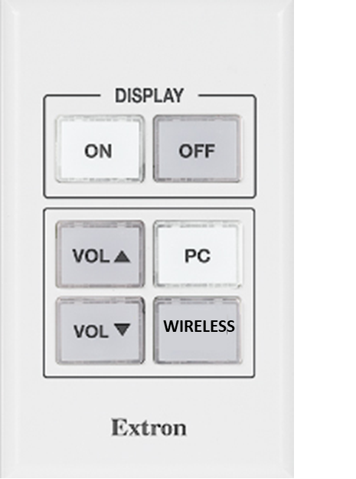
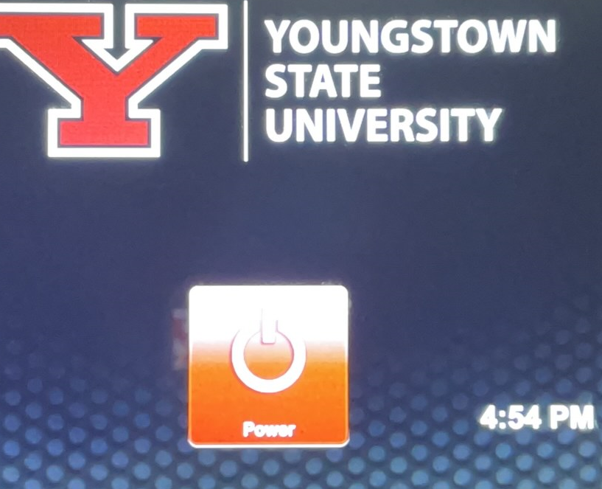
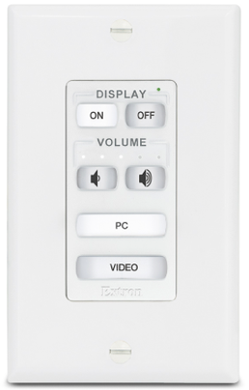
Push Button Control Panels Multimedia Classroom - Phase 1
Airtame | Airtame Touch | Airtame Auditorium
Notes:
Teaching Station Desktop Computer
Airtame (to connect and share wirelessly with devices such as laptops)
Push Button Control Panel on Teaching Station to switch between Desktop Computer and Airtame
Laser Projector and Screen
Webcam with Built-In Mic on adjustable gooseneck stand (doubles as document camera)
Built in Room Speakers

Slide 7
Download Airtame

Slide 8
MMCR Phase 2*
Estimating costs to determine fiscal viability using Federal funding
Leveraging standard Webex configuration
Single or dual camera configuration
Single camera (rear) – instructor focused
Dual camera (front) - projects classroom view &
(rear) – instructor focused
Ceiling mounted microphones included in both options
Laser projector and screen
Target Completion Date – May 2022
*Estimated cost determines classrooms updated in FY22
Notes:
5 RFPs for this project
Expected start date

Slide 9
BYOD
BYOD Labs enable you to bring your own computing devices to charge, work, and print.
Labs contain:
Monitor
HDMI Cord / Display Cable
Power Strip with USB outlet
High-capacity WiFi
Locations:
Beeghley Hall 1310
Bliss Hall (Beecher Lab) 4017
DeBartolo B35, B28, B45, B48, 558
Lincoln Hall 403, 408
Maag Library 406A

Slide 10
BYOD Hybrid Locations
Use a YSU device or bring your own computing devices to charge, work, and print.
Labs contain:
Monitor
HDMI Cord / Display Cable
Power Strip with USB outlet
High-capacity Wi-Fi
Computers with monitors
Hybrid Locations:
Bliss B05
Moser 2380
Notes:
5-year plan to right size to University for physical lab configurations

Slide 11
Technology Support Portal

Slide 12
Wi-Fi Enhancements
YSU has worked to upgrade and remediate the Wi-Fi across campus.
Capacity has doubled.
Using all new equipment.
Available in certain areas outside
Area around the fountain
M70 parking lot (Look for the Y-Fi Zones)

Slide 13
IT Governance
We would like your participation on a governance committee.

Slide 14
Audience Q&A Session
ⓘ Start presenting to display the audience questions on this slide.

Slide 15
Thank you!
Contact the IT Service Desk
Phone: (330) 941-1595 Visit: Kilcawley Center 1st Floor

