Slide 1
Listening Is Not Enough: Sustaining a Culture of Belonging

Slide 2
Counting Vowels in 45 seconds
How accurate are you?
Count all the vowels
in the words on the next slide.

Slide 3
Dollar Bill
Dice
Tricycle
Four-leaf Clover
Hand
Six-Pack
Seven-Up
Octopus
Cat Lives
Bowling Pins
Football Team
Dozen Eggs
Unlucky Friday
Valentine’s Day
Quarter Hour

Slide 4
How many words or phrases do you remember?

Slide 5
Let’s look at the words again…
What are they arranged
according to?

Slide 6
Dollar Bill
Dice
Tricycle
Four-leaf Clover
Hand
Six-Pack
Seven-Up
Octopus
Cat Lives
Bowling Pins
Football Team
Dozen Eggs
Unlucky Friday
Valentine’s Day
Quarter Hour

Slide 7
1 Dollar Bill
2 Dice
3 Tricycle
4 Four-leaf Clover
5 Hand
6 Six-Pack
7 Seven-Up
8 Octopus
9 Cat Lives
10 Bowling Pins
11 Football Team
12 Dozen Eggs
13 Unlucky Friday
14 Valentine’s Day
15 Quarter Hour

Slide 8
NOW, how many words or phrases do you remember?

Slide 9
How do our students know they are welcome?

Slide 10
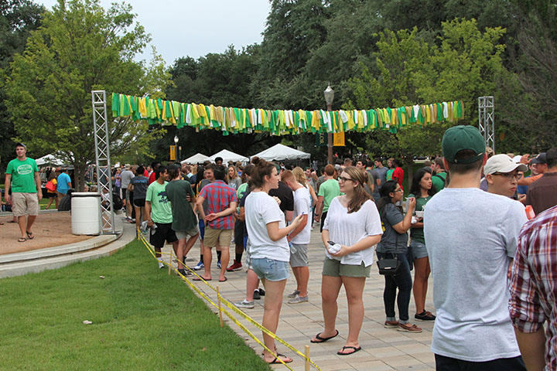
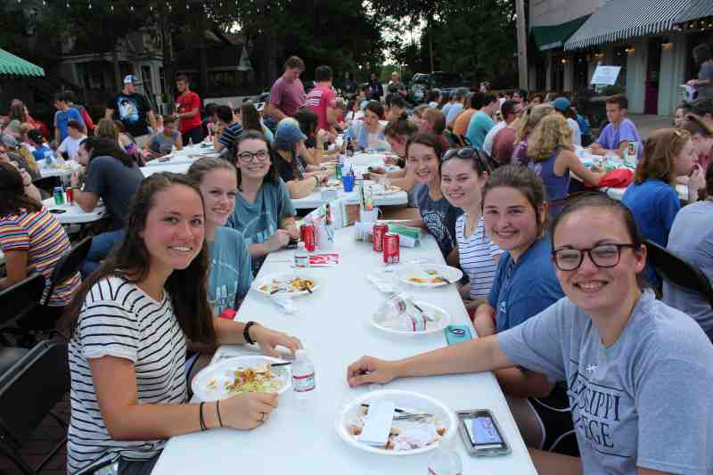

Slide 11
How do our students know they belong here?

Slide 12
“College Customs”
What’s a “Registrar?”
What is this “Blackboard” thing my profs keep talking about?
Do I have to ask to go to the bathroom?
What are “office hours?” Do you go when you’re in trouble?
Wait..we buy our books?
I can drop a class if I’m failing?
How many classes should I take?
Why do I have an “advisor?”

Slide 13
“Belonging Uncertainty”
(Walton and Cohen, 2007)
Students frame the hypothesis: “People like me do not belong here.” Then they look for evidence to support that hypothesis.
They usually find it.

Slide 14
“In fact, Walton and Cohen found that even a single instance of isolation or rejection can undermine sense of belonging.” Strayhorn, 2019

Slide 15
The Hidden Curriculum: “those unstated norms, values, and beliefs transmitted to students through the underlying structure...those norms and values usually not talked about in teachers' statements of objectives or goals, even though such norms and values are implicitly and effectively taught in their classrooms.” (Giroux, 1978)
Flickr user Astrid van Veen

Slide 16
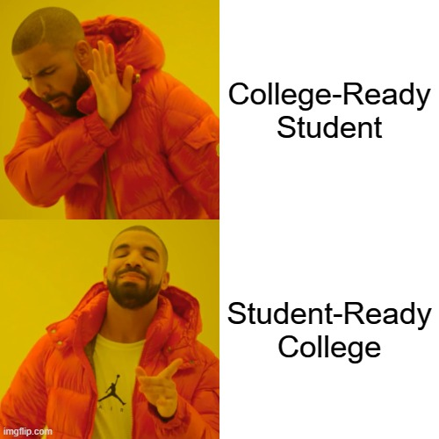

Slide 17
“What does it mean to be a student-ready college? Being a student-ready college requires more than a mission or diversity statement that touts philosophical ideals of inclusiveness…[it] means more than expressed commitments to inclusion and student-centeredness. A student-ready college is one that strategically and holistically advances student success, and works tirelessly to educate all students...”
(McNair, et al., 2016)

Slide 18
“What does it mean to be a student-ready college? Being a student-ready college requires more than a mission or diversity statement that touts philosophical ideals of inclusiveness…[it] means more than expressed commitments to inclusion and student-centeredness. A student-ready college is one that strategically and holistically advances student success, and works tirelessly to educate all students...”
(McNair, et al., 2016)

Slide 19
“At student-ready colleges, all services and activities—from admissions, to the business office, to the classroom, and even campus security—are intentionally designed to facilitate students’ progressive advancement toward college completion and positive post-college outcomes. Student-ready colleges are committed not only to student achievement, but also to organizational learning and institutional improvement.”
(McNair, et al., 2016)
Notes:
Student-Ready College--the challenge and the reality

Slide 20
“At student-ready colleges, all services and activities—from admissions, to the business office, to the classroom, and even campus security—are intentionally designed to facilitate students’ progressive advancement toward college completion and positive post-college outcomes. Student-ready colleges are committed not only to student achievement, but also to organizational learning and institutional improvement.”
(McNair, et al., 2016)
Notes:
Student-Ready College--the challenge and the reality

Slide 21
We listen, but do we hear?

Slide 22
“You told us you were always available to us when we needed help, but every time I tried to schedule a time to meet, you would come up with an excuse.”

Slide 24
“Man, my professor didn’t grade my first paper that I turned in three months ago.”

Slide 26
“My stats prof can’t pronounce my name, so she never calls on me.”

Slide 28
“I may have laughed at your sexual jokes relating to the curriculum, but it’s only because it made me uncomfortable and I didn’t know how else to respond.”

Slide 30
“I am like the rock star of my family, so I feel a lot of pressure to do well in school.”

Slide 32
“When profs do not learn a Black student’s name because it’s ‘too hard’ but they can learn scientific names for plants and animals.”

Slide 34
What does it feel like to be excluded?
What are the consequences of exclusion?

Slide 35
“Bandwidth refers to our cognitive capacity and our ability to pay attention, make good decisions, stick with our plans and resist temptations.” Mullainathan and Shafir, 2014

Slide 36
“BANDWIDTH”
“When students have been raised in conditions of economic insecurity and/or are members of a nonmajority group, and have lived with discrimination and exclusion for their entire life, they are most likely functioning with limited cognitive resources for learning and success in college.”
(Verschelden, 2017, p. 2)

Slide 37
How many of our students are paying “bandwidth taxes?”
And how often are they paying them?

Slide 38
What steals our students’ bandwidth?
Physical and Mental Health: racial and socioeconomic disparities
“John Henryism” and “Skin-Deep resiliency”
Scarcity and Persistent Anxiety
“Imagine sitting in a college classroom with one ear and one eye closed and music playing so loudly that it is hard to hear the professor. No matter how hard you try, you miss out on too much and your concentration is shot.” [Verschelden, 29]
“Underminers”
“relentless wearying drone of negativity from which there is no escape.” [Thompson, 2008]
A Scarcity of Respect and Belonging: a hostile racial climate
Microaggressions and “subtle racism”
people “waste a great deal of energy trying to understand what is happening...energy on all levels, emotional, physical, and spiritual, is wasted in such unclear situations. And people in such circumstances become unable to use their full potential.” [Luczaj, 2008]

Slide 39
Bandwidth depletion affects two key cognitive areas:
Cognitive Capacity
(think clearly, take in and process new ideas and information)
Executive Function
(focus, prioritization, impulse control)

Slide 40
“When we apply interventions to help students, we’re not adding anything to their intelligence or giving them some kind of advantage; rather, we are trying to draw out what is already inside them that has been inhibited by exposure to psychosocial underminers.” Verschelden (2017), 60.

Slide 41
Welcome. And re-welcome. And re-welcome. And re-welcome. And re-welcome. And re-welcome. And re-welcome. And re-welcome. And re-welcome. And re-welcome. And re-welcome. And re-welcome. And re-welcome. And re-welcome. And re-welcome.

Slide 42
“People who have a trusting relationship with a teacher or
mentor are better able to take advantage of critical feedback and
other opportunities to learn.” Walton and Cohen (2007)

Slide 43
“There’s only one rule that I know of, babies—God damn it, you’ve got to be kind.” Kurt Vonnegut

