Slide 1


Title
Budget Advisory Committee Update
October 1, 2018

Slide 2
Agenda
Institutional Technology Spend
  Centralized PC Refresh
Space Utilization
  Course Scheduling System Business Case & ROI

Slide 3
Institutional Technology Spend
Goal: Provide faculty, staff and students with a highly reliable technology experience at a lower cost today and into the future.

Slide 4
Institutional Technology Spend
Centralization Spend Success Story:
  Enhanced Print Management Initiative
Technology Spend: Current State (Decentralized)
Technology Spend: Proposed Future State (Centralized)
Advantages of Centralized Technology Spend
Actual Technology Spend (FY17) vs. 5-year Refresh Cycle Technology Spend
Governance of Centralized Technology Budget
Next Steps

Slide 5
Enhanced Print Management Initiative
Good example of savings associated with centralization of technology spend.
  Project start to date (YR 3):
  Savings = $250,000 (toner only)
  Print device reduction = 366 fewer printers
  Forecasted Savings (FY2020):
  Savings > $350,000 (toner only)
  Print device reduction approximately 1,000 fewer printers
  Capital cost avoidance associated with refresh of 200 printers per year (5 year refresh) @ $275/printer = $55,000/year
Notes:
ComDoc contract = $185,000/year; Internal Refresh = $135,000/year

Slide 6
Current State - Decentralized
Colleges burden technology acquisition costs for:
  Multimedia Classroom units (no refresh cycle established)
  Computer Labs
  Faculty/Staff computers
Some colleges have established computer refresh cycle for Computer Labs, but most have not established for Faculty or Staff computers
“Pass Down” of Computer Lab computers is common in the Colleges but is operationally inefficient as it creates excess work for ITS
Technology refresh occurs from May-August; creates ITS staffing challenges during the Summer and Fall

Slide 7
title
** Most of the computers over 5 years old are faculty or staff devices.

Slide 8
Proposed Future State - Centralized
Centralize technology spend for Multimedia Classroom units, Computer Labs and Faculty/Staff computers
(5-year refresh cycle Windows/6-year Apple).
Refresh Criteria Recommendation for upcoming IT Steering Committee:
  Age/Operating System (starting with oldest)
  Ensure that every College/Department participates
  Implementation by Building (operational efficiency)
Net New Computers would be procured through department and added to centralized refresh funding after initial purchase
Non-standard devices will be approved as exceptions for research only
Upgrades from standard will require Departmental/College contribution (replacement budget is based on “like” device).

Slide 9
Advantages - Centralized
Level ITS resource demand, reducing Summer overtime or refreshes stretching out to Winter break
  Currently ITS receives a significant number of refresh requests in late-May or early-June for installation over the Summer
  PC and MMCR deployment over the fiscal year versus “on demand” (i.e. 850 devices/year or 212/quarter versus 700 every Summer and 150 the rest of the year)
Assess computer leasing opportunities for Computer Labs
  Potential for a 3-year refresh cycle at the same or lower annual cost of 5-year purchases
Use centralized funding to adopt high “ROI” technologies
  Thin-client and/or application virtualization in Computer Labs, development of BYOD Computer Labs, etc.

Slide 10
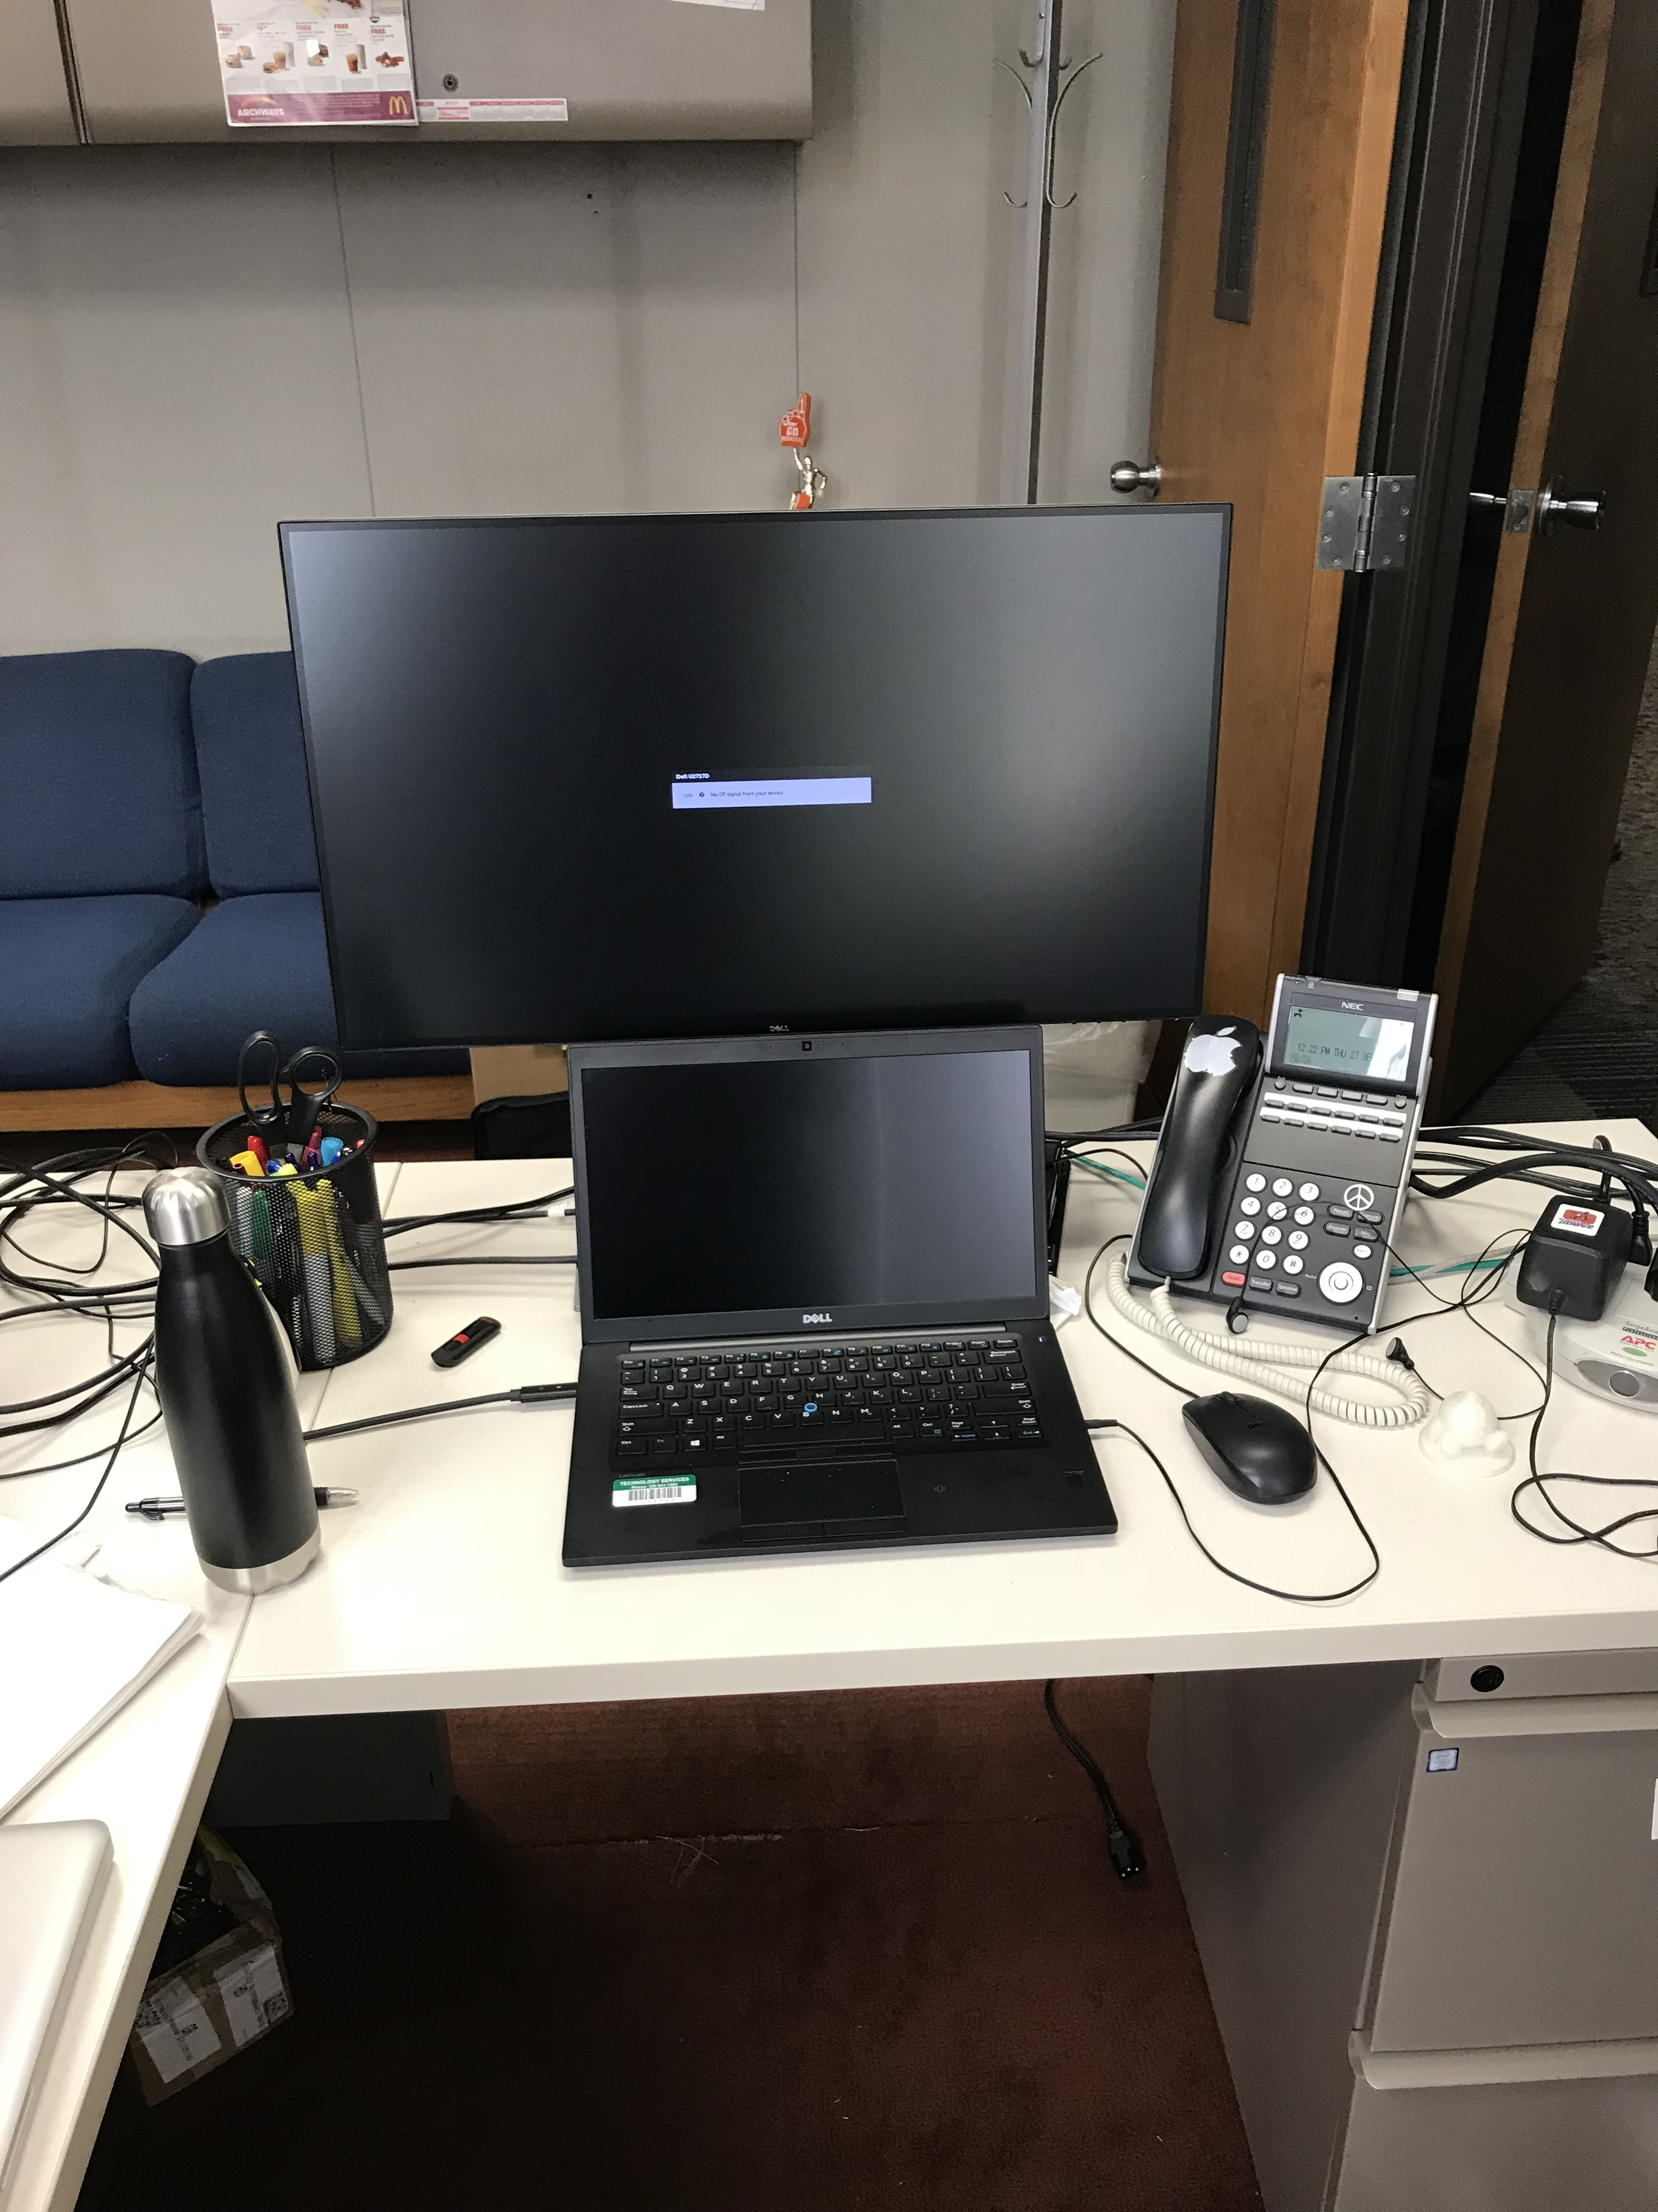
Advantages - Centralized
Leverage economies of scale through “bulk purchases” and committed purchase volume (i.e. 850 units per year)
Eliminates the need for a faculty member to have two devices (“pass down” desktop and laptop)
  Agreed upon standard: One laptop device and docking station for all full-time faculty.
Mitigates future operating systems end of support issues
  Microsoft is slated to end support on Win 7 on 1/14/20
Higher adoption of technology standards leading to efficiency gains in computer support, service wait times, etc.
Centralized Technology Refresh is consistent with peer IUC universities

Slide 11
*Actual Technology Spend
Category | CY2017 Spend | Comments
Multimedia Classroom (MMCR) | $203,141 | Colleges refreshed 28 units in CY2017**
Computers | $910,286 | Includes Computer Labs, Faculty & Staff
Total CY2017 Spend | $1,113,427
* Source of all CY2017 Spend data is e-Cube
**Note: MMCR standard refresh cost was $10,000/unit in FY17; recently revised to $4,700/unit

Slide 12
Spend Needed for 5-year Refresh Cycle
Proposed Refresh Cost Allocation | Annual Cost | Comments
MMCR (Current Standard) | $206,800 | 44 units/year @ $4,700/unit; 5-year refresh cycle
Computers | $938,860 | 4,105 computers; 5-year Windows, 6-year Apple refresh cycle
Total Annual Refresh Cost | $1,145,660
Variance from Current Spend= +$32,233 or +2.9%
Computer Refresh need exceeds actual spend by less than 3%. Efficiencies gained through centralization, will be approximately 5-10% per year the first five years.
MMCR refresh will be shared expense (75% ITS/25% College)
* Source of all Refresh data is Altiris desktop management software
Notes:
ITS is applying increased revenue from Penguin Promise to MMCR Refresh

Slide 13

title
I.T. Governance Structure
January 2017
Manage Centralized Technology
Budget through IT Governance Structure
Tod Hall Leaders
I.T. Executive Steering Committee
(New Committee)
Academic Senate
(Existing Committee)
“Steering Committees” are chartered to make budgetary decisions
I.T. Steering Committee
(Existing Committee, fka ITAC)
Academic Senate
Technologies Committee
(Existing Committee)
ITSC will review “Refresh List” quarterly before devices are ordered
Examples:
Enterprise Applications Advisory Committee
(Existing Committee, fka EBOT)
Banner, business software, device standardization for business users, printer consolidation in business areas, etc.
Security & Policy Advisory Committee
(New Committee)
Security software and security appliance selection, security policy review, vetting of new cyber attacks and solutions, etc.
Technology Advisory Committee
(New Committee)
Data Center considerations, infrastructure technology refresh and standardization, wireless communication standards, etc.

Slide 14
Next Steps
ITSC Recommended Centralized Technology Refresh Initiative on May 31st
Dean’s Council Approved on August 15th
Central Technology Budget funded in mid-September FY19
IT Governance Oversight of FY19 Budget beginning with ITSC Meeting on October 3rd (review and approve refresh of first 250 PC’s)
Notes:
UPDATE FOR BAC

Slide 15
Course Scheduling System Business Case & ROI

Slide 16
title

Slide 17

Benchmarking Metric
10,432 Student FTE's and 1,829 Computer Lab/Classroom workstations is a ratio of 5.7
EDUCAUSE Benchmark for mid-sized public universities (<15,000 Student FTE's) is 12.
Overserved by twice the benchmark. Meaning, YSU should have approximately 900 computers dedicated to Computer Labs.

Slide 18

title
Student FTE’s per Computer Lab workstations
Trends: Virtualization & BYOD
*
Acceptable Range 12.0-14.0
* WSU has virtualized 70% of their Computer Lab devices (much lower TCO than YSU)
** Akron University moving to BYOD Computers Labs
Notes:
YSU: 10,566 FTE’s / 1,829 CL computers = 5.8
BGSU: 14,862 / 1,075 = 13.8
WSU: 13,861 / 2,800 = 4.95 *

Slide 19
Average Computer Lab Utilization
Total Operating Hours = 2,142/year
Notes:
Operating hours = 5 days per week x 32 weeks (Fall/Spring) – 7 holidays * 14 hours/day (8am-10pm)
@ 1,377 hours per year (8am-5pm); Kilcawley = 47% utilization

Slide 20
30 Lowest Utilized Computer Labs*
* Computer Labs with 15 or more computers/65 Total

Slide 21
How will the CollegeNet Course and Event Scheduling System help?
CollegeNet’s prescriptive team of experts will be on campus to help build and implement the system according to “best practices” for space utilization optimization
Real-time interface to Banner ERP/SIS
Centralized management of classroom and event schedules
Provides information on classroom availability and details of each room
Single sign-on with access for specific privileges
Requires institutional commitment to space utilization optimization

Slide 22
ROI Key Assumptions
Computer Lab Workstation Refresh by:
  Optimizing labs and eliminating 900 workstations "OR"
  Converting half of the computer lab workstations to BYOD seats in half of the Computer Labs on campus.
Reduce MMCR Refresh by 25% through space utilization.
  Implementing both of these initiatives would result in a conservative annual cost avoidance of $165,000.
Use Lincoln Building as “swing space” for construction and close the building for the Summer.
Notes:
5%-50% decrease of devices equates to $110,000-$220,00/year = $550,000-$.1.1M over 5 years
Many other to consider – create Student Success Center with existing buildings, close oldest buildings that require significant renovation, etc.

Slide 23
CollegeNet Course Scheduling System ROI

Slide 24
title

Slide 25
CollegeNet Course Scheduling System ROI

Slide 26
title

Slide 27

title

