Slide 1
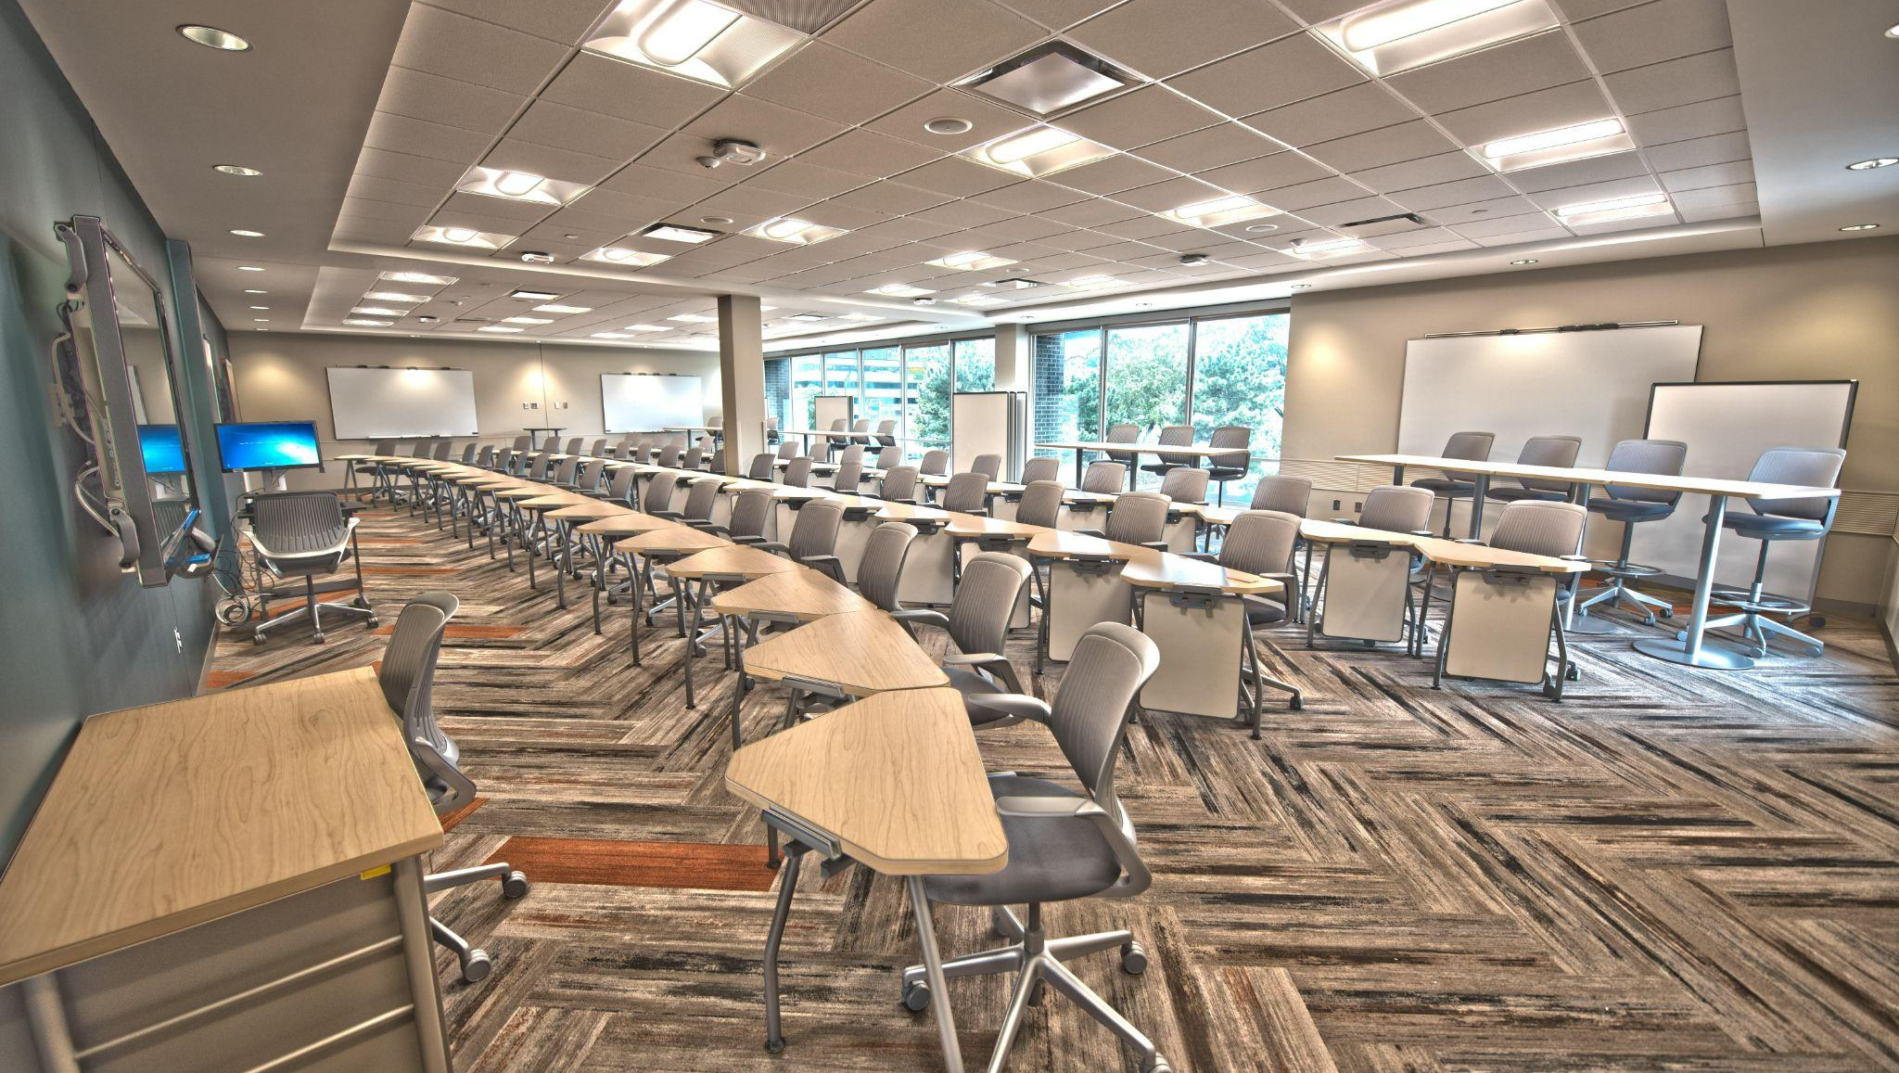
A Pedagogy of Hope

Slide 2
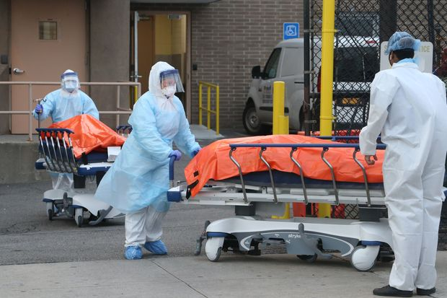

Slide 3


Slide 4
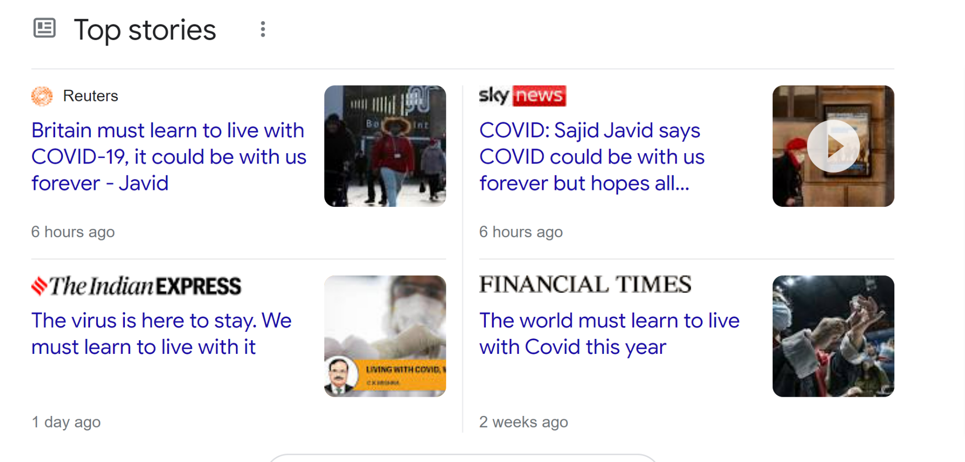

Slide 5


Slide 6


Slide 7
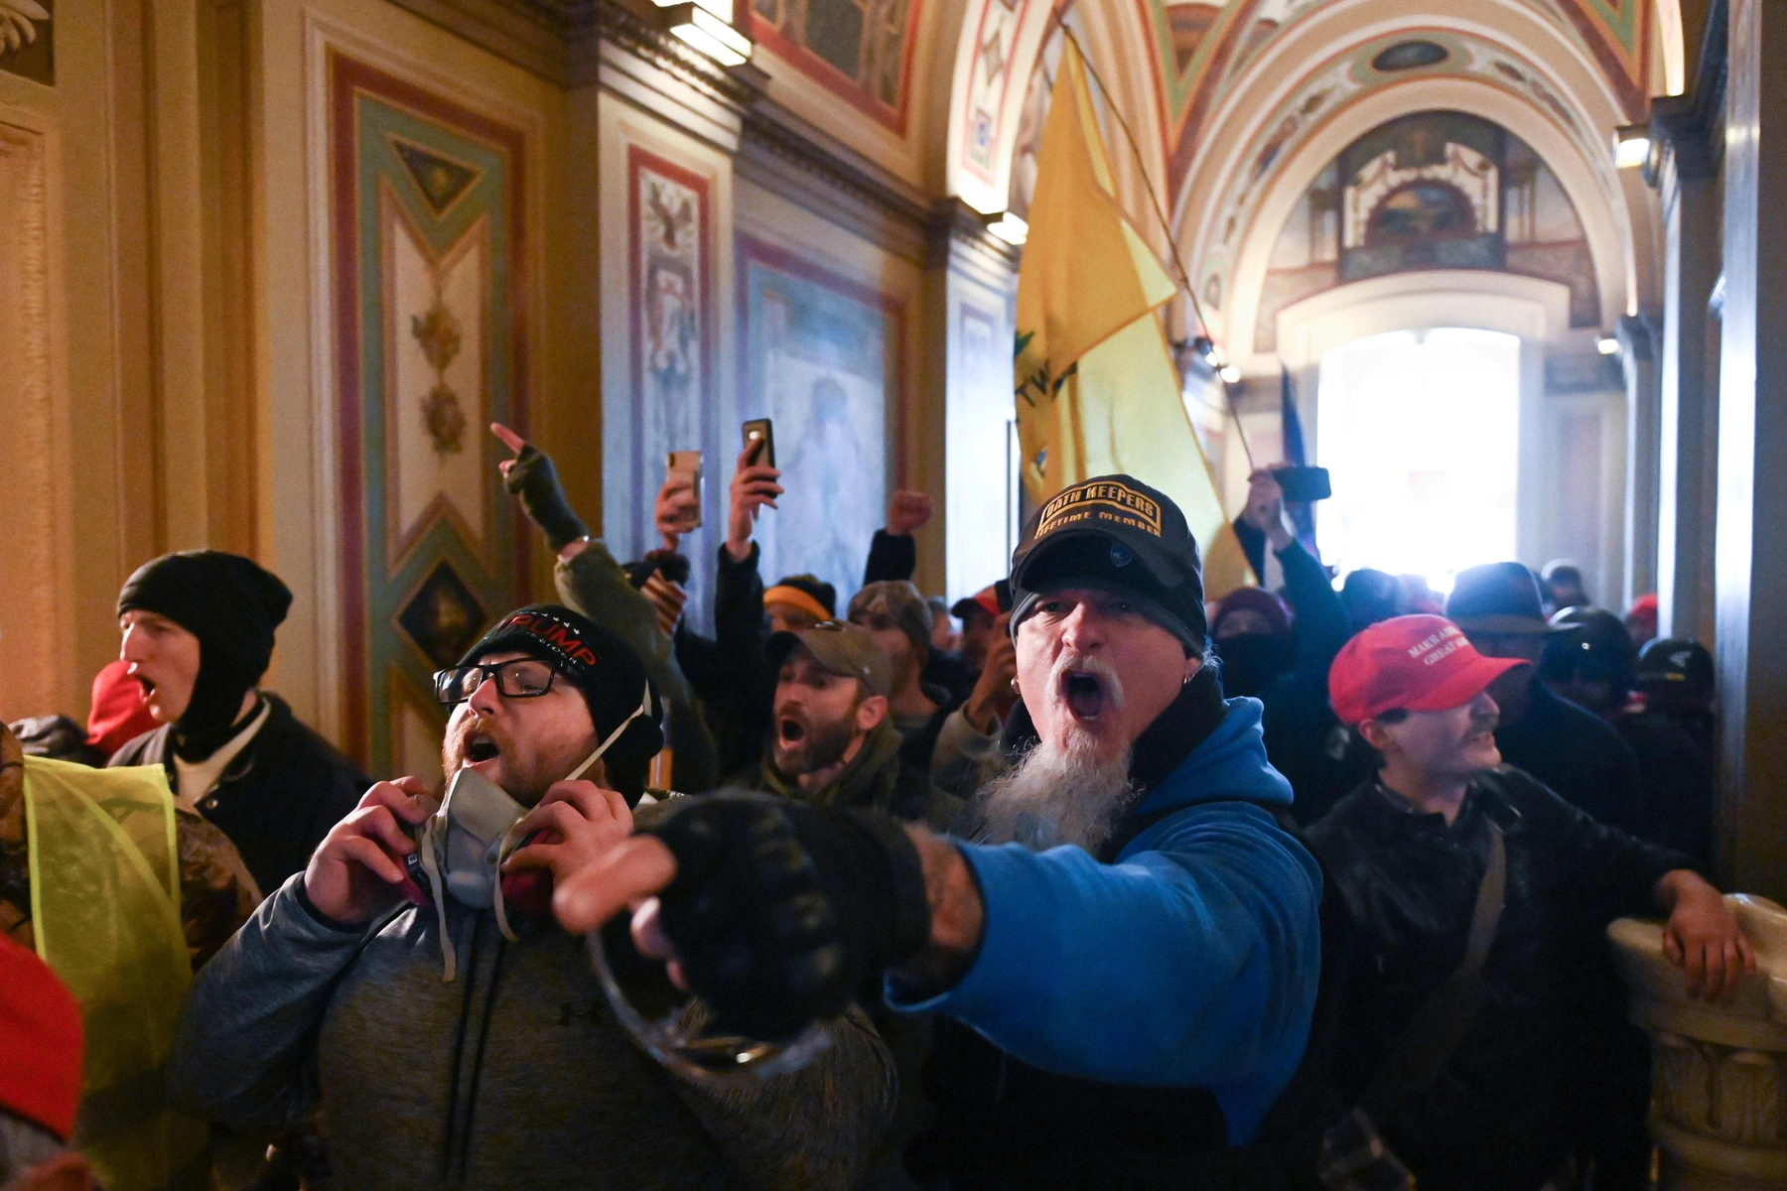

Slide 8
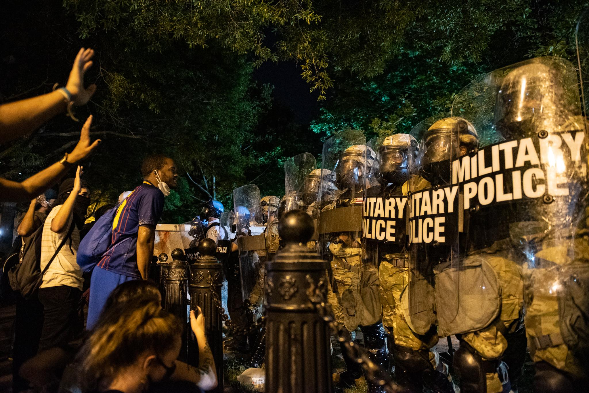

Slide 9
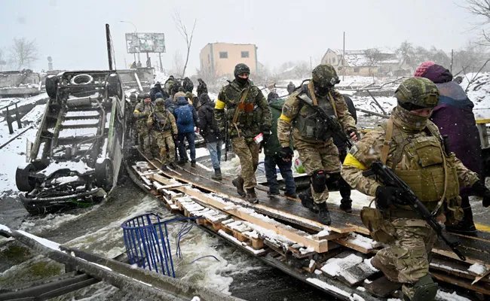

Slide 10
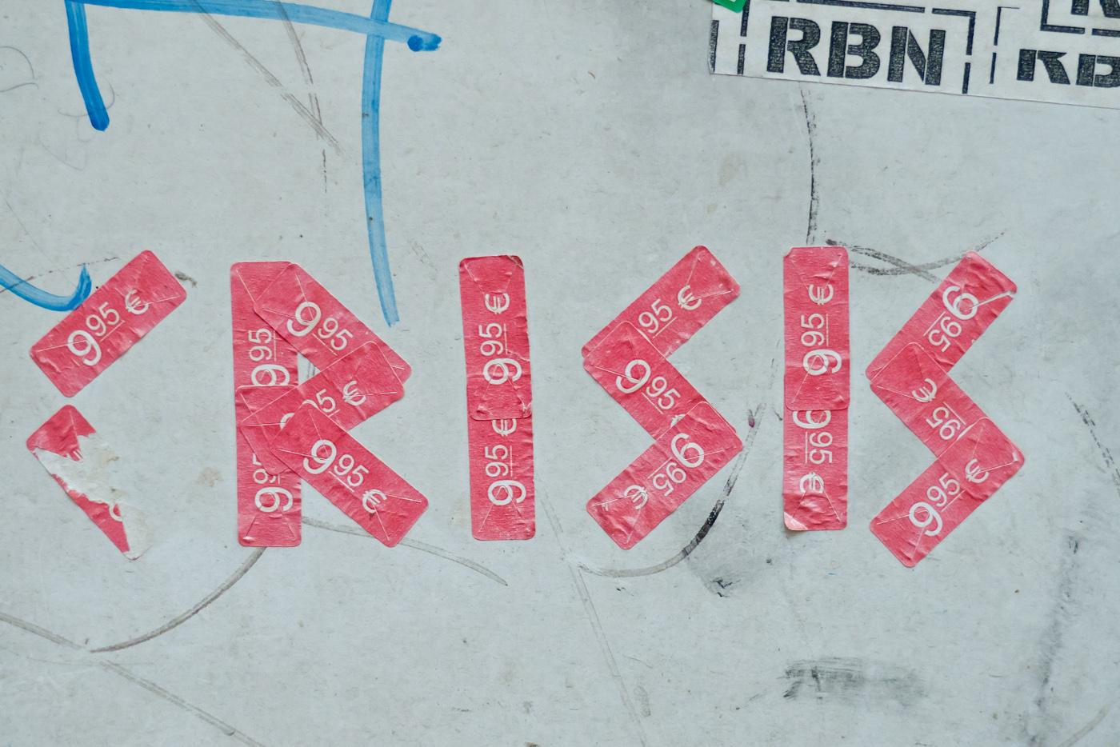

Slide 11
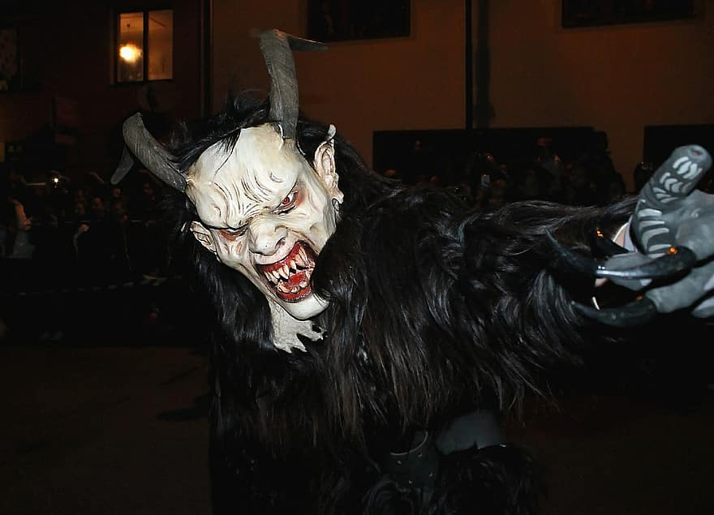
“The crisis consists precisely in the fact that the old is dying and the new cannot be born; in this interregnum a great variety of morbid symptoms appear.” Antonio Gramsci
“The old world is dying, and the new world struggles to be born: now is the time of monsters.” Slavoj Zizek’s (loose) translation of Gramsci

Slide 12
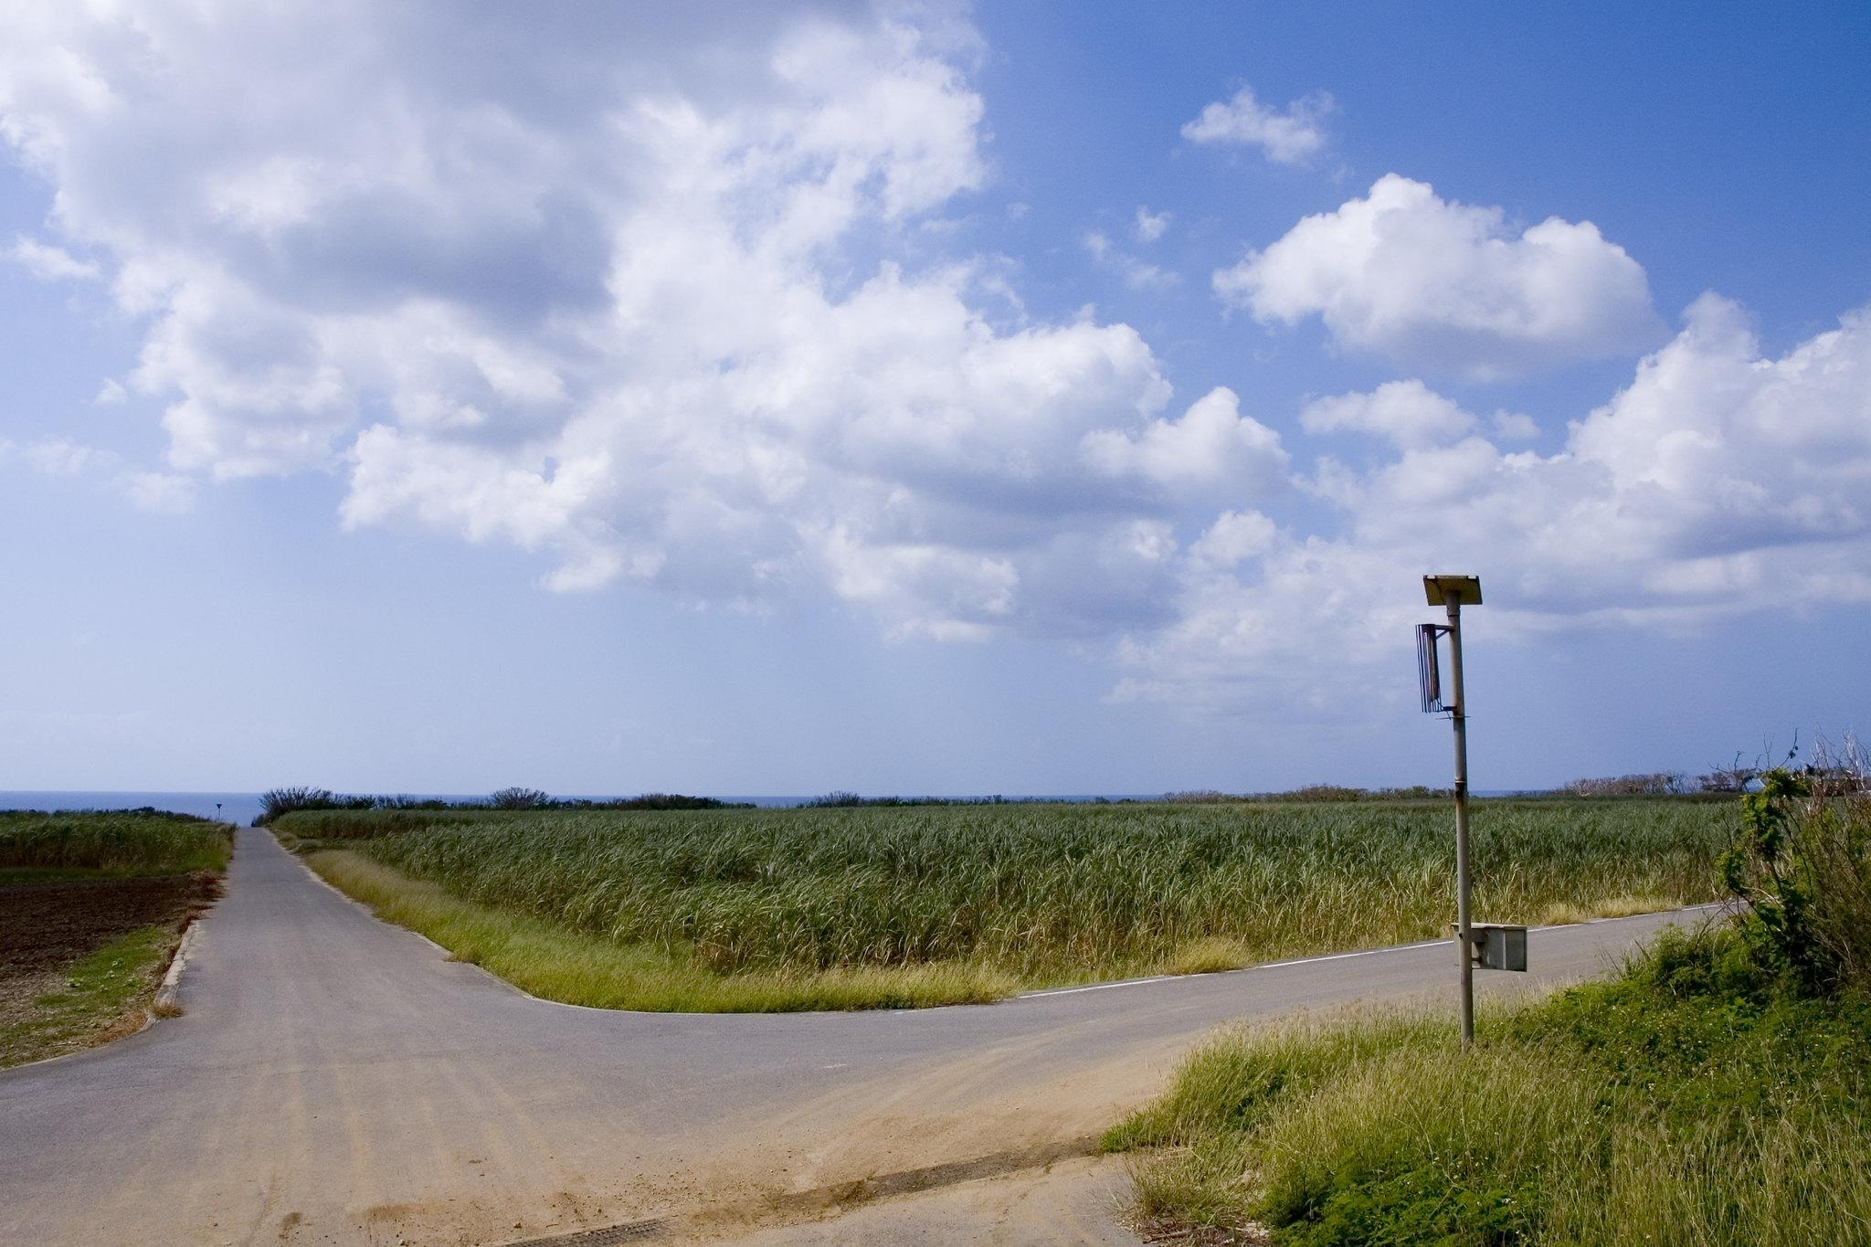
Without an unflinching honesty about where we are, we cannot discern where we need to go.

Slide 13
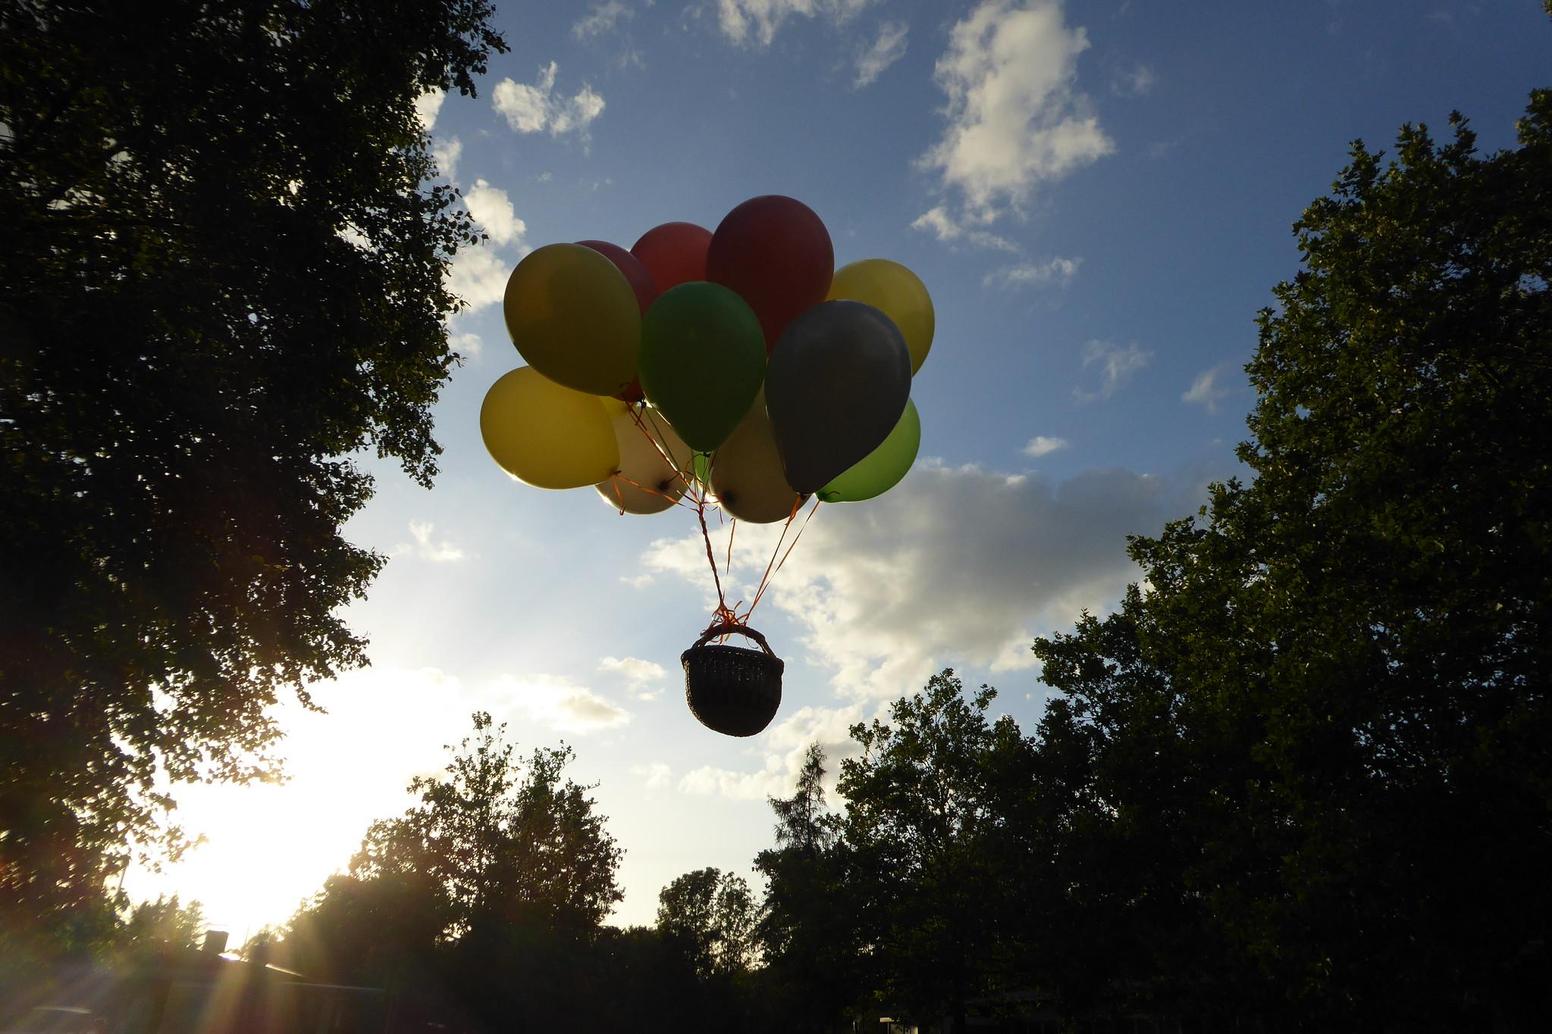
What does a pedagogical praxis rooted in hope look like?
Notes:
Flickr photo: Rising, by Erich Ferdinand

Slide 14
What does a pedagogical praxis rooted in hope look like
during the “time of monsters?”
Notes:
Flickr photo: Rising, by Erich Ferdinand

Slide 15

Hope is not a lottery ticket you can sit on the sofa and clutch, feeling lucky. It is an axe you break down doors with in an emergency....To hope is to give yourself to the future - and that commitment to the future is what makes the present inhabitable.” Rebecca Solnit, Hope in the Dark

Slide 16
Hope is not a lottery ticket you can sit on the sofa and clutch, feeling lucky. It is an axe you break down doors with in an emergency....To hope is to give yourself to the future - and that commitment to the future is what makes the present inhabitable.” Rebecca Solnit, Hope in the Dark

Slide 17

Hope = Agency + Pathway(s)
(McGowan & Felten, 2021)

Slide 18

Structures of inequality will always reproduce themselves until we intervene to stop that reproduction.
Flickr user ume-y

Slide 19

How do we intervene?

Slide 20
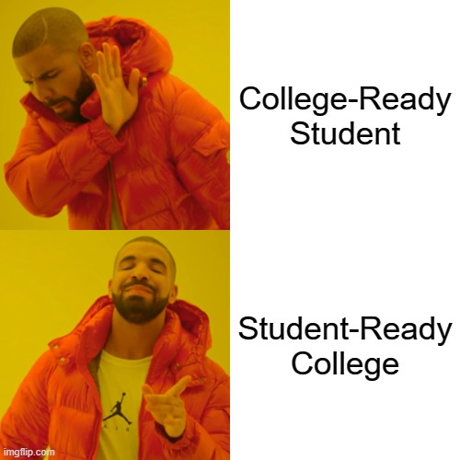

Slide 21

What can we no longer ignore about our students and their learning?
And what are we going to do with this knowledge?
Notes:
Breakout Rooms discussion and report out

Slide 22

In education, the opposite of hope is fear.

Slide 23
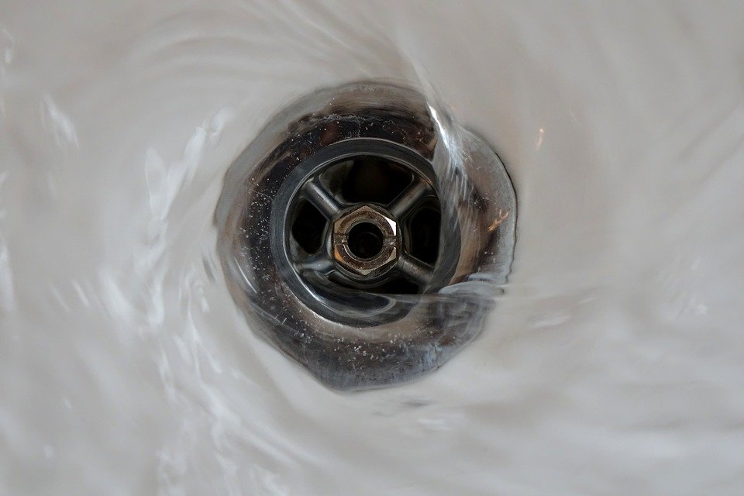
Are we making decisions from a place of fear?

Slide 24
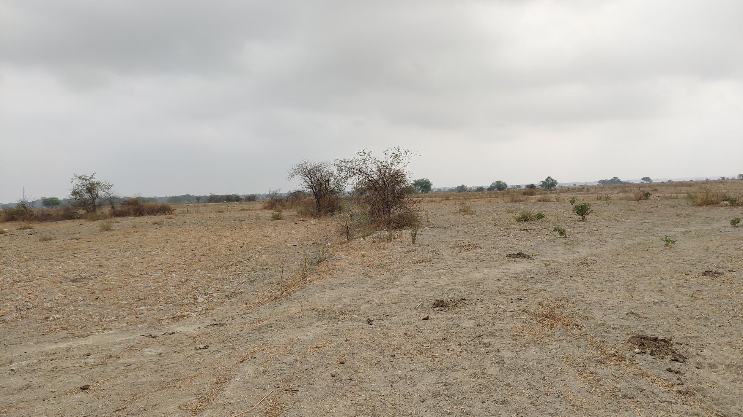
When we make decisions based in fear, we become hoarders. We clutch harder at what we see as scarce, because it gives us the illusion of control.

Slide 25
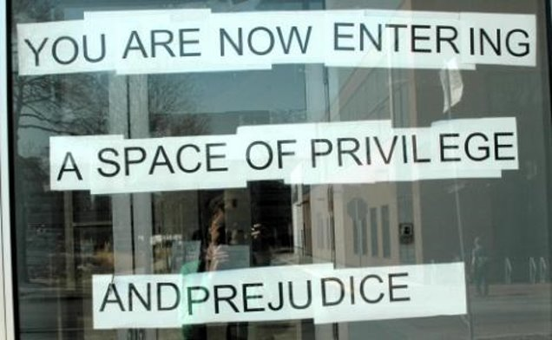
How many students are experiencing college this way?

Slide 26

Weaponized Design
“electronic systems whose designs either do not account for abusive application or whose user experiences directly empower attackers.” -Cade, On Weaponised Design
Notes:
How should we approach the work of designing learning spaces, in this moment, now?

Slide 27
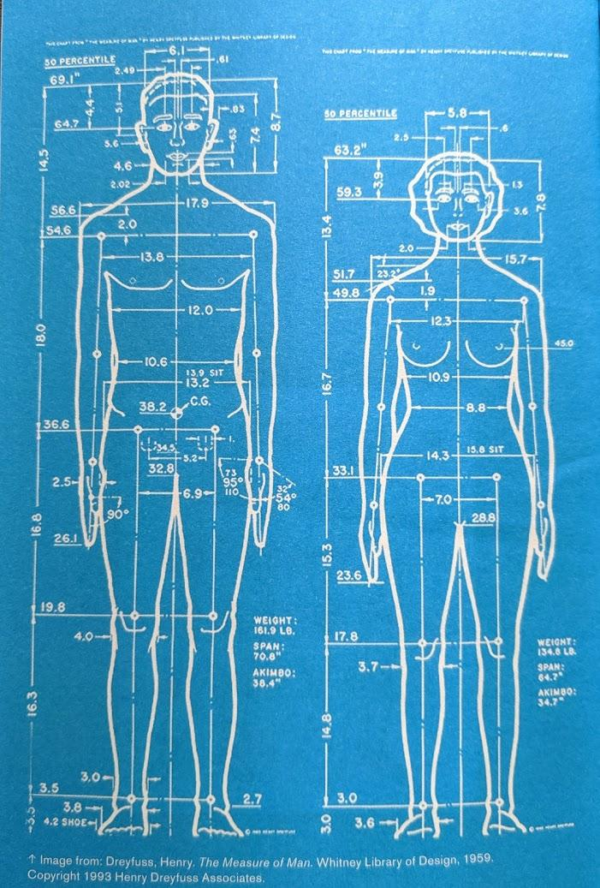
Henry Dreyfuss,
The Measure of Man (1959)
“It is not customary to design for everyone. The few at either end of the normal curve may be so extreme that an encompassing design could become too large or too expensive to produce.”
Quoted in Pater (2016)

Slide 28
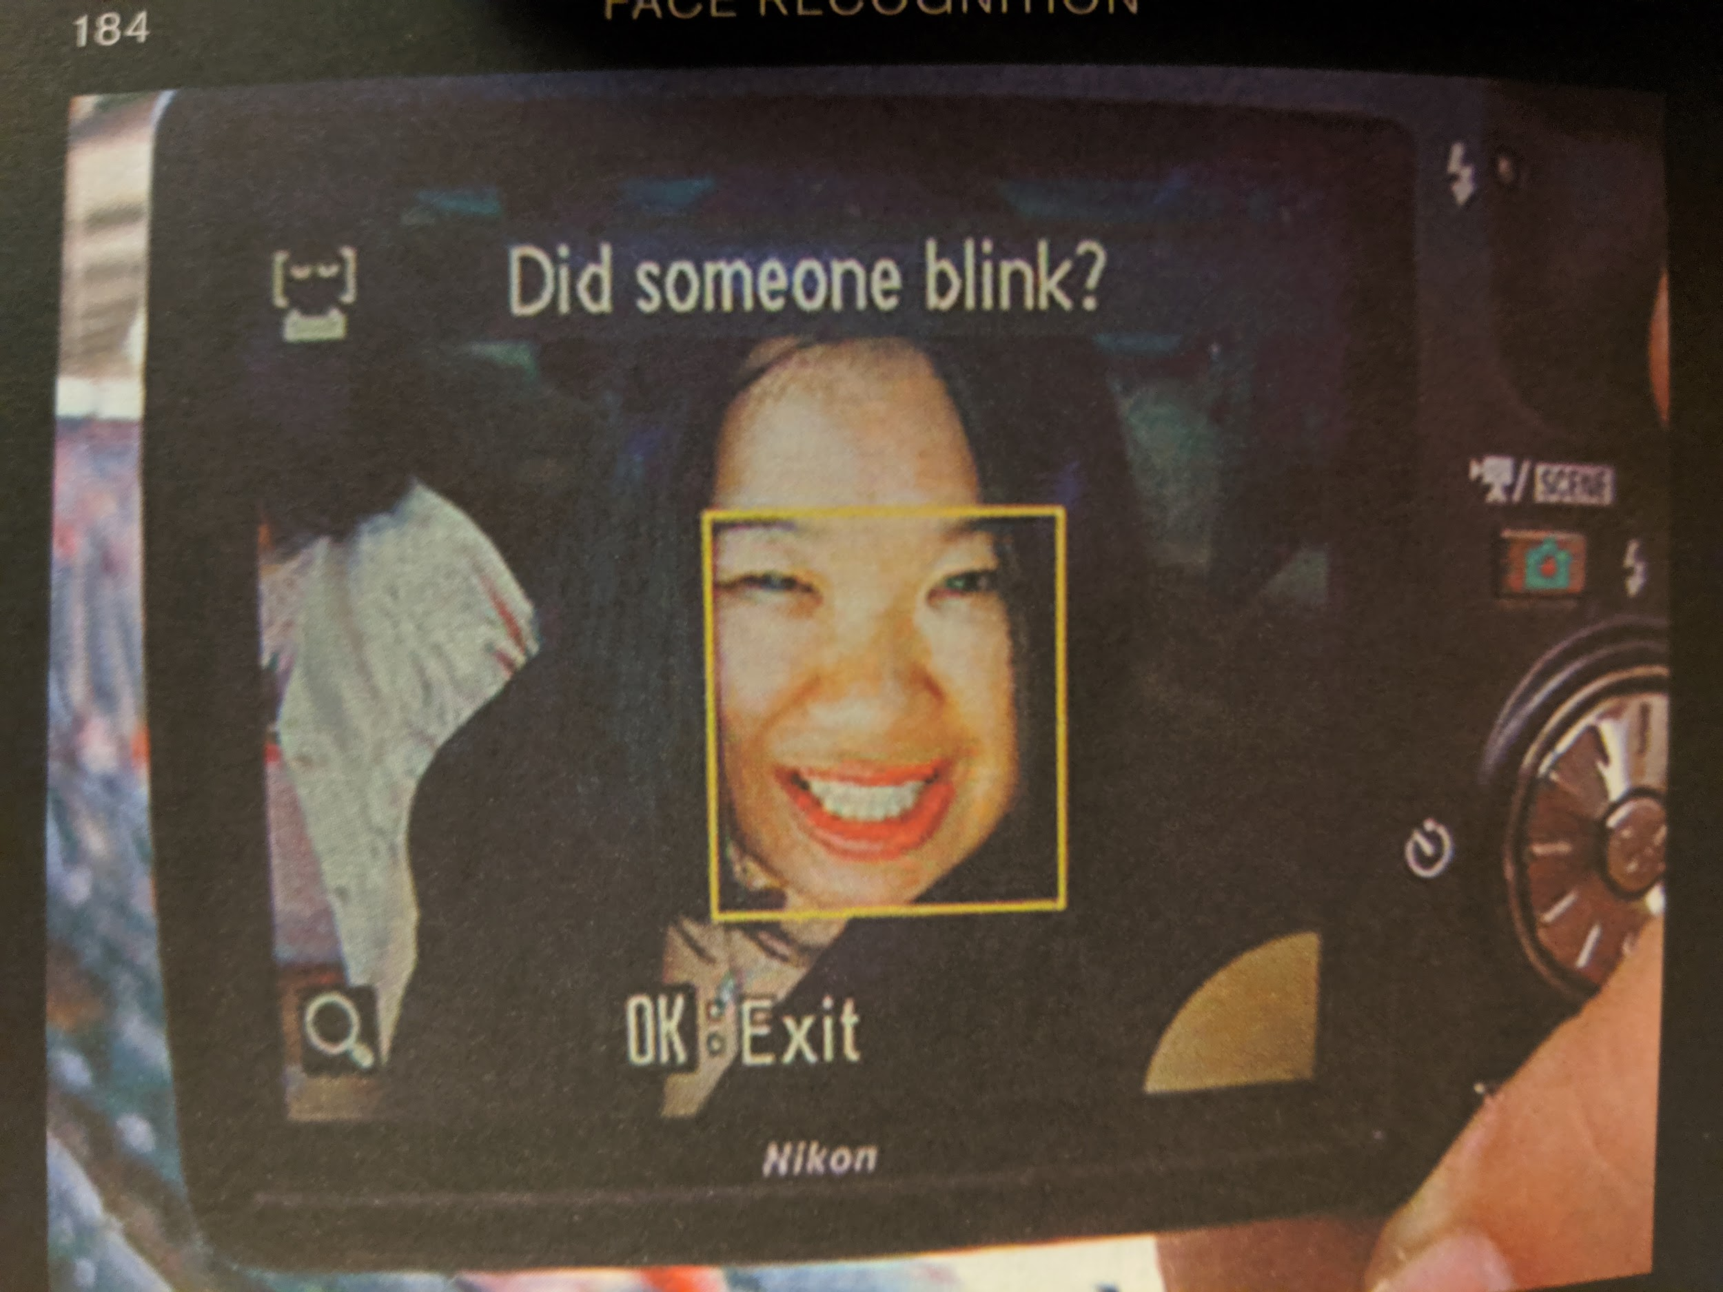

Slide 29
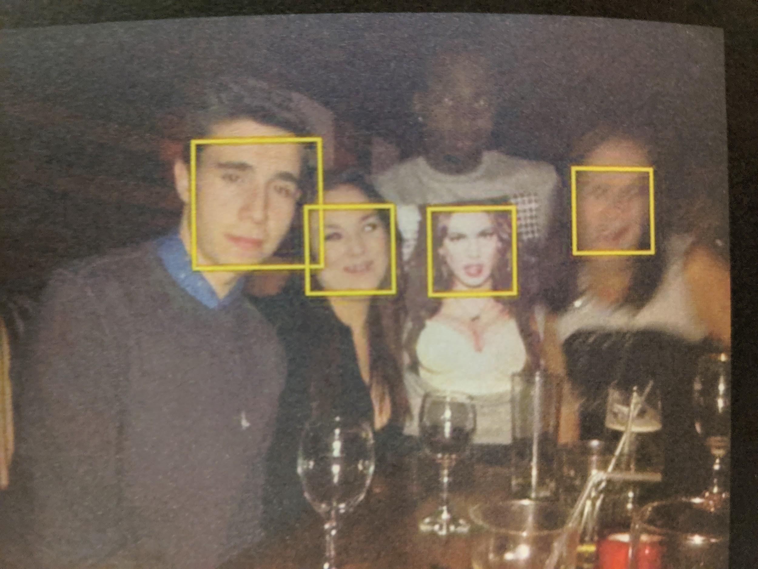

Slide 30


Slide 31
“Mismatch”
“Mismatches are barriers to interacting with the world around us. They are a byproduct of how our world is designed… mismatches are the building blocks of exclusion.” -Kat Holmes

Slide 33



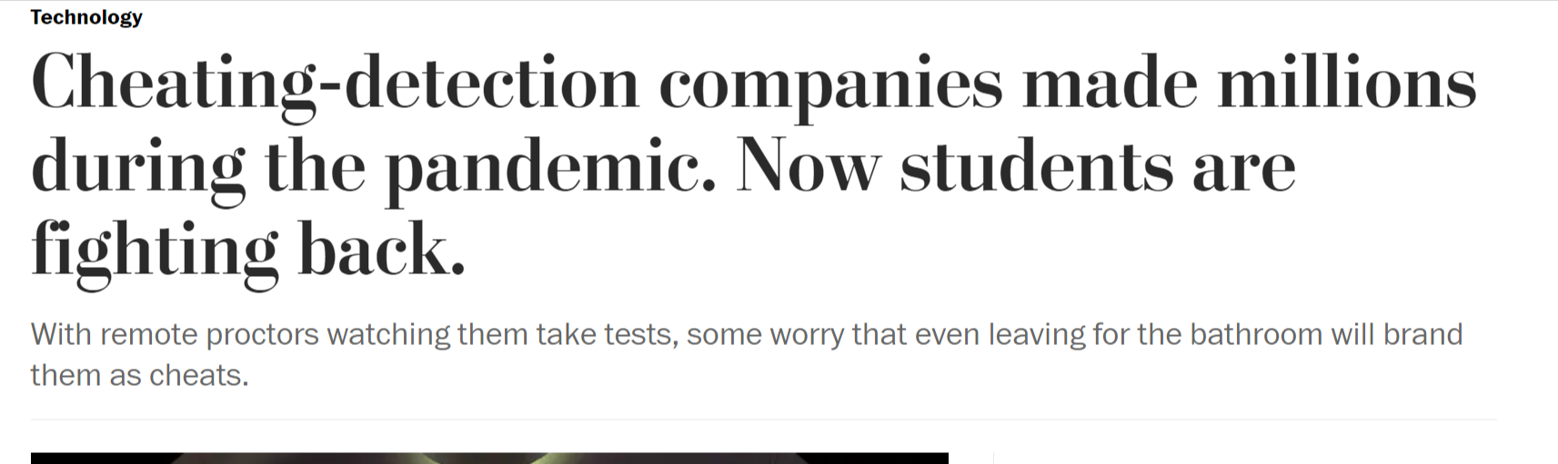
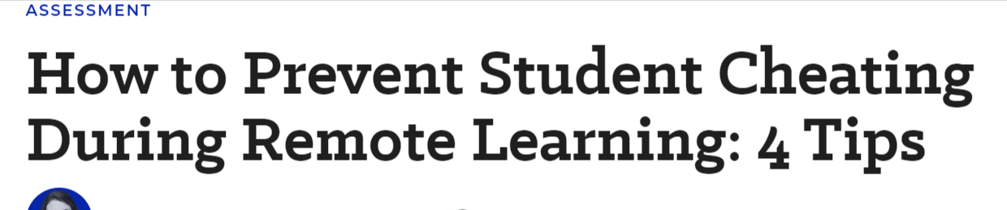

Slide 34

Dehumanization, which marks not only those whose humanity has been stolen, but also (though in a different way) those who have stolen it, is a distortion of the vocation of becoming more fully human.
Paulo Freire, Pedagogy of the Oppressed, ch. 1

Slide 35
How many students are experiencing college this way?

Slide 36
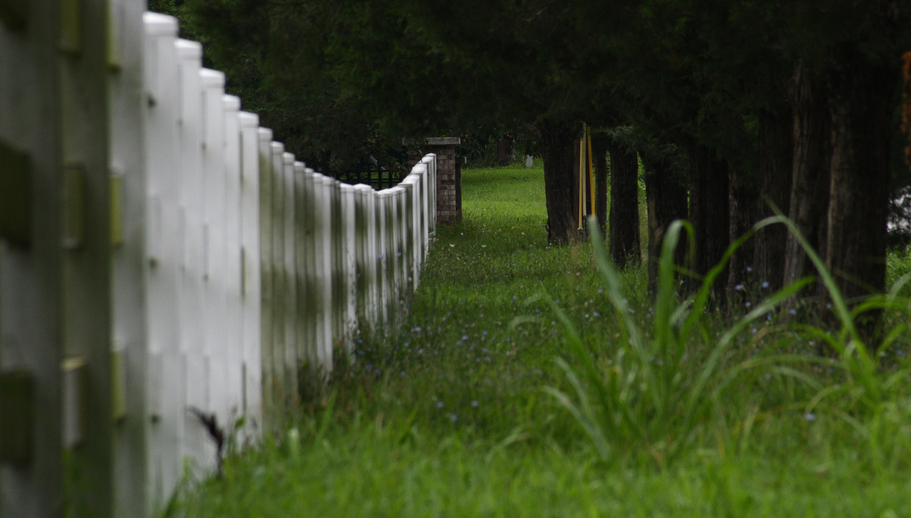
Educere (Latin): to draw out, to draw forth
Flickr user Fabian Gutierrez

Slide 37
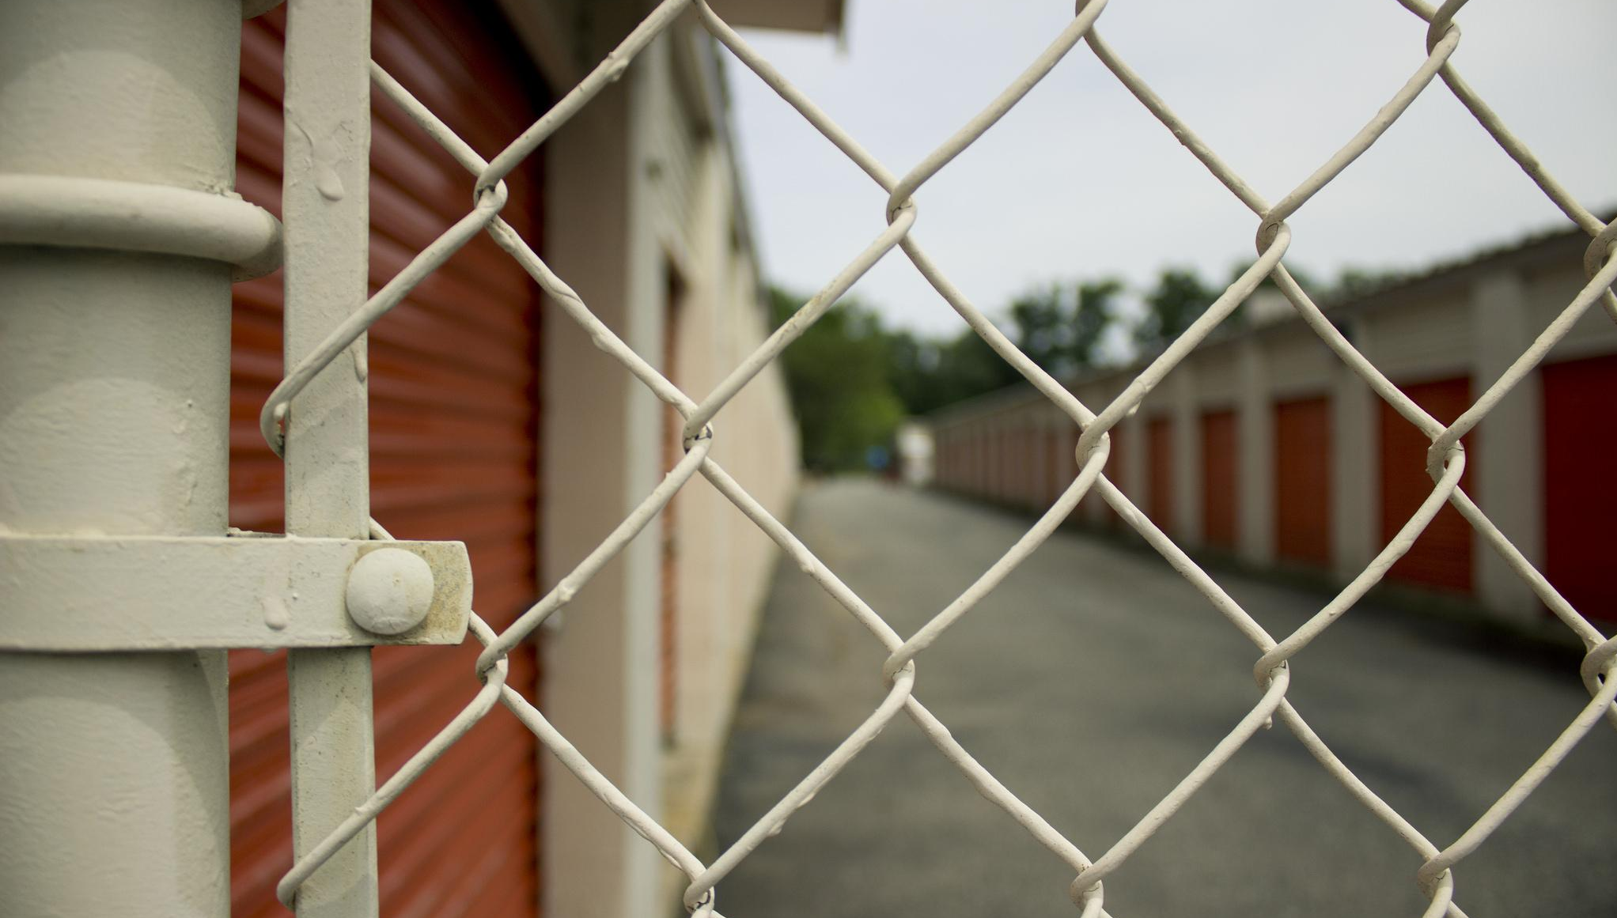
It’s hard to draw something forth if it’s behind a fence.
Flickr user Carmen Shields

Slide 38

Diversity statements are not enough.
Notes:
Flickr user Brian Kelly

Slide 39
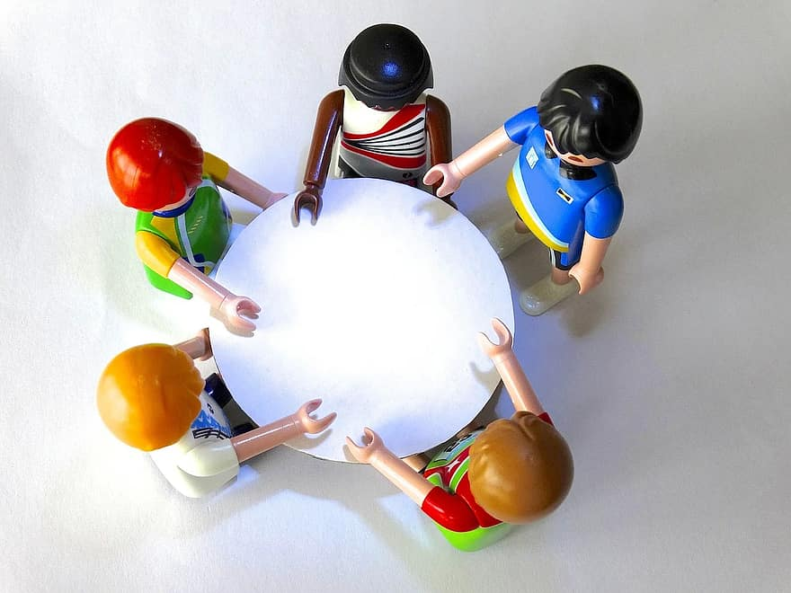
“We are open to having the tough conversations…”

Slide 40

Flickr user Alex Liivet
We should design courses for students, not in spite of them.

Slide 41
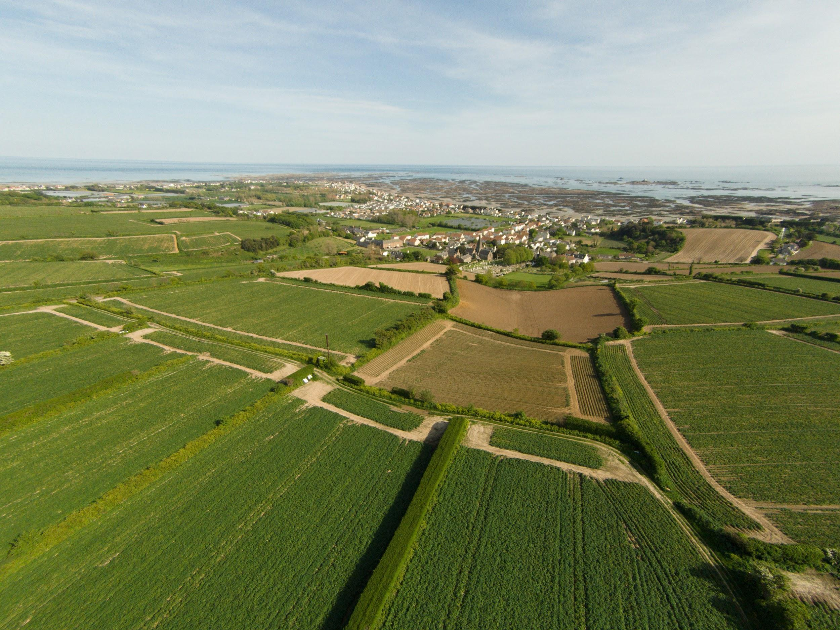
“Covering content” is something teachers do, not students.

Slide 42

Let’s create spaces that foster meaningful and genuine PRESENCE

Slide 43
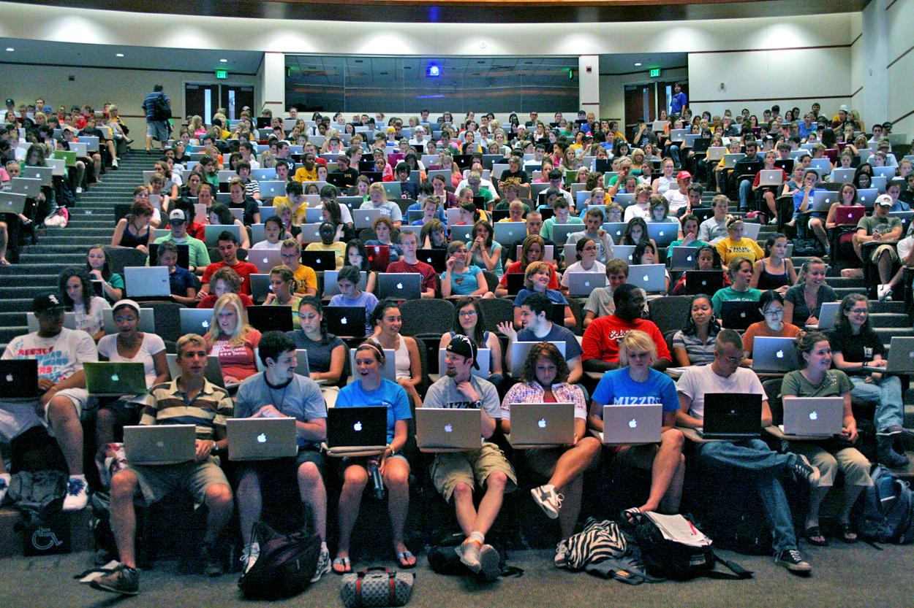
Where, and How, does the most meaningful learning occur?

Slide 44
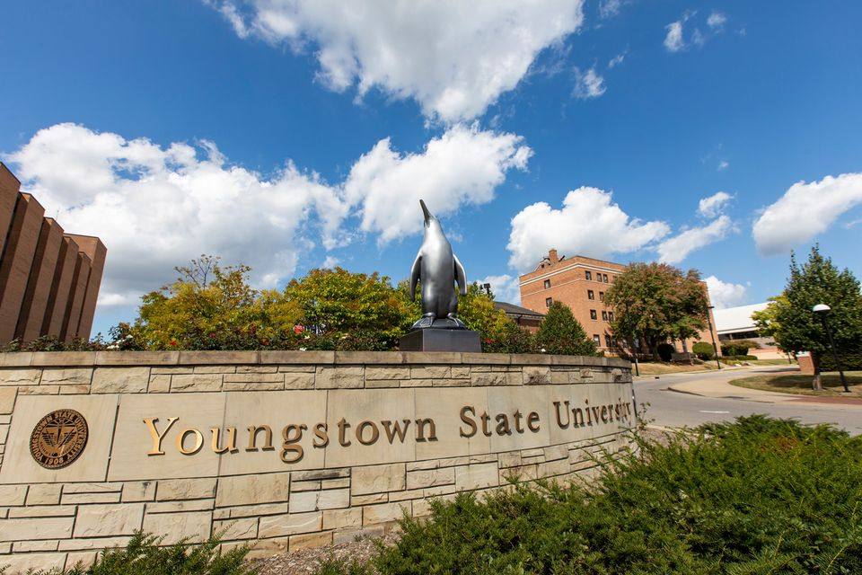
Where, to whom, and how do we allocate resources?

Slide 45
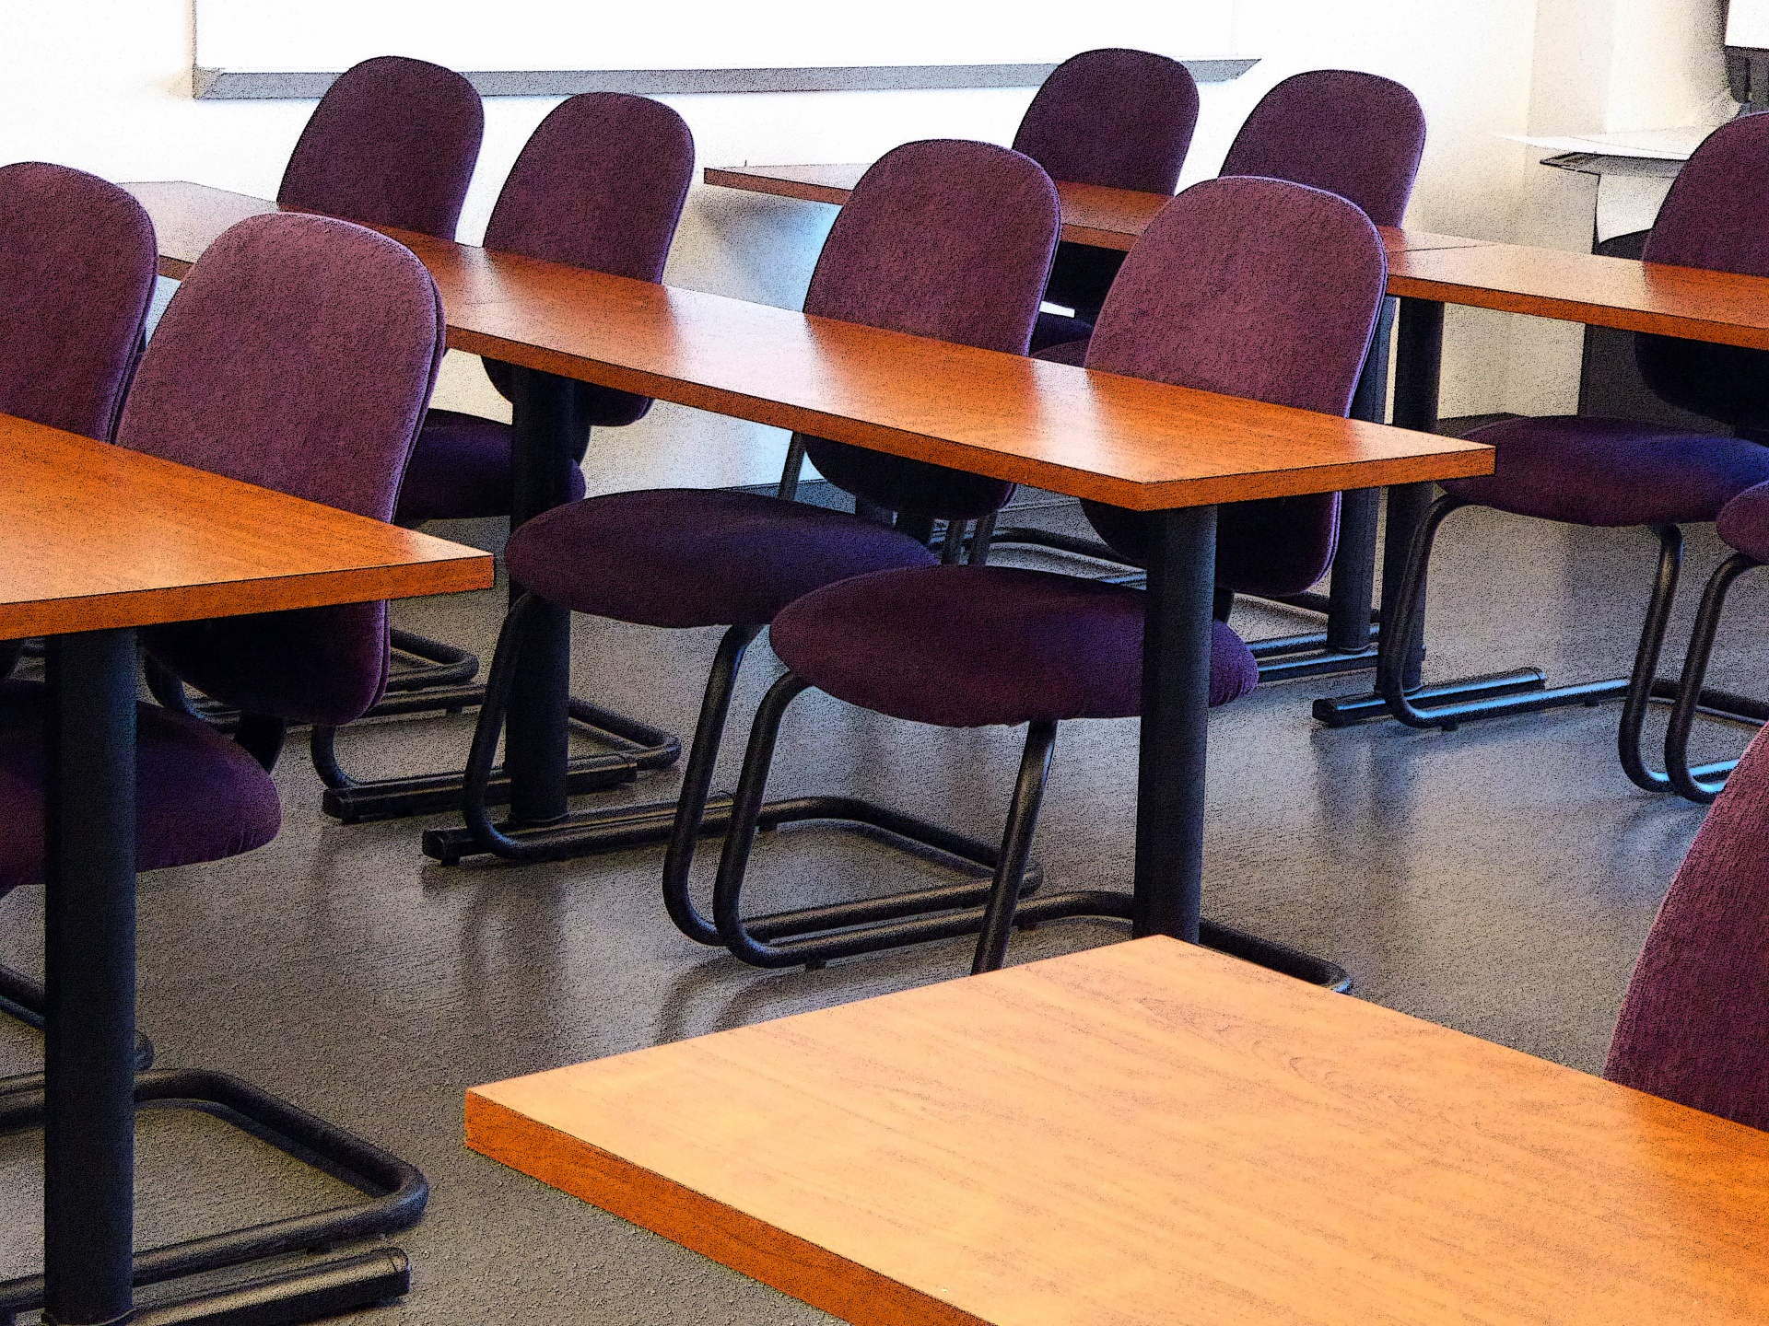
Teacher working conditions are student learning conditions.

Slide 46
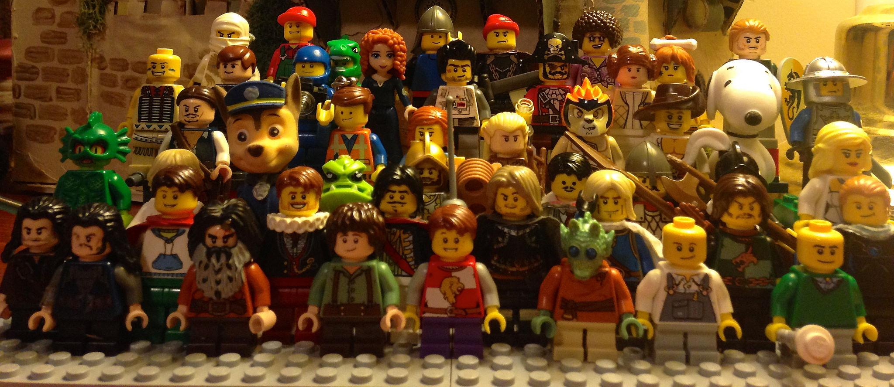
Flickr user Ravindar LEGO
At its fundamental level, learning is social.

Slide 47

Learning is both a cognitive and affective process.
Notes:
Flickr Kevin Rheese: “Eastward”

Slide 48
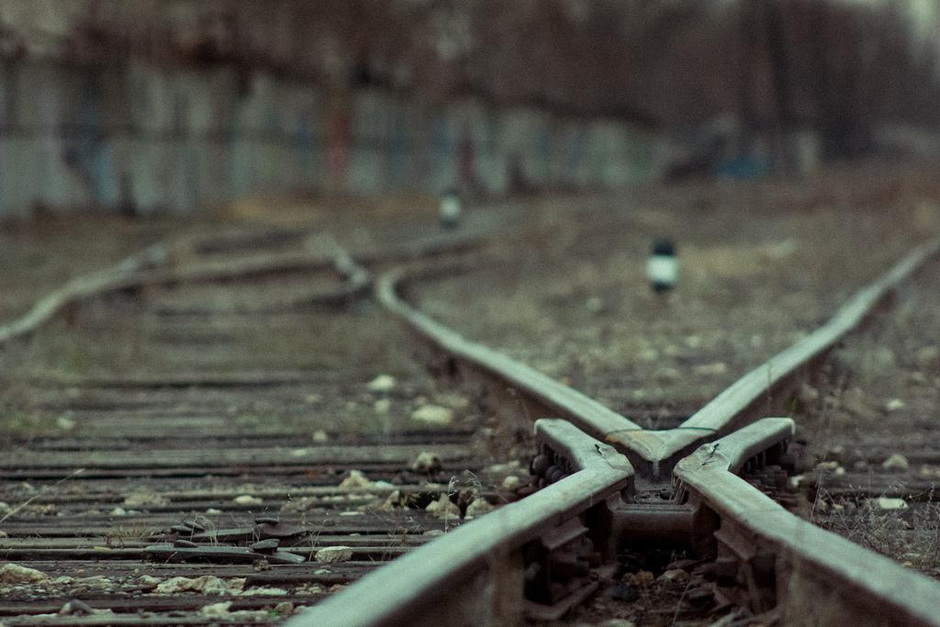
“The first revolution is when you change your mind.”
Gil Scott-Heron

Slide 49
imagine different.
imagine better.

Slide 50

“When it becomes a program, hopelessness paralyzes us, immobilizes us. We succumb to fatalism, and then it becomes impossible to muster the strength we absolutely need for a fierce struggle that will re-create the world.
I am hopeful not out of mere stubbornness, but out of an existential, concrete imperative.”
Paulo Freire, Pedagogy of Hope

Slide 51
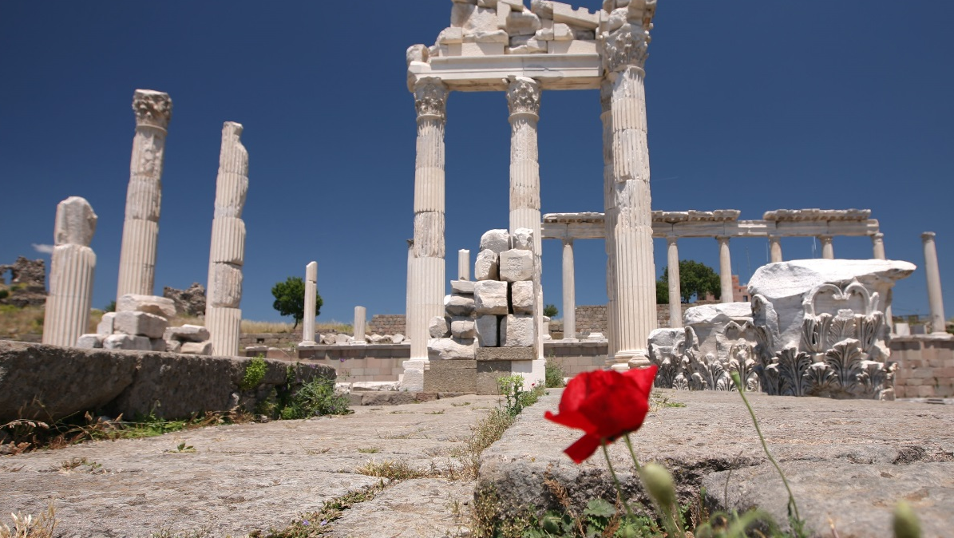
Commit radical acts of hope.
Flickr user Laszlo Ilyes

Slide 52
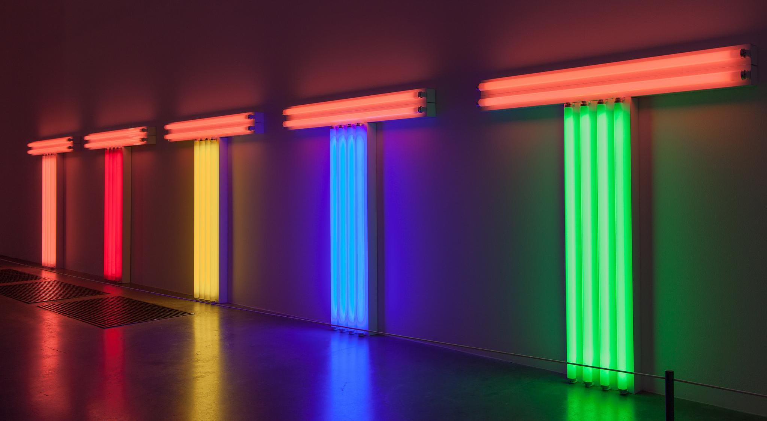
References and Further Resources available at THIS LINK.
Kevin Gannon
kgannon@grandview.edu
Twitter: @thetattooedprof
http://thetattooedprof.com

