Slide 1
Supporting Student Wellness in FYSS 1500
Amy E. Williams & Kristin Bruns
aewilliams02@ysu.edu/kbruns@ysu.edu

Slide 2
Agenda
What is wellness?
Neurobiology of survival and stress
The Indivisible Self model of wellness
Using the Indivisible Self to identify strengths and needs
Personal goals for wellness and stress management
Integrating the Indivisible Self into the FYSS Curriculum
Processing the Process
Questions

Slide 3
What is Wellness?
Using the paper provided, brainstorm all of the things that come to mind when you think of wellness.
Share your ideas with the person next to you.
Let’s explore as a group!

Slide 4
Stress!!!

Slide 5
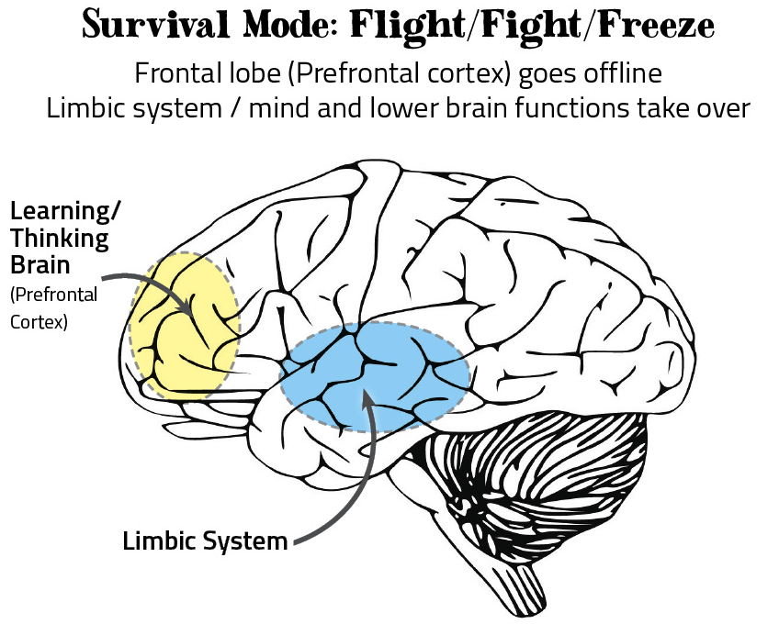
The Neurobiology of Survival
Image Source: http://communityresiliencecookbook.org/your-body-brain/

Slide 6
Survival and Stress
Thinking versus reacting
Biological impact of stress responses
Acute versus chronic stress
Goal is to offset stress and increase stress tolerance/threshold

Slide 7
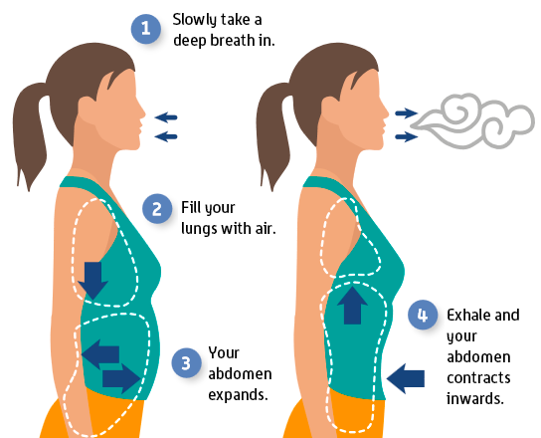
Grounding Activity: Diaphragmatic Breathing
Image Source: https://onepointhealth.com.au/wp-content/uploads/2018/11/How-to-breathe-deeply-1.png

Slide 8
Wellness and Stress Management

Slide 9
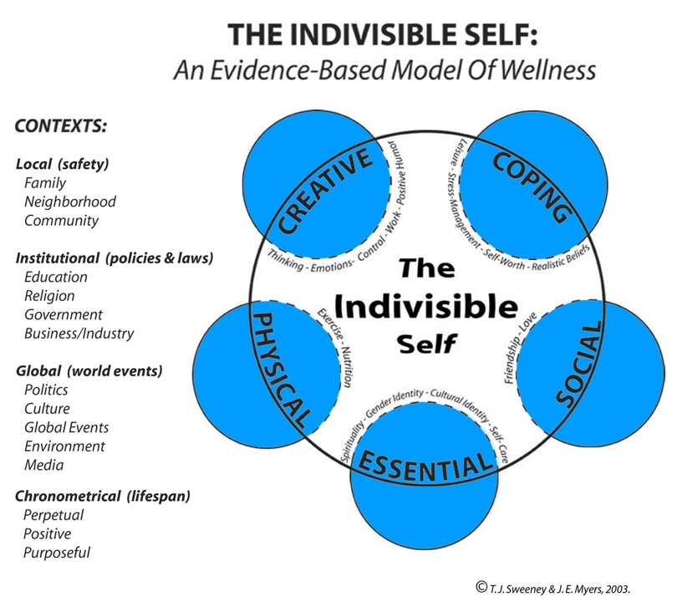
What is wellness?
Source: http://www.csi-net.org/members/group_content_view.asp?group=162835&id=573510

Slide 10
What are your wellness strengths and needs?
Identify the strengths you possess on the outside and your needs on the inside of the large circle for each domain.
Select the top 3 most important needs you would like to address.
Consider ways you might want to address these needs and why doing so is important to you.

Slide 11
Preparing to Plan
Using the handout, identify the areas you most want to focus on
1
Describe what data you plan to collect and how you will use them
2
Identify what else you need to be successful in goal setting
3

Slide 12
Setting SMART Goals
Goals that are Specific, Measurable, Achievable, Rewarding/Realistic, and Time-based are more likely to lead to success (e.g., I will read 10 pages of my Biology textbook each night at 8 pm for the next 7 days to prepare to pass my test on Friday)
Take time now to set a SMART goal, explore potential obstacles and how you will address them, and identify a plan for action
Share your goal and plan with another person to promote support and accountability

Slide 13
Learning Goals for FYSS and Connection to Wellness
Work with a partner to identify which domain(s) of the Indivisible Self are addressed in the following learning goals (listed below). Then, discuss how you might connect your learning activities in these areas to information/ideas you’ve learned today.
Use information provided on course syllabi to assess their workload
Assess their study habits and workload to maintain a realistic and effective study plan
Use information on course syllabi to monitor their overall grade performance in each class
Apply principles of mindset theory in order to overcome setbacks and challenges
Know standards for good academic standing and financial aid eligibility, and how to calculate a grade point average
Understand and follow their curriculum sheet, four year play, and academic progress requirements for their major
Creative | Coping | Social | Essential | Physical

Slide 14
Processing the Process

Slide 15
In Summary…
Stress impacts the brain and body and may affect both learning and engagement (for us and students alike)
Wellness is multifaceted and individualized
Identifying and working toward wellness goals over time supports stress management and overall wellbeing
Using a wellness framework to support student learning goals and objectives provides cohesion and supports overall coping
Activities that facilitate connection, meaning-making, and personalization support learning and overall wellness

Slide 16
Questions?
aewilliams02@ysu.edu

