Slide 1
Friendships, and Dating, and Roommates, Oh My!
Needs and Boundaries

Slide 2
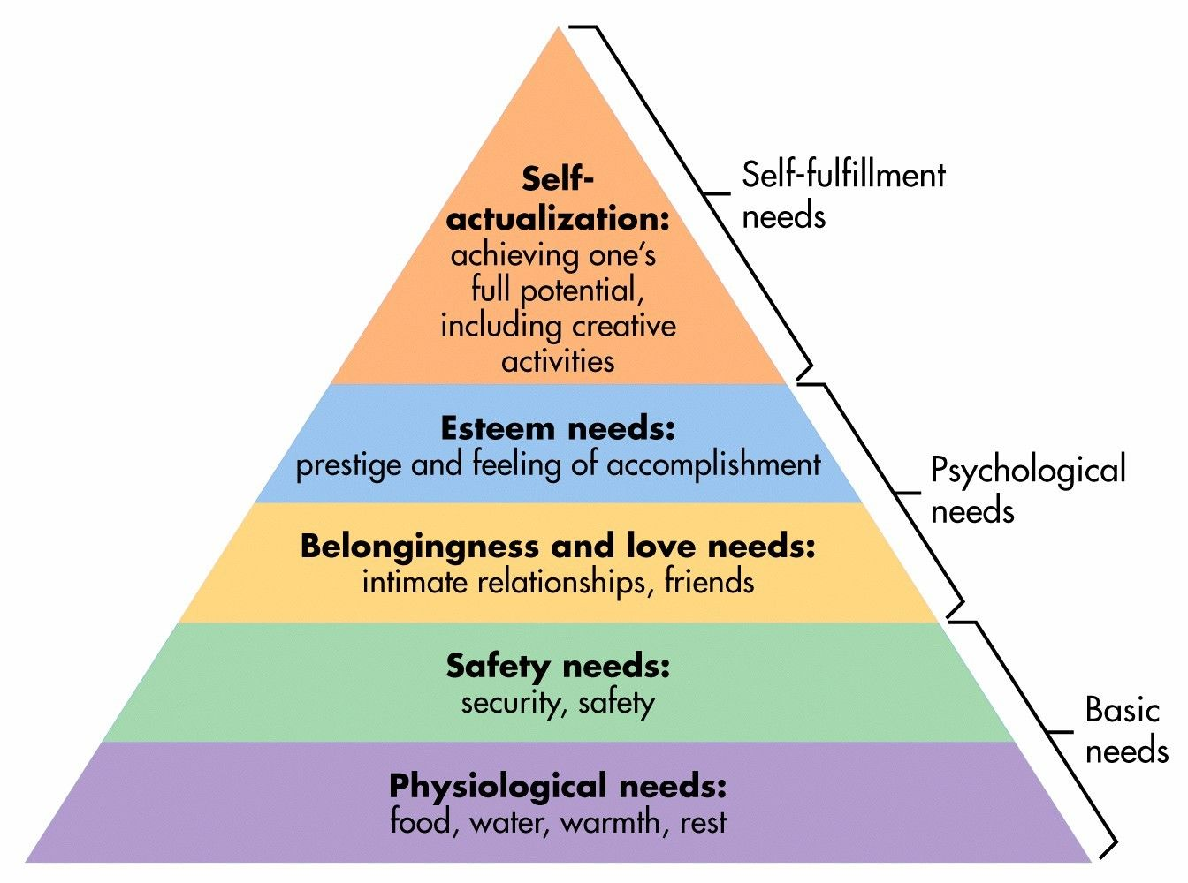
What is a need?

Slide 3
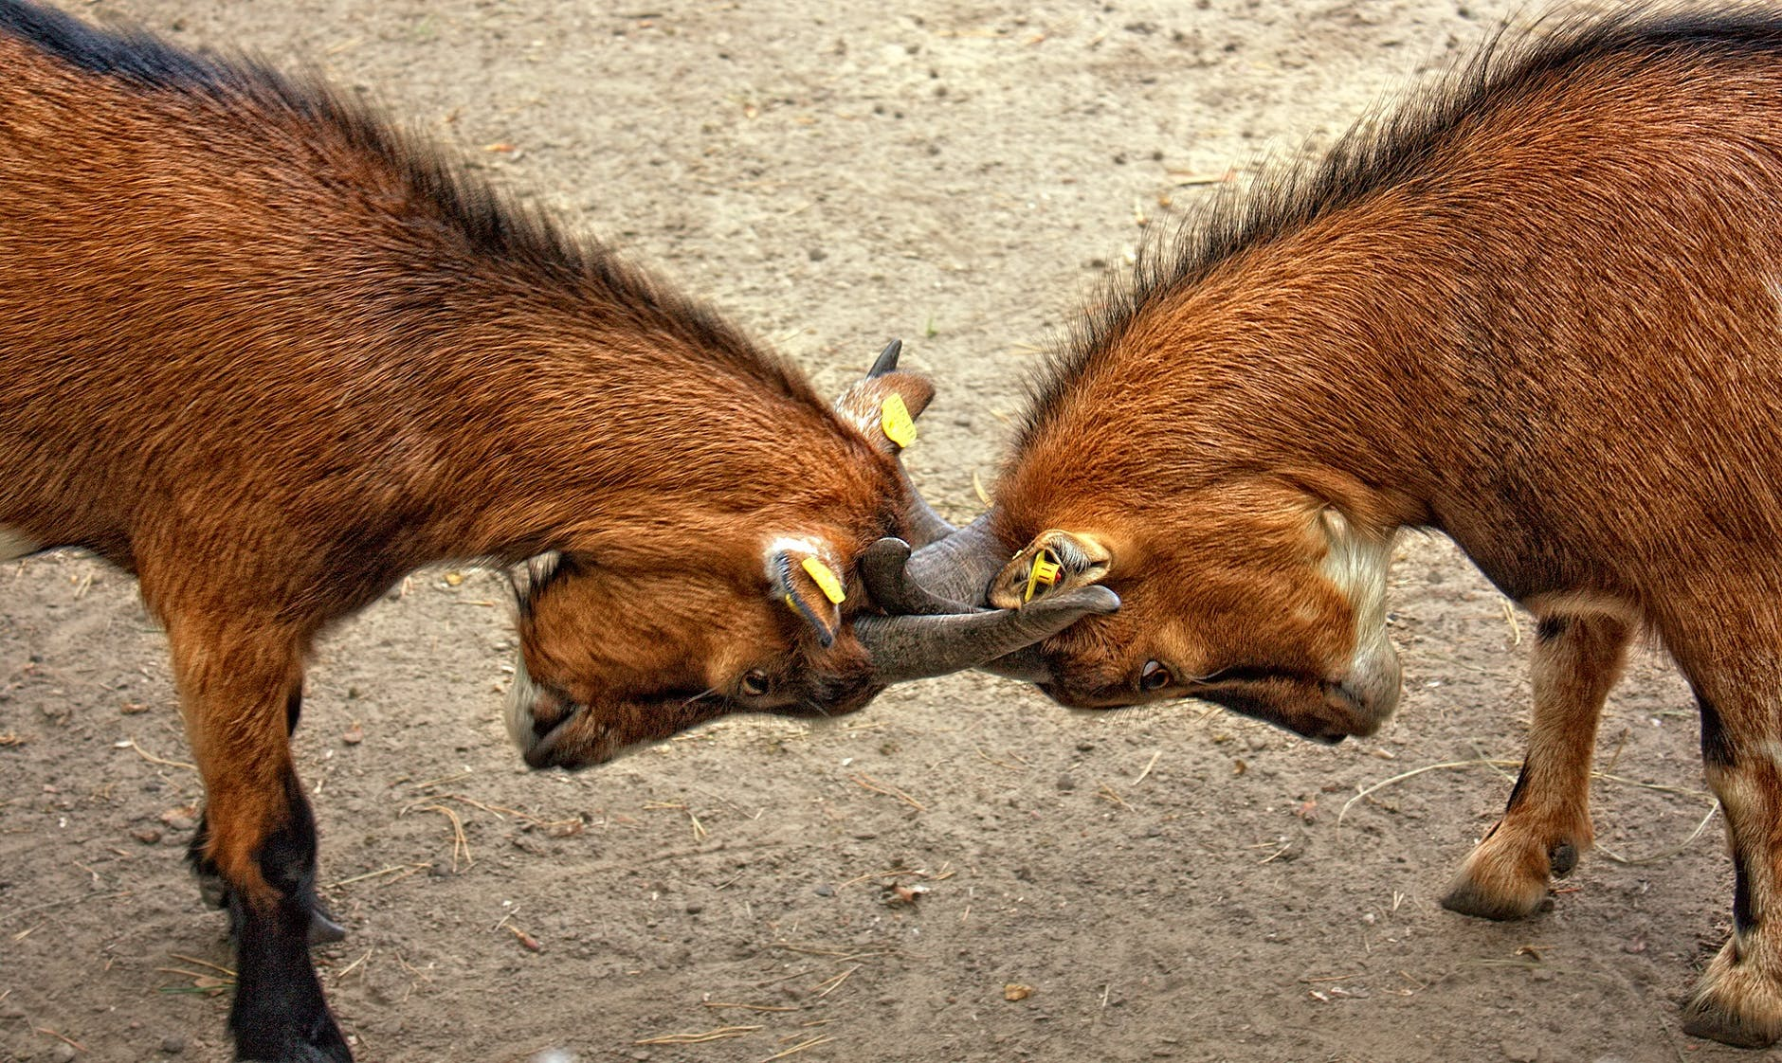
Why are needs important?
We all have needs
If our needs are neglected, negative emotions and behaviors may arise

Slide 4
How are needs communicated?
Set and setting
Focus on the facts
Use “I” statements
(Practice)

Slide 5
Discussion Question
What are some needs that we do not often think about but can hurt a lot when when are without them?

Slide 6
What is a boundary?
A place where you end and others begin
A place where you gain or lose autonomy
The “outline” of you
Your identity

Slide 7
Who are boundaries for?
Everyone!
Friends
Family
Partners
Colleagues

Slide 8
Why are boundaries important?
Lack of boundaries may lead to…
Hurt Feelings
Miscommunication
Lost Relationships
General Confusion

Slide 9
Where can you use boundaries?
Home
School
Work
Within Friendships
Within Relationships
In Public

Slide 10
How do you use boundaries?
https://www.youtube.com/watch?v=tUOvY6Lfm1A

Slide 11
Reference
https://positivepsychology.com/great-self-care-setting-healthy-boundaries/
https://www.ncu.edu/blog/10-tips-effective-communication-relationships#gref

